Slide 1
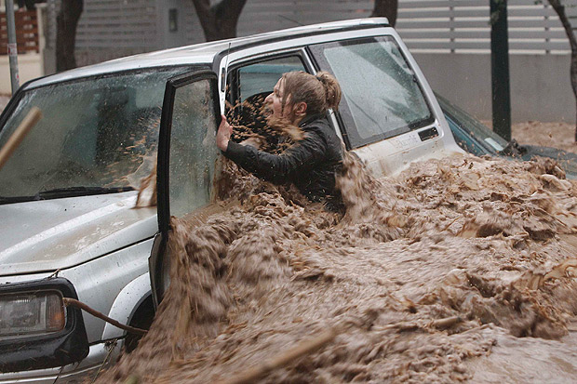
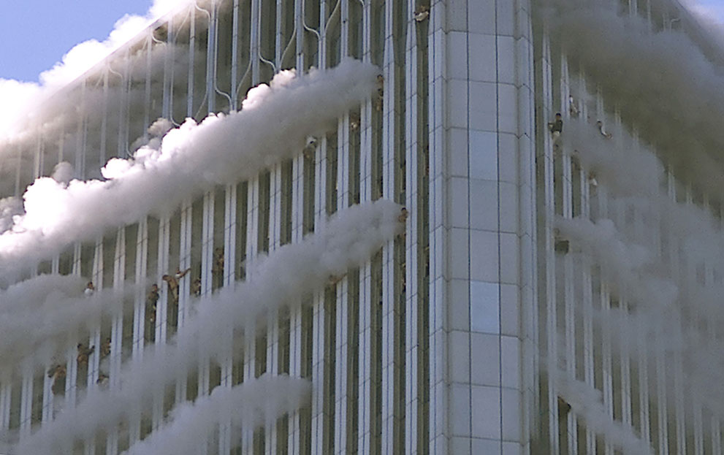
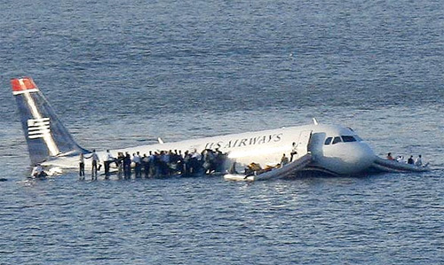
BEING LOST IN SIN IS NOT LIKE THIS!

Slide 2
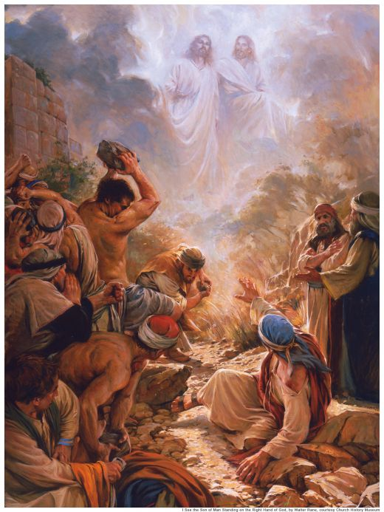
“Indeed, I myself thought I must do many things contrary to the name of Jesus … This is also did in Jerusalem, and many of the saints I shut up in prison … and when they were put to death, I cast my vote against them.

Slide 3
And I punished them often in every synagogue and compelled them to blaspheme; and being exceedingly enraged against them, I persecuted them even to foreign cities.”
Acts 26:9-11

Slide 4
The Joy of
Forgiveness
We can be forgiven regardless of:
What we have done.
Who we have hurt.

Slide 5
Joy in the
Ease of Forgiveness
The blessing of forgiveness is far out of proportion with the ease with which it can be obtained.

Slide 6
Joy in the
Ease of Forgiveness
The ease of obtaining forgiveness belies the terrible price God had to pay to give us this opportunity.

Slide 7
Joy in the
Ease of Forgiveness
When we learn to accept this great love, when we truly believe the promise of forgiveness, then joy replaces the gloom of guilt.

