Slide 1
JOY
What Is It?

Slide 2
True joy is not based on emotion.

Slide 3
True joy is not based on outward circumstance.

Slide 4
How do you expect me to be joyful when … ?

Slide 5
JOY
Are you as joyful today as when you first became a Christian?

Slide 6
JOY
As we mature spiritually, we realize how bad sin really is.

Slide 7
JOY
We accept initial forgiveness by grace, then tend to rely on merit.

Slide 8
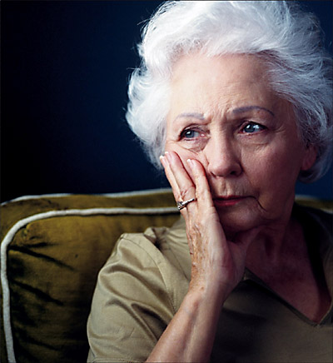
If you live to be 80 or 90 years old, will your hope be on something other than forgiveness?

