Slide 2
2Pet.1:13; 3:1 - reminder…
Who is greatest…
Mt.16:13-19 - in the district of Caesarea Philippi
Mk.9:33 - come to Capernaum in Galilee
Mk.9:34 - discussing who is greatest
Mt.18:1-6; Mk.9:33-50; Lk.9:46-50 - humble self as child
1
2
Mt.20:20-28; Mk.10:35-52
Lk.22:1-4; Jn.13:6-20
3

Slide 3
2Pet.1:13; 3:1 - reminder…
Prayer…
Lk.11:1-4
Lk.10:38-42; Jn.11:1 - at Martha’s in Bethany
Jn.10:40 - leaves Judea & into Perea (“beyond the Jordan”) then returns to Bethany when Lazarus is sick (Jn.11:6-7)
Mt.6:1-15

Slide 4
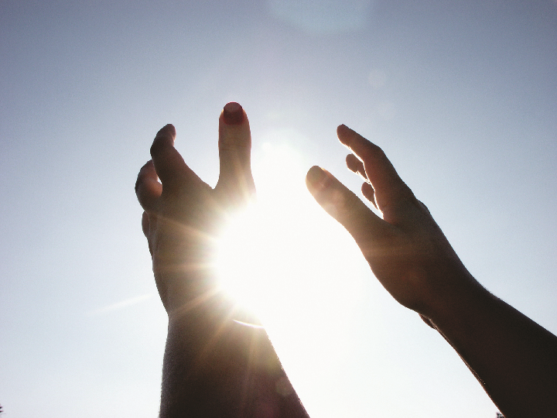
Lord Teach Us To Pray
Take Time
1Ths.5:17
Js.4:2
Js.1:5
Mt.7:7-11
Jesus Took Time
Mk.1:29-39
Lk.5:15-16
Lk.6:12

Slide 5
Lord Teach Us To Pray
Reverential Attitude
Lk.11:2 - “hallowed”
Ps.117:1-2 - “laud”
Lk.18:13-14
Acts 4:23-31
Dan.4:1-3, 37

Slide 6
Lord Teach Us To Pray
Faith
Js.1:5-8
Js.1:17
Eph.3:20
Mt.21:22 (Pray “believing”)
1Jn.5:14
Js.4:3

Slide 7
Lord Teach Us To Pray
Proper Motive
Js.4:3
1Kgs.3:5-14
Mt.26:39
1Jn.5:14

Slide 8
Lord Teach Us To Pray
Sincerity Of Heart
Php.4:6-7
Js.5:16 - “energeo”
Ps.118:1
Mt.6:5-8
Mt.15:8

Slide 9
Lord Teach Us To Pray
Penitent Heart
1Jn.1:9
Ps.51
Ps.66:18-20
Isa.1:10-17
Js.5:16 (“of a righteous man”)
1Tim.2:8
Prov.28:9, 13

Slide 10
Lord Teach Us To Pray
Persistence
Lk.11:5-8
Ex.32-34
Ex.32:30-32 & Deut.9:18-19, 25-29
Ex.24:16-18 - Mt. Sinai 40 days
Ex.31:18 - Tablets written
Ex.32:19 - Tablets shattered
Ex.34:1 - Tablets replaced
Ex.32:11-14 - Moses pleads
Ex.32:30-32 - Pleads again
Ps.147:11

Slide 11
Lord Teach Us To Pray
God Is Faithful To Us
Ps.119:90 - “Your faithfulness continues throughout all generations…”
1Pet.4:19 - “Therefore those who suffer according to the will of God, shall entrust their souls to a faithful Creator in doing what is right”

