Slide 2
They Remembered His Words
Lk.24:1-9
vs.6-8 - He is not here, but He has risen. Remember how He spoke to you while He was still in Galilee, saying that the Son of Man must be delivered into the hands of sinful men, and be crucified, and the third day rise again." And they remembered His words
Jn.2:18-22
vs.22 - So when He was raised from the dead, His disciples remembered that He said this; and they believed the Scripture and the word which Jesus had spoken

Slide 3
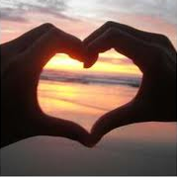
They Remembered His Words
Jn.16:13-15
Mt.28:18-20
Heb.9:11-17
1Cor.14:37
Marriage
Mt.9:3-12

Slide 4
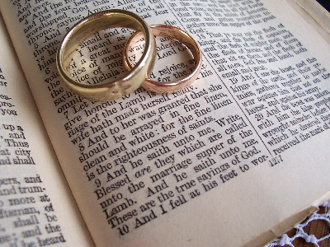
They Remembered His Words
We MUST Respect His Word
Ps.1:1-2
vs.
2Tim.4:3-4 (2Pet.3:16)
Mt.19:3-12
Ps.107:8-15
Do you believe God’s guidance results in our happiness?
Will you make a decision to let God guide you in your marriage no matter what?
Jer.10:23
Js.1:21-25

Slide 5
They Remembered His Words
We MUST Respect His Word
Ps.19:7-11
(the testimony of the Lord is sure making wise the simple)
Gen.25:8
Prov.19:20-21
Mt.19:3-12
Ps.73:24-28
vs.24 - “You will guide me with Your counsel and afterward receive me to glory”
vs.28 - “But it is good for me to draw near to God, I have put my trust in the Lord”

Slide 6
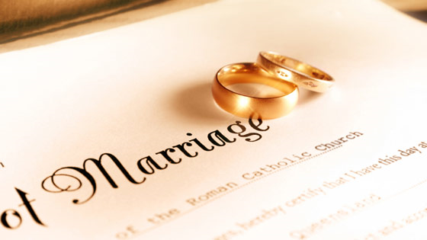
They Remembered His Words
GOD JOINS…
Mt.19:3-12
Gen.2:21-25
“leave & cleave”
Mal.2:14
God is a witness of the covenant made between husband and wife

Slide 7
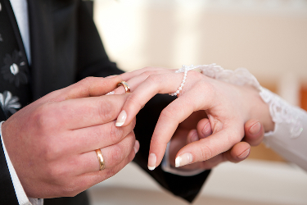
They Remembered His Words
GOD JOINS…
I take you as my lawful wedded wife / husband
I commit myself to your happiness
I will love, honor and respect you
I will cherish, serve and trust you
I will do this in sickness or in health
I will do this whether rich or poor
I will forsake all others and keep myself only unto you
I will do these things for as long as we both shall live
With this ring, I thee wed, pledging my life and my love
Mt.19:3-12
Num.30:1-2, Deut.23:21 Eccl.5:4-5 Mt.5:37

Slide 8
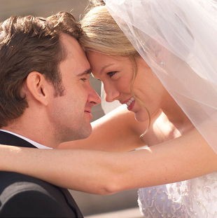
They Remembered His Words
GOD JOINS Male with Female
Mt.19:3-12
Eph.5:11, 13
Homosexuality is a Sin!
…. God declares it as such
1Tim.1:8-11
Rom.1:26-29a
1Cor.6:9-11

Slide 9
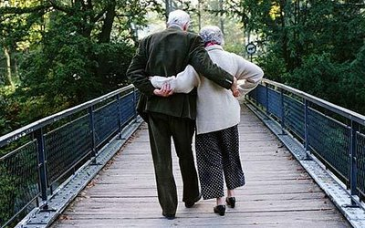
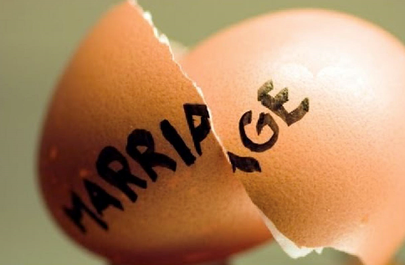
They Remembered His Words
GOD JOINS Male with Female
Mt.19:3-12
How did you stay together for so long?
…. we came from a time that if something was broken, you fixed it rather than throwing it away
Ps.106:13
Gal.1:6-9
Mt.7:24-27
Ps.127:1

Slide 10
They Remembered His Words
We MUST Respect His Word
Ps.119…
vs.1-3
vs.11
vs.15-16 vs.24
vs.30
vs.31
vs.33
vs.34
vs.35
vs.55
vs.59-60
vs.69
vs.92-93
vs.97
vs.101
vs.105
vs.112
vs.128
vs.165-168
Mt.19:3-12

