Slide 2
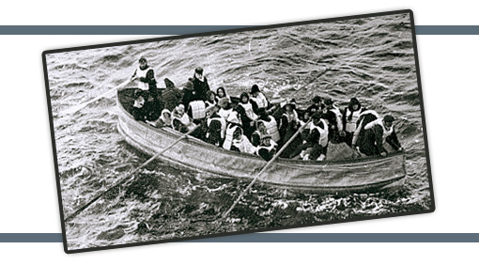
Heb.10:19-25
Get In
Stay In
Help Others

Slide 3
God’s Lifeboat
Heb.10:19-25
Heb.7:25 - Christ our High Priest, saves, makes intercession
Heb.9:6-7, 11, 24-25 - entrance into Holy Place, Joint heirs
Therefore… Heb.10:19

Slide 4
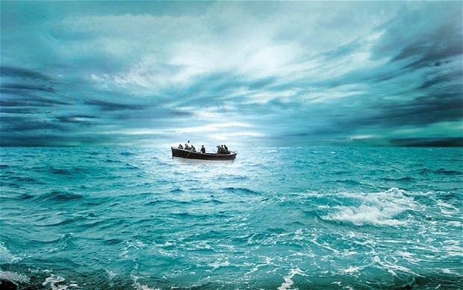
God’s Lifeboat
Isa.59:1-2
Js.4:7-8
Let Us “Get In”
Heb.10:22

Slide 5
God’s Lifeboat
Let Us “Get In”
Hear - Jn.6:44-45
Believe - Rom.10:17; Jn.8:24
Repent - Lk.13:3; Acts 17:30
Confess - Rom.10:9-10; Acts 8:37
Baptized - Acts 2:38
reach the blood (Acts 22:16; Rev.7:14)
why… Mk.16:16

Slide 6
God’s Lifeboat
Acts 2:37…
Obey God’s conditions!
Sincere heart
Full assurance of faith (Heb.11:6)
Hearts sprinkled, bodies washed
Let Us “Get In”
Heb.10:22
Lev.16 … Heb.9:13-14; 12:24
Acts 22:16 - wash away your sins
1Pet.3:21 - baptism saves
Gal.3:26-27

Slide 7
God’s Lifeboat
1Cor.15:1-2 “if”
Gal.1:6-9; 5:1-7
2Pet.2:1-22
Rom.6:4-17
Acts 11:20-26
Acts 14:21-23
Let Us “Stay In”
Heb.10:23
“He Who promised is faithful”
Col.3:1-2
1Cor.15:58
Acts 8:22; 1Jn.1:9
Heb.12:1

Slide 8
God’s Lifeboat
“Not forsaking the assembling of ourselves together”
1Cor.12:24-26
1Ths.5:11
Let Us “Help Others”
Heb.10:24-25

Slide 9
God’s Lifeboat
Heb.4:9-16
Get In
Stay In
Help Others
Let Us “Help Others”
Heb.10:19-25

