Slide 1
Truth
“The body of real things, events, and facts. The body of true statements and propositions. The property of being in accord with fact or reality. In accordance with fact.”

Slide 2
Religion
“A personal set or institutionalized system of religious attitudes, beliefs, and practices. A cause, principle, or set of beliefs held to with ardor and faith.”

Slide 3
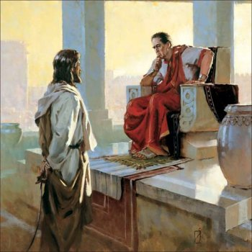
Truth
John 18:36-38
Is Important
Jn. 8:31-32; Jn. 16:13
We need to know what it is
and from where it comes
Matt. 15:7-9; Gal. 1:6-9; 2 Tim. 4:1-4;
1 Tim. 3:15; Jn. 17:17; 2 Tim 3:16-17;
Acts 17:11
We should demonstrate
regard/respect for it
1 Thess. 2:13; Luke 6:46-49; Lev. 10:3;
Ps. 119:11; 1 Tim. 4:13; Phil. 3:8-11
We should let nothing keep
us from it
Rev. 22:18-19; 1 Cor. 1:21-25; Eph. 4:4-6

