Slide 1
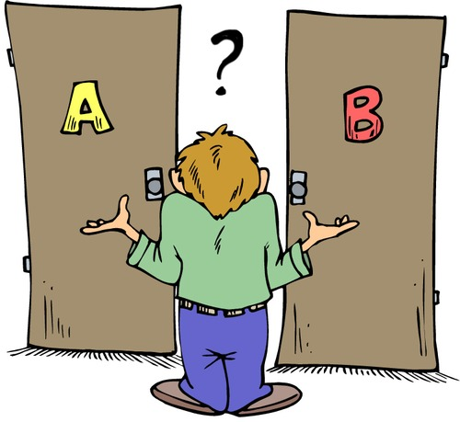

Slide 5
Gen.4:1-12
Choices Cain made…

Slide 6
What Am I Going To Do In Life?
Gen.4:1-12 First Choice
Mt.6:33
“But seek first His Kingdom and His righteousness…”

Slide 7
What Am I Going To Do In Life?
Lk.10:38-42
“Now as they were traveling along, He entered a certain village; and a woman named Martha welcomed Him into her home. And she had a sister called Mary, who moreover was listening to the Lord's word, seated at His feet. But Martha was distracted with all her preparations; and she came up to Him, and said, "Lord, do You not care that my sister has left me to do all the serving alone? Then tell her to help me." But the Lord answered and said to her, "Martha, Martha, you are worried and bothered about so many things; but only a few things are necessary, really only one, for Mary has chosen the good part, which shall not be taken away from her. "

Slide 8
What Am I Going To Do In Life?
1Tim.6:9-12
“But those who want to get rich fall into temptation and a snare and many foolish and harmful desires which plunge men into ruin and destruction. For the love of money is a root of all sorts of evil, and some by longing for it have wandered away from the faith, and pierced themselves with many a pang. But flee from these things, you man of God; and pursue righteousness, godliness, faith, love, perseverance and gentleness. Fight the good fight of faith; take hold of the eternal life to which you were called, and you made the good confession in the presence of many witnesses.”

Slide 9
What Am I Going To Do In Life?
Mt.10:37-39
"He who loves father or mother more than Me is not worthy of Me; and he who loves son or daughter more than Me is not worthy of Me. "And he who does not take his cross and follow after Me is not worthy of Me. "He who has found his life shall lose it, and he who has lost his life for My sake shall find it.

Slide 10
Gen.4:1-12
What Am I Going To Offer God?
Gen.4:1-12 Second Choice
2Cor.5:7 / Rom.10:17
Heb.11:4
Jer.10:23
Deut.12:32; Jn.6:45; Rom.10:8-18

Slide 11
What Am I Going To Offer God?
Mt.23:29-36 - the blood of righteous Abel
1Jn.3:11-12 - Cain was of the evil one
Mt.7:24-27

Slide 12
What Am I Going To Offer God?
My Best? Exactly what God has revealed? Set my thoughts aside & truly listen to God? Worship from my heart? Put God first in my daily choices?
or…
Give God less than He deserves? Go by own wisdom? Minimum effort? Just enough to get by? Make excuses?

Slide 13
Where Am I Going To Go From Here?
Gen.4:1-12 Third Choice
Learn from mistake, correct it, move on or…
Make things worse for self & others, let my emotions “rule”?
Make determination to not return to that sin again or…
Say to myself, “when Satan tempts me again, outcome isn’t going to any different”?

Slide 14
Where Am I Going To Go From Here?
1Jn.2:28 - 3:12
1Jn.2:28-29 - practice righteousness (born of Him)
1Jn.3:1-2 - God’s love takes us to be His children (the best is yet to come; cf. Php.3:20-21)
1Jn.3:3 - if have hope, we purify ourselves
1Jn.3:4-10 - we don’t practice sin, we don’t willfully continue in sin (Note 1Jn.1:5 - 2:6)

Slide 15
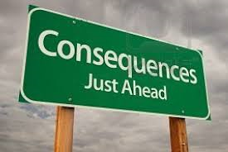
2Chr.12:14
Ps.19:10-14

