Slide 1
Ephesus

Slide 2
Ephesus – Government Center

Slide 3
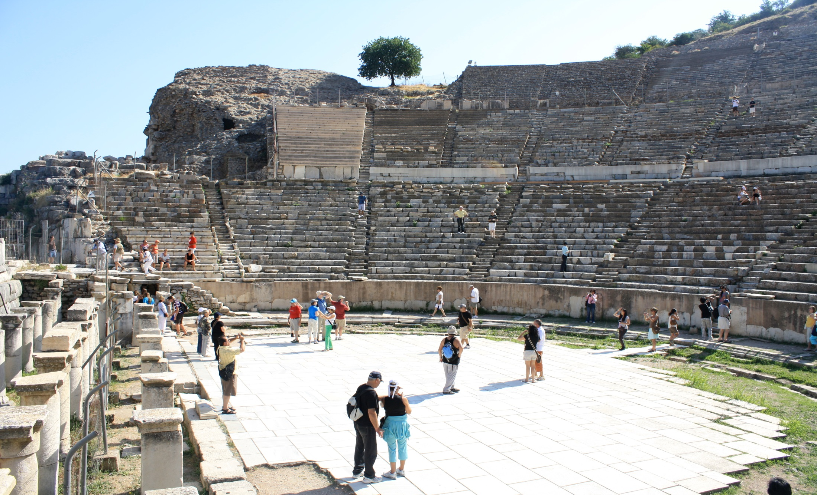
Ephesus – Roman Stadium

Slide 4
Ephesus – Roman Stadium

Slide 5
Ephesus - Library

Slide 6
Mezari

Slide 7
John’s Tomb in Mezari

Slide 8
Oldest Known Baptistery

Slide 9
Outskirts of Ephesus

Slide 10
Paul’s Prison

Slide 11
Hate
What is hate?
Are Christians haters?
Is there anyone we should hate?
homosexuals?
those who don’t believe like us?
Is calling Christians ‘haters’ something new?
Who first called Christians ‘haters’?
What does the Bible say?

Slide 12
Hate
Definition:
verb (used with object) To dislike intensely or passionately; feel extreme aversion for or extreme hostility toward; detest
to hate the enemy; to hate bigotry; to hate school
verb (used without object) To feel intense dislike, or extreme aversion or hostility

Slide 13
Vines’ Biblical Definitions of Hate Greek word: ‘miseo’
of malicious and unjustifiable feelings towards others, whether towards the innocent or by mutual animosity
1 John 2: 9-11, 1 John 3:15
of a right feeling of aversion from what is evil
Psalm 119:104, Revelation 2:6
of relative preference for one thing over another, by way of expressing either aversion from, or disregard for, the claims of one person or thing relatively to those of another
Luke 14:26-27, Matt. 10:37, John 12:25, Ephesians 5:29

Slide 14
Word Play – A legitimate, universal, and historical literary device
Love, Hate
Light, Darkness
Good, Evil
White, Black (Black, White)
White hat, Black Hat
Tolerant, Intolerant

Slide 15
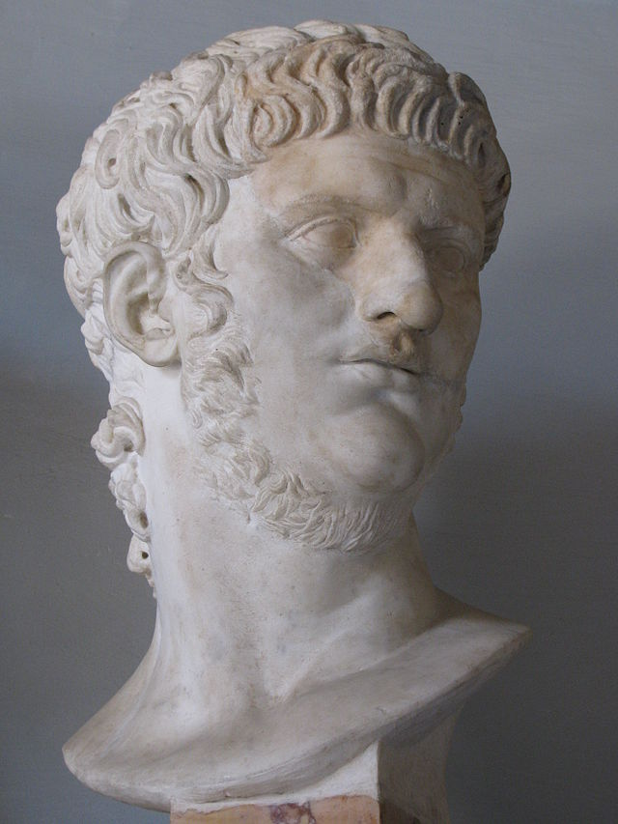
Nero
Roman Emperor (54-68 AD)

Slide 16
Tacitus
Roman Senator and Historian (54-117+AD)
Annals (116 AD)
“Consequently, to get rid of the report, Nero fastened the guilt and inflicted the most exquisite tortures on a class hated for their abominations, called Christians by the populace. Christus, from whom the name had its origin, suffered the extreme penalty during the reign of Tiberius at the hands of one of our procurators, Pontius Pilatus, and a most mischievous superstition, thus checked for the moment, again broke out not only in Judæa, the first source of the evil, but even in Rome, where all things hideous and shameful from every part of the world find their centre and become popular. Accordingly, an arrest was first made of all who pleaded guilty; then, upon their information, an immense multitude was convicted, not so much of the crime of firing the city, as of hatred against mankind.”

Slide 17
Three Things We Learn from Tacitus’ Account
There were a sizable number of Christians in Rome during Nero’s time
It was possible to distinguish between Christians and Jews
At the time pagans made a connection between Christianity in Rome and its origin in Roman Judea
(Tacitus was not fond of Christians)

Slide 18
Nero’s Persecution
He wasn’t the first and he wasn’t the last
“Mockery of every sort was added to their [Christians'] death. Covered with the skins of beasts, they were torn by dogs and perished, or were nailed to crosses, or were doomed to the flames and burnt, to serve as a nightly illumination when daylight had expired. Nero offered his gardens for the spectacle, as exhibiting a show in the circus.”

Slide 19
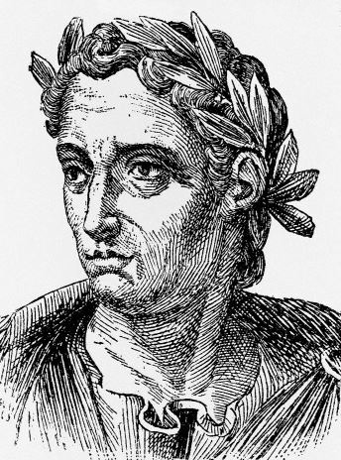
Pliny the Younger
Lawyer, Author, Magistrate of Rome (61 – c. 113 AD)

Slide 20
What Pliny Called Christians
Letter to emperor Trajan
Expressed his own frustration over the fact that Christians would not “invoke the gods”
Lamented their “stubbornness and unyielding obstinacy”
In other words, he was angry over their intolerance

Slide 21
Why Was Pliny Unhappy with Christians?
The influence of the Christians had caused the pagan temples to be “deserted”
“very few purchasers could be found” for the sacrificial animals
In other words, they were losing money
The Christians were intolerant
They were HATERS

Slide 22
A New Word for Hate: ‘Intolerance’
Definition:
lack of toleration; unwillingness or refusal to tolerate or respect contrary opinions or beliefs, persons of different races or backgrounds, etc.

Slide 23
Tolerance
Definition:
a fair, objective, and permissive attitude toward those whose opinions, practices, race, religion, nationality, etc., differ from one's own; freedom from bigotry.
a fair, objective, and permissive attitude toward opinions and practices that differ from one's own.
interest in and concern for ideas, opinions, practices, etc., foreign to one's own; a liberal, undogmatic viewpoint.

Slide 24
A New Word for Hate: ‘Intolerance’
Definition:
lack of toleration; unwillingness or refusal to tolerate or respect contrary opinions or beliefs, persons of different races or backgrounds, etc.
Intolerance is just another word for Hate

Slide 25
Is Hate Ever Acceptable?
God Hates
Jeremiah 44:2-6, Psalm 5:4-5, Psalm 11:5
David Hates
Psalm 26:5, Psalm 101:3, Psalm 119:104, Proverbs 6:16-19
Jesus Hates
Rev. 2:6 (you hate the works of the
Nicolaitans, which I also hate.)

Slide 26
What Should Christians Hate?
Evil
PS. 97:10, Proverbs 8:13
This world
John 12:25
People?
No biblical reference for hating people
The bible only condones hating deeds

Slide 27
Doesn’t God Hate Sinners?
1 John 4:8 “God is Love”
Metonymy
‘A figure by which one name or noun is used instead of another, to which it stands in a certain relation” Luke 16:29 “They have Moses…”
Metaphors
‘An image which suggests similarities between two different ideas, without implying that they are identical.’ Psalms 62:2 “he is my rock…”

Slide 28
The Old Saying:
Romans 12:9
2 Thessalonians 3:14-15
Matthew 5:43-48
2 Corinthians 5:21
John 3:16-21
Love the sinner…….hate the sin!

Slide 29
Can you learn to hate…your sin?

