Slide 1
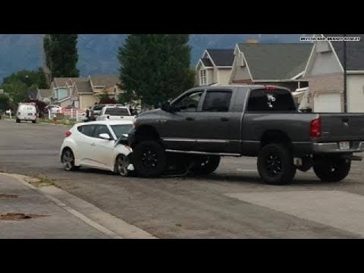
Circumstances not always what we’d like them to be…

Slide 2
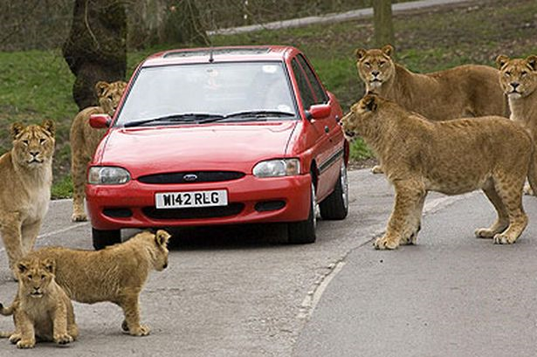
Surrounded by life’s difficulties…

Slide 3
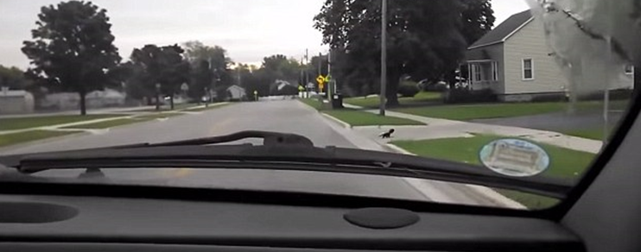
Sometimes it’s about what we’ve done to ourselves…

Slide 4
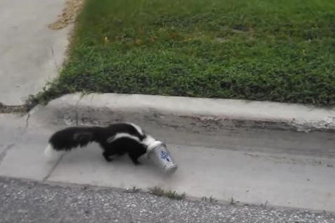
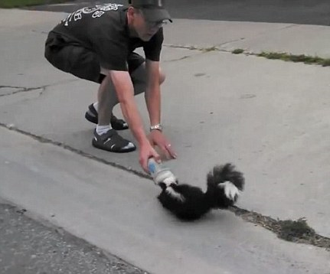
Sometimes it’s about what we’ve done to ourselves…

Slide 5
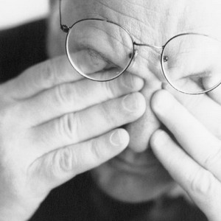
Don’t Worry About It
Health concerns?
Financial concerns?
Work related concerns?
Relationship concerns?
Worry?
Worry / Anxious - Grk. “merimnao”
“The term may refer to “unnecessary worry” or “legitimate concern”

Slide 6
Don’t Worry About It
“The term may refer to “unnecessary worry” or “legitimate concern”
Negative
Mt.6:25-34
Mt.10:19
Lk.10:41
Lk.8:14
Lk.21:34
Positive
Php.4:20
1Cor.12:25
1Cor.7:32-34
2Cor.11:28

Slide 7
Don’t Worry About It
Focus On God
Israel…
Ex.14:9-15
Ex.16:1-7
Ex.17:1-3
Jesus…
Mt.26:36-46
1Pet.2:23
vs.
Prov.3:5-8
Mt.6:25-34

Slide 8
Don’t Worry About It
Focus On God
Ps.11:4…
God knows - Ps.139:1-3; Ex.3:7-8
God cares - 1Pet.5:7
God has power to help - Eph.3:20; Lk.1:37
God “will” help - Ps.55:22; 34:4

Slide 9
Don’t Worry About It
Pray Without Ceasing
1Ths.5:17
Lk.18:1-8
Js.5:16
1Pet.3:12
1Jn.5:14-15
Php.4:6-7

Slide 10
Don’t Worry About It
Keep Things In Perspective
Heb.11:24-26
2Cor.1:8-11
2Tim.4:16-18
2Cor.4:7-18

Slide 11
Don’t Worry About It
Train ourselves to have a positive attitude
Rom.8:31-39
Rom.5:1-5
Heb.13:5-6

Slide 12
Don’t Worry About It
Take one day at a time
Mt.6:34
Rom.8:28

Slide 13
Don’t Worry About It
Mt.11:28-30
Ps.37:5

