Slide 1
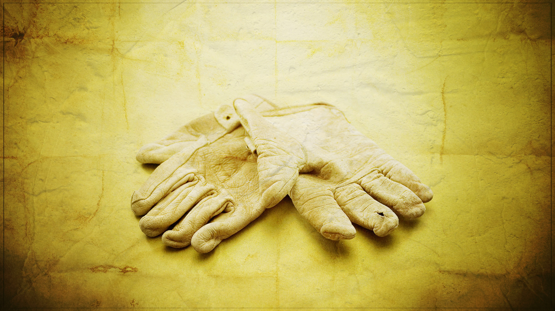

Slide 2
Putting Our Hands to the Work

Slide 3
God Gave Adam Work to Do
Adam was given the work of a garden keeper (Gen. 2:15).
In order for Adam’s life to be successful on earth he had to develop, nurture, and tend the garden.
God didn’t tell him “Don’t worry about it. You don’t have to do a thing.” No, God gave Adam work to do in order for him to be successful.
PUTTING OUR HANDS TO THE WORK

Slide 4
God Gave Noah Work to Do
God gave Noah and his family the work of building an ark (Gen. 6:14-17).
They were to build the ark according to God’s design.
By faith Noah put his hands to the work (Heb. 11:7).
For Noah and his family to successfully obtain salvation from the flood that had to be to the work of ark building (Gen. 6:22).
PUTTING OUR HANDS TO THE WORK

Slide 5
God Gave Israel Work to Do
God gave Israel the work of tabernacle building (Ex. 25:8-9).
Just as God gave Noah a pattern to build the ark, he also gave Israel a pattern to build the tabernacle (v. 40).
Later we find the people getting to the work that God had given them to do (Ex. 35:21).
The work of tabernacle building was a long, tedious, and careful work, which was accomplished by everyone working together for the Lord (Ex. 40:17, 33).
PUTTING OUR HANDS TO THE WORK

Slide 6
God Gave Israel Work to Do
God gave Israel the work of temple building (1 Kgs. 5:5-18).
The temple, as well, was to be built according to the Lord’s pattern (1 Chron. 28:11-12, 29:19).
These were dedicated and because of such they were successful in finishing their work (1 Kgs. 7:51).
Have we, as servants of God today, dedicated ourselves to the work of building up the spiritual temple of God?
PUTTING OUR HANDS TO THE WORK

Slide 7
God Gave Israel Work to Do
God gave Israel the work of wall rebuilding.
The Background (2 Chron. 36:15-19).
Then came a day of return and restoration and a call to work went out (Neh. 2:17-18).
In (Neh. 3) we have recorded the names of those who put their hands to the work.
These worked together with cooperation in the face of great opposition (4:1-5, 7-8).
PUTTING OUR HANDS TO THE WORK

Slide 8
God Gave Israel Work to Do
God gave Israel the work of wall rebuilding.
The people prayed to God for strength (Neh. 4:4) and put their minds to the work (4:6, 17, 21).
The people of God were successful because they had a heart to work hard together and in doing so accomplished their task (Neh. 6:15).
God never told Israel, “I want you as my people, but there’s nothing for you to do.” No, God always had work for Israel to do.
PUTTING OUR HANDS TO THE WORK

Slide 9
Jesus Was to the Work of the Father
Jesus understood this very early on in His earthly life (Luke 2:48-49).
Jesus says that it’s His purpose to do the work His Father has sent Him to do (John 4:34; 9:4).
In the Lord’s prayer at the end of His ministry we find a sense of accomplishment (John 17:4).
The Father gave the Son work to do and He was able to finish the work because He put His hands to it.
PUTTING OUR HANDS TO THE WORK

Slide 10
We Need to Be to the Work
We need to be to the work of seeking the lost (Prov. 11:30).
We spend so much of our time seeking after material things, but that reward is only temporary (Eccl. 12:13-14).
It was Jesus who set the example for us (John 4:31-35).
The foolish man strives for and earthly crown, but the wise man is one who strives for the crown of life and helps others to do so also (Matt. 16:26-27; Luke 19:10).
PUTTING OUR HANDS TO THE WORK

Slide 11
We Need to Be to the Work
We need to be to the work of sharing the gospel message (1 Cor. 15:3-4).
People need to know that sin separates man from God (Is. 59:1-2) and all have sinned (Rom. 3:23), but God has a remedy for sin (Rom. 6:23).
People need to hear the gospel (Mk. 16:15) and need to know that the gospel demands a response (Mk.16:16; Acts 2:36-38).
PUTTING OUR HANDS TO THE WORK

Slide 12
We Need to Be to the Work
We need to be to the work of rescuing the perishing.
There are those that are no longer faithful to the Lord and because of such are perishing in their sin (Luke 13:3).
Some have stopped serving God and allowed their hearts to become corrupted once again with the things of this life (Acts 8:22).
It is the duty of us as their brothers and sisters in Christ to do our best to snatch them from the fire (Jm. 5:19-20).
PUTTING OUR HANDS TO THE WORK

Slide 13
We Need to Be to the Work
We need to be about the work of growing in the grace and knowledge of our Lord.
Spiritual growth is accomplished through feeding upon God’s word (1 Pet. 2:1-2).
When we work at our own individual growth we will facilitate the growth of the local church (Eph. 4:15-16).
When we accomplish spiritual growth individually and collectively we then will be seen by the Lord as steadfast, spotless, and blameless (2 Pet. 3:14-18).
PUTTING OUR HANDS TO THE WORK

Slide 14
Putting Our Hands to the Work

