Slide 2
DEALING
DOUBT
WITH
Matthew 27:54

Slide 3
And when the centurion, who was standing right in front of Him, saw the way He breathed His last, he said, "Truly this man was the Son of God! Mark 15:39
Now when the centurion saw what had happened, he began praising God, saying, "Certainly this man was innocent.“
Luke 23:47

Slide 4
What did the Centurion Hear or See?
The Claims of Pilate
And he said to them the third time, "Why, what evil has this man done? I have found in Him no guilt demanding death; I will therefore punish Him and release Him
Luke 23:22

Slide 5
What did the Centurion Hear or See?
The Claims of Pilate
The Words of the Thief
The Mocking Words of the Crowd
and while being reviled, He did not revile in return; while suffering, He uttered no threats, but kept entrusting Himself to Him who judges righteously;
1 Peter 2:23

Slide 6
What did the Centurion Hear or See?
The Claims of Pilate
The Words of the Thief
The Mocking Words of the Crowd
The Words of Jesus

Slide 7
But Jesus was saying, "Father, forgive them; for they do not know what they are doing." And they cast lots, dividing up His garments among themselves.
Luke 23:34

Slide 8
And He said to him, "Truly I say to you, today you shall be with Me in Paradise."
Luke 23:43

Slide 9
When Jesus therefore saw His mother, and the disciple whom He loved standing nearby, He said to His mother, "Woman, behold, your son!"
John 19:26

Slide 10
And about the ninth hour Jesus cried out with a loud voice, saying, "Eli, Eli, lama sabachthani?" that is, "My God, My God, why have you forsaken Me?"
Matthew 27:46

Slide 11
And Jesus, crying out with a loud voice, said, "Father, into Your hands I commit My spirit." And having said this, He breathed His last.
Luke 23:46

Slide 12
What did the Centurion Hear or See?
The Claims of Pilate
The Words of the Thief
The Mocking Words of the Crowd
The Words of Jesus
The Miracles

Slide 13
Now from the sixth hour darkness fell upon all the land until the ninth hour.
Matthew 27:45

Slide 14
And behold, the veil of the temple was torn in two from top to bottom, and the earth shook; and the rocks were split,
Matthew 27:51

Slide 15
and the tombs were opened; and many bodies of the saints who had fallen asleep were raised;
Matthew 27:52

Slide 16
Now the centurion, and those who were with him keeping guard over Jesus, when they saw the earthquake and the things that were happening, became very frightened and said, "Truly this was the Son of God!"
Matthew 27:54

Slide 17
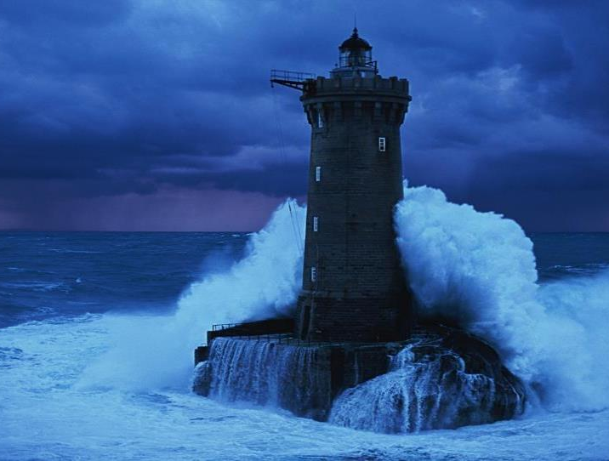

Slide 18
How did the Psalmist handle his doubts?
He withheld his doubts from a younger crowd (v. 15)
He continued to search for the answer (v. 16)
He continued to worship (v. 17)
He admitted his wrong thinking (v. 21-22)

Slide 19
but these have been written that you may believe that Jesus is the Christ, the Son of God; and that believing you may have life in His name.
John 20:31

Slide 20
And according to Paul's custom, he went to them, and for three Sabbaths reasoned with them from the Scriptures, explaining and giving evidence that the Christ had to suffer and rise again from the dead, and saying, "This Jesus whom I am proclaiming to you is the Christ.“
Acts 17:2-3

Slide 21
For since the creation of the world His invisible attributes, His eternal power and divine nature, have been clearly seen, being understood through what has been made, so that they are without excuse.
Romans 1:20

Slide 22
but test everything; hold fast what is good
1 Thessalonians 5:21

Slide 23
The simple believes everything, but the prudent gives thought to his steps.
Proverbs 14:15

Slide 24
The gullible believe anything they’re told; the prudent sift and weigh every word.
Proverbs 14:15 (Paraphrase)

Slide 25
Now these were more noble-minded than those in Thessalonica, for they received the word with great eagerness, examining the Scriptures daily, to see whether these things were so.
Acts 17:11

Slide 26
and said to Him, "Are You the Expected One, or shall we look for someone else?" 4 And Jesus answered and said to them, "Go and report to John what you hear and see:
Matthew 11:3-4

Slide 27
"If I do not do the works of My Father, do not believe Me; but if I do them, though you do not believe Me, believe the works, that you may know and understand that the Father is in Me, and I in the Father."
John 10:37-38

Slide 28
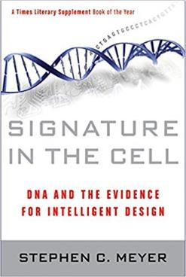
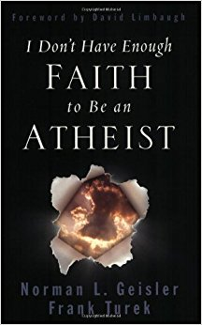
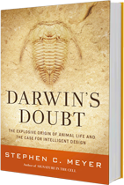
Is there a God?
Is Jesus the Son of God?
Is the Bible God’s words?
Did Jesus rise from the dead?
What about the church?

Slide 29
"The secret things belong to the LORD our God, but the things revealed belong to us and to our sons forever, that we may observe all the words of this law.
Deuteronomy 29:29

Slide 30
"Ask, and it shall be given to you; seek, and you shall find; knock, and it shall be opened to you. 8 "For everyone who asks receives, and he who seeks finds, and to him who knocks it shall be opened.
Matthew 7:7-8

Slide 31
But let him ask in faith without any doubting, for the one who doubts is like the surf of the sea driven and tossed by the wind. ⁷ For let not that man expect that he will receive anything from the Lord, ⁸ being a double-minded man, unstable in all his ways.
James 1:6-8
Be watchful, stand firm in the faith, act like men, be strong
1 Corinthians 16:13

Slide 32
“Doubt sees the obstacles;
Faith sees the way.
Doubt sees the darkest night,
Faith sees the day.
Doubt dreads to take a step,
Faith soars on high.
Doubt questions ‘who believes?’
Faith answers, ‘I’.”

