Slide 1
How can I know
God is good?

Slide 2
2 PRELIMINARY THOUGHTS:
THIS QUESTION IS COMPLEX
THIS QUESTION IS PERSONAL

Slide 3
How can I know
God is good?
WHY IS THERE PAIN IN THE WORLD?
THE WORLD IS BROKEN
BECAUSE OF YOU AND ME
Do not be deceived, God is not mocked; for whatever a man sows, this he will also reap. Galatians 6:7

Slide 4
How can I know
God is good?
WHY IS THERE PAIN IN THE WORLD?
THE WORLD IS BROKEN
BECAUSE OF YOU AND ME
BECAUSE OF SOMEONE ELSE
Oh, taste and see that the LORD is good! Blessed is the man who takes refuge in him! Psalm 34:8
And during supper, the devil having already put into the heart of Judas Iscariot, the son of Simon, to betray Him,
John 13:2
Simon, Simon, behold, Satan has demanded permission to sift you like wheat; Luke 22:31
And I will put enmity between you and the woman, And between your seed and her seed; He shall bruise you on the head, And you shall bruise him on the heel." Genesis 3:15
And these are the ones who are beside the road where the word is sown; and when they hear, immediately Satan comes and takes away the word which has been sown in them.
Mark 4:15
I say to the LORD, "You are my Lord; I have no good apart from you." Psalm 16:2
Then Satan stood up against Israel and moved David to number Israel. 1 Chronicles 21:1
because we wanted to come to you-- I, Paul, again and again-- but Satan hindered us. 1 Thessalonians 2:18
So the LORD said to Satan, "Behold, he is in your power, only spare his life. Job 2:6
But Peter said, "Ananias, why has Satan filled your heart to lie to the Holy Spirit, and to keep back some of the price of the land? Acts 5:3

Slide 5
How can I know
God is good?
HOW DO WE TASTE THE GOODNESS OF GOD?
BY WHAT HE CREATES OUT OF NOTHING
And God saw all that He had made, and behold, it was very good. And there was evening and there was morning, the sixth day. Genesis 1:31
For everything created by God is good, and nothing is to be rejected if it is received with thanksgiving,
1 Timothy 4:4
in order that you may be sons of your Father who is in heaven; for He causes His sun to rise on the evil and the good, and sends rain on the righteous and the unrighteous. Matthew 5:45
He has made everything beautiful in its time…
Ecclesiastes 3:11

Slide 6
How can I know
God is good?
HOW DO WE TASTE THE GOODNESS OF GOD?
BY WHAT HE CREATES OUT OF NOTHING
BY WHAT HE CREATES OUT OF SINNERS
Good and upright is the LORD; therefore he instructs sinners in his ways. Psalm 25:8
Therefore if any man is in Christ, he is a new creature; the old things passed away; behold, new things have come.
2 Corinthians 5:17
For I am confident of this very thing, that He who began a good work in you will perfect it until the day of Christ Jesus.
Philippians 1:6

Slide 7
But by the grace of God I am what I am... 1 Corinthians 15:10
“I’m not what I ought to be. How imperfect and deficient I am!? I’m not what I wish to be. Although I abhor that which is evil and cleave to that which is good. I’m not what I hope to be. But soon I will be out of mortality, and with it all sin and imperfection. But although I am not what I ought to be, nor what I wish to be, nor yet what I hope to be—I can truly say I am not what I once was, a slave to sin and Satan. I can join with the apostle Paul and say, “I am what I am, by the grace of God.”- John Newton

Slide 8
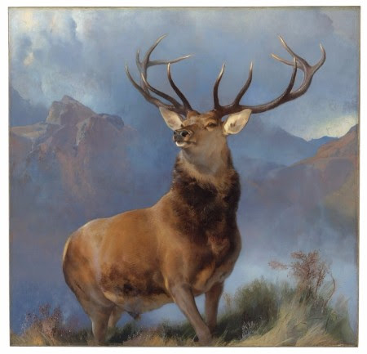
How can I know
God is good?
HOW DO WE TASTE THE GOODNESS OF GOD?
BY WHAT HE CREATES OUT OF NOTHING
BY WHAT HE CREATES OUT OF SINNERS
BY WHAT HE CREATES OUT OF EVIL
But he said to her, "You speak as one of the foolish women speaks. Shall we indeed accept good from God and not accept adversity?" In all this Job did not sin with his lips. Job 2:10
And as for you, you meant evil against me, but God meant it for good in order to bring about this present result, to preserve many people alive. Genesis 50:20

Slide 9
And we know that God causes all things to work together for good to those who love God, to those who are called according to His purpose. For whom He foreknew, He also predestined to become conformed to the image of His Son, that He might be the first-born among many brethren;
Romans 8:28-29
work together for
to those who love God
good
according to His purpose
become conformed to the image of His Son

Slide 10
How can I know
God is good?
REMEMBER WHAT I SEE IS NOT ALL THERE IS
"Look among the nations! Observe! Be astonished! Wonder! Because I am doing something in your days-- You would not believe if you were told.” Habakkuk 1:5

Slide 11
How can I know
God is good?
REMEMBER WHAT I SEE IS NOT ALL THERE IS
REMEMBER WHAT I SEE IS NOT WHAT MATTERS MOST
For momentary, light affliction is producing for us an eternal weight of glory far beyond all comparison, while we look not at the things which are seen, but at the things which are not seen; for the things which are seen are temporal, but the things which are not seen are eternal. 2 Corinthians 4:17-18

Slide 12
How can I know
God is good?
REMEMBER WHAT I SEE IS NOT ALL THERE IS
REMEMBER WHAT I SEE IS NOT WHAT MATTERS MOST
REMEMBER I AM NOT ALONE
After these things I looked, and behold, a great multitude, which no one could count, from every nation and all tribes and peoples and tongues, standing before the throne and before the Lamb, clothed in white robes, and palm branches were in their hands; Revelation 7:9
And I said to him, "My lord, you know." And he said to me, "These are the ones who come out of the great tribulation, and they have washed their robes and made them white in the blood of the Lamb. Revelation 7:14

Slide 13
Have you ever felt alone, afraid, discouraged, anxious?
Have you ever experienced family pain – strained relationships, divorce, prodigals?
Have you ever faced persecution – loss of friends, opportunities, ridiculed for Christ?
Rejoice with those who rejoice, and weep with those who weep. Romans 12:15
Have you ever felt the pain from your past – mistakes, sins bringing regret, sorrow?
Have you ever experienced the loss of jobs, health, a friend, a mate, a child, a sibling, a parent?

Slide 14
How can I know
God is good?
REMEMBER WHAT I SEE IS NOT ALL THERE IS
REMEMBER WHAT I SEE IS NOT WHAT MATTERS MOST
REMEMBER I AM NOT ALONE
REMEMBER THE GOD I KNOW
Why, O LORD, do you stand far away? Why do you hide yourself in times of trouble? Psalm 10:1

Slide 15
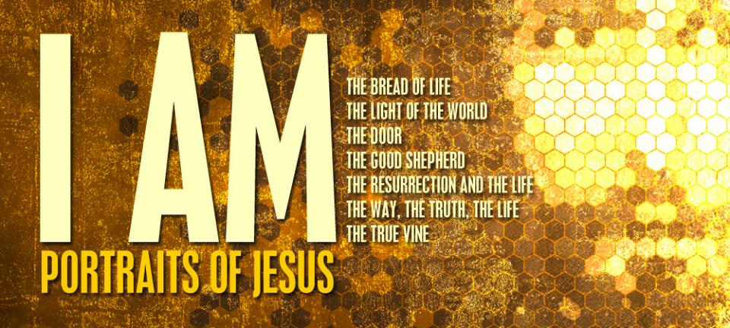
Oh give thanks to the LORD, for he is good, for his steadfast love endures forever! Let the redeemed of the LORD say so, whom he has redeemed from trouble Psalm 107:1-2

