Slide 1
How can I know
The bible is god’s word?

Slide 2
How can I know
The bible is god’s word?
The Claims
All Scripture is inspired by God and profitable for teaching, for reproof, for correction, for training in righteousness; that the man of God may be adequate, equipped for every good work.
2 Timothy 3:16-17
For I would have you know, brethren, that the gospel which was preached by me is not according to man. For I neither received it from man, nor was I taught it, but I received it through a revelation of Jesus Christ
Galatians 1:11-12
For I received from the Lord that which I also delivered to you, that the Lord Jesus in the night in which He was betrayed took bread;
1 Corinthians 11:23
The word of the LORD which came to Hosea the son of Beeri, during the days of Uzziah, Jotham, Ahaz, and Hezekiah, kings of Judah, and during the days of Jeroboam the son of Joash, king of Israel.
Hosea 1:1
Then the LORD stretched out His hand and touched my mouth, and the LORD said to me, "Behold, I have put My words in your mouth.
Jeremiah 1:9
And for this reason we also constantly thank God that when you received from us the word of God's message, you accepted it not as the word of men, but for what it really is, the word of God, which also performs its work in you who believe.
1 Thessalonians 2:13

Slide 3
How can I know
The bible is god’s word?
The Claims
The proof of prophecy

Slide 5
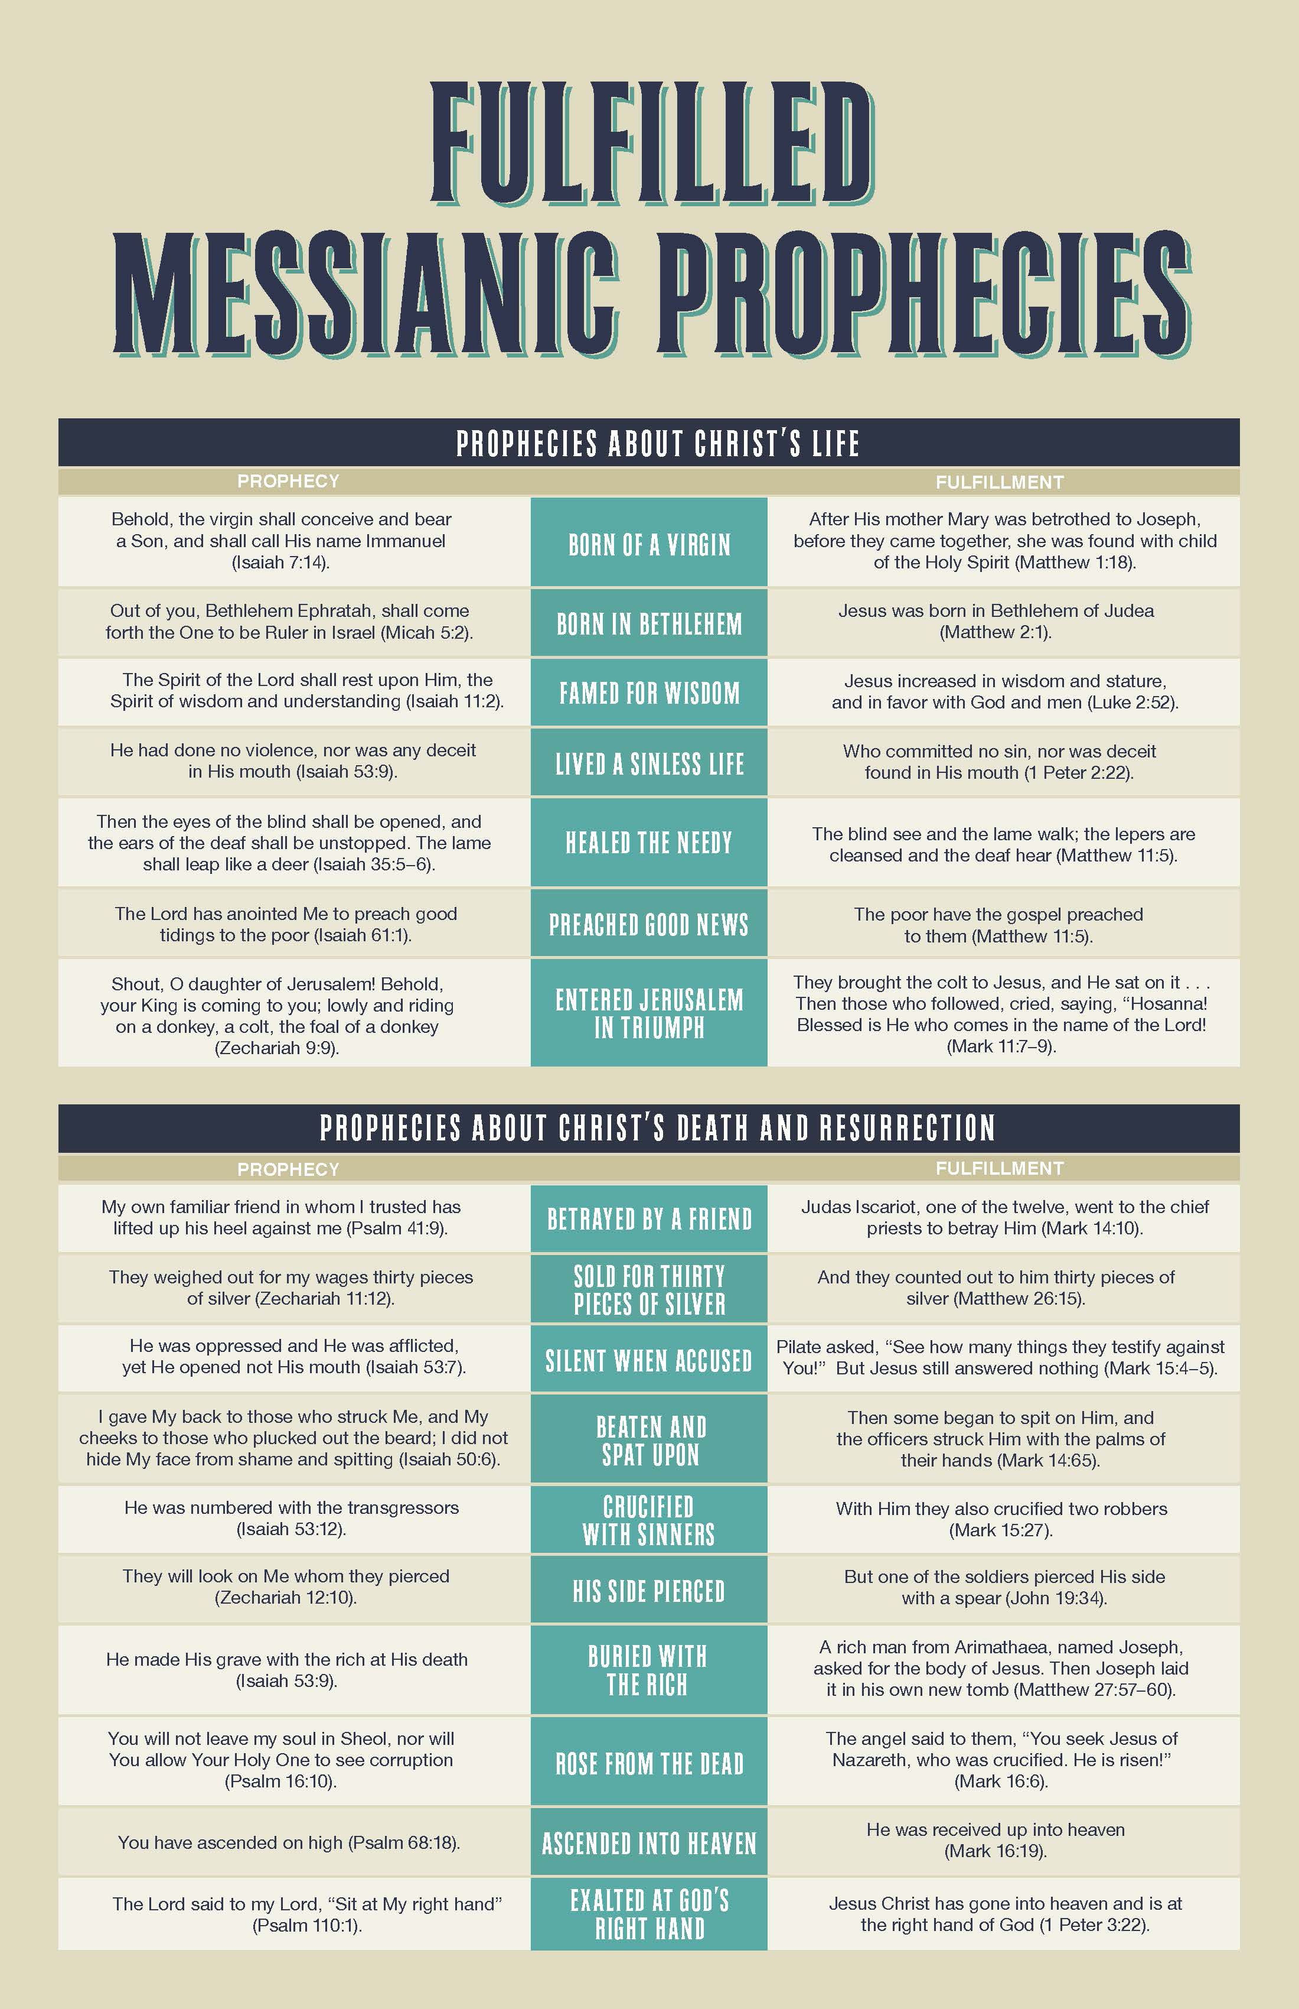

Slide 6
How can I know
The bible is god’s word?
The Claims
The proof of prophecy
The proof of archaeology

Slide 7
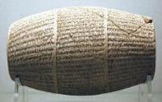
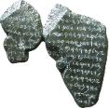
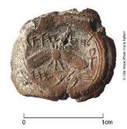
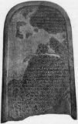
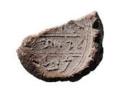
The Nabonidus Cylinder
The Tel Dan Stele
King Hezekiah’s seal
The Mesha stele
Isaiah’s Seal

Slide 8
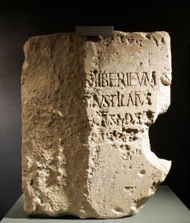
How can I know
The bible is god’s word?
The Claims
historical
The proof of prophecy
geological
Now in the fifteenth year of the reign of Tiberius Caesar, when Pontius Pilate was governor of Judea, and Herod was tetrarch of Galilee, and his brother Philip was tetrarch of the region of Ituraea and Trachonitis, and Lysanias was tetrarch of Abilene,
Luke 3:1
There is one glory of the sun, and another glory of the moon, and another glory of the stars; for star differs from star in glory. 1 Corinthians 15:41
'This is the law when a man dies in a tent: everyone who comes into the tent and everyone who is in the tent shall be unclean for seven days. 15 'And every open vessel, which has no covering tied down on it, shall be unclean. Numbers 19:14-15
It is he who sits above the circle of the earth, and its inhabitants are like grasshoppers; who stretches out the heavens like a curtain, and spreads them like a tent to dwell in; Isaiah 40:22
The proof of archaeology
biological
The proof of accuracy
Astronomical

Slide 9
How can I know
The bible is god’s word?
The Claims
The proof of prophecy
The proof of archaeology
The proof of accuracy
The proof of manuscripts

Slide 10
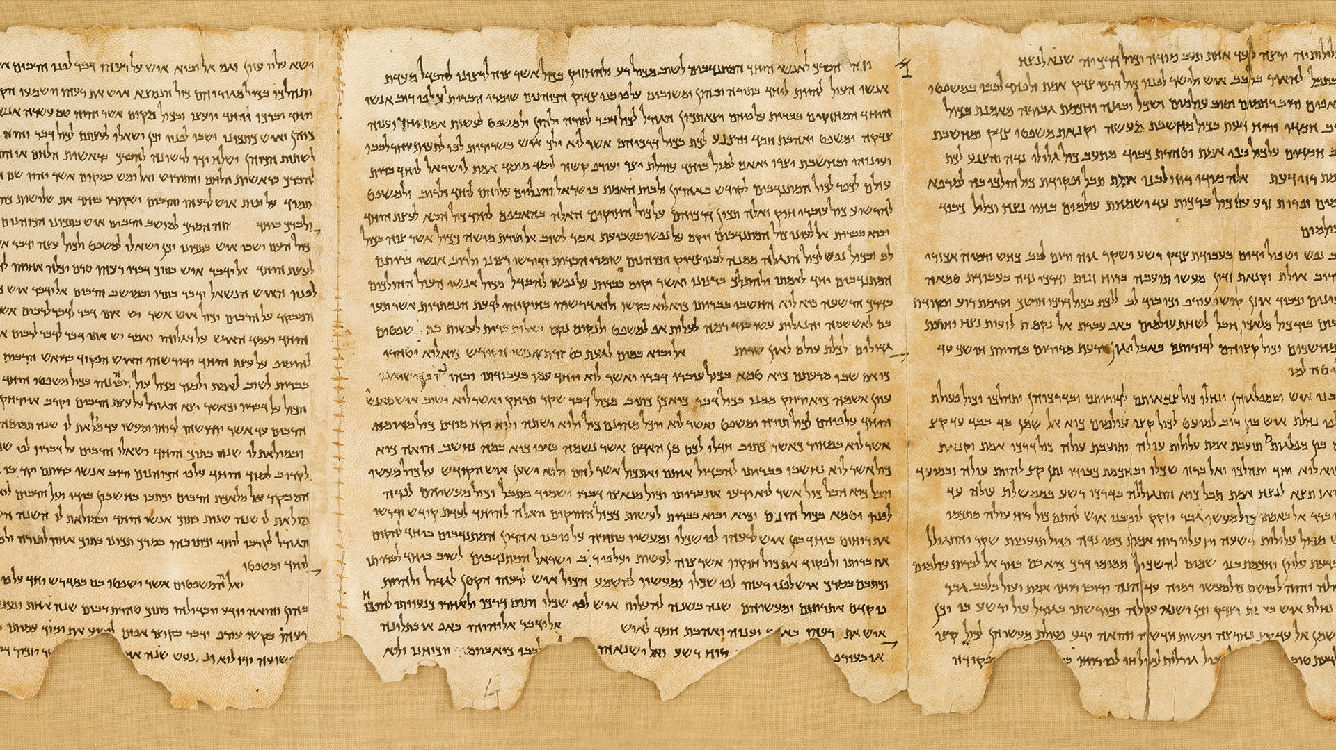
So what?

Slide 11
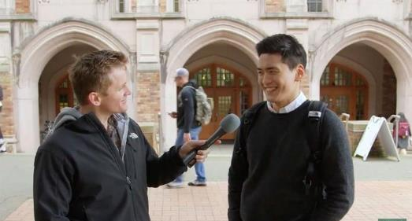
How can I know
With the bible…
The bible is god’s word?
God has given us truth
Be diligent to present yourself approved to God as a workman who does not need to be ashamed, handling accurately the word of truth. 2 timothy 2:15
And He answered and said, "Have you not read, that He who created them from the beginning made them male and female, Matthew 19:4
Sanctify them in the truth; your word is truth. John 17:17
And by referring to this, when you read you can understand my insight into the mystery of Christ,
Ephesians 3:4
and you shall know the truth, and the truth shall make you free." John 8:32

Slide 12
How can I know
With the bible…
The bible is god’s word?
God has given us truth
God has given us direction
So the LORD commanded us to observe all these statutes, to fear the LORD our God for our good always and for our survival, as it is today. Deuteronomy 6:24
Moreover, by them is your servant warned; in keeping them there is great reward. Psalm 19:11

Slide 13
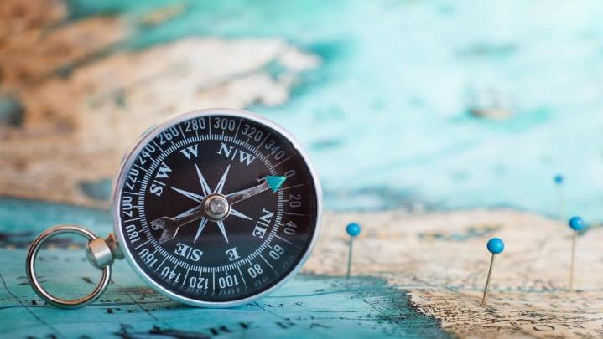
Trust in the LORD with all your heart, And do not lean on your own understanding. In all your ways acknowledge Him, And He will make your paths straight. Proverbs 3:5-6
Your word is a lamp to my feet and a light to my path.
Psalm 119:105

Slide 14
How can I know
With the bible…
The bible is god’s word?
God has given us truth
God has given us direction
God has given us hope

