Slide 2
ABRAHAM
LIVED TO A RIPE OLD AGE
WAS SATISFIED WITH LIFE
WAS GATHERED TO HIS PEOPLE
'I am the God of Abraham, and the God of Isaac, and the God of Jacob '? He is not the God of the dead but of the living." Matthew 22:32
And inasmuch as it is appointed for men to die once and after this comes judgment, Hebrews 9:27
By faith Abraham, when he was called, obeyed by going out to a place which he was to receive for an inheritance; and he went out, not knowing where he was going. Hebrews 11:8

Slide 3
Instruct those who are rich in this present world not to be conceited or to fix their hope on the uncertainty of riches, but on God, who richly supplies us with all things to enjoy.
1 Timothy 6:17
Enjoy life with the woman whom you love all the days of your fleeting life which He has given to you under the sun; for this is your reward in life, and in your toil in which you have labored under the sun. Ecclesiastes 9:9
He makes the barren woman abide in the house As a joyful mother of children. Praise the LORD! Psalm 113:9
Serve the LORD with gladness; Come before Him with joyful singing. Psalm 100:2

Slide 4
A life of satisfaction has less to do with the absence of trials, and more to do with the presence of God.

Slide 5
TO FIND THE JOY IN THE JOURNEY:
1. RELEASE YOUR BAGGAGE
WORRY
Be anxious for nothing, but in everything by prayer and supplication with thanksgiving let your requests be made known to God. And the peace of God, which surpasses all comprehension, shall guard your hearts and your minds in Christ Jesus. Philippians 4:6-7
Therefore do not worry about tomorrow, for tomorrow will worry about itself. Each day has enough trouble of its own. Matthew 6:34
"Therefore do not worry, saying, 'What shall we eat?' or 'What shall we drink?' or 'What shall we wear?' "For after all these things the Gentiles seek. For your heavenly Father knows that you need all these things. Matthew 6:31-32

Slide 7
TO FIND THE JOY IN THE JOURNEY:
1. RELEASE YOUR BAGGAGE
WORRY
BITTERNESS
Let all bitterness and wrath and anger and clamor and slander be put away from you, along with all malice. And be kind to one another, tender-hearted, forgiving each other, just as God in Christ also has forgiven you.
Ephesians 4:31-32
Be angry, and yet do not sin; do not let the sun go down on your anger, Ephesians 4:26

Slide 8
TO FIND THE JOY IN THE JOURNEY:
1. RELEASE YOUR BAGGAGE
WORRY
BITTERNESS
GUILT
For the sorrow that is according to the will of God produces a repentance without regret, leading to salvation; but the sorrow of the world produces death. 2 Corinthians 7:10
But solid food is for the mature, who because of practice have their senses trained to discern good and evil.
Hebrews 5:14
Cast your burden upon the LORD, and He will sustain you; He will never allow the righteous to be shaken. Psalm 55:22
"She has done what she could; she has anointed My body beforehand for the burial. Mark 14:8

Slide 9
TO FIND THE JOY IN THE JOURNEY:
1. RELEASE YOUR BAGGAGE
2. CELEBRATE YOUR VICTORIES
We give thanks to God always for all of you, making mention of you in our prayers; constantly bearing in mind your work of faith and labor of love and steadfastness of hope in our Lord Jesus Christ in the presence of our God and Father,
1 Thessalonians 1:2-3

Slide 10
TO FIND THE JOY IN THE JOURNEY:
1. RELEASE YOUR BAGGAGE
2. CELEBRATE YOUR VICTORIES
3. REMEMBER YOUR HOPE

Slide 11
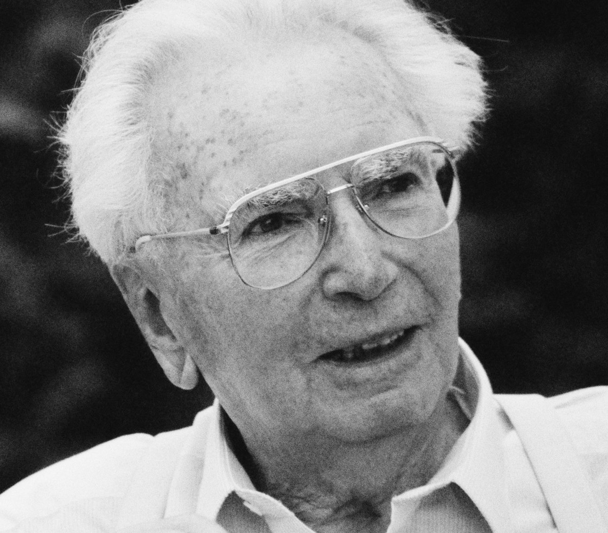
WITHOUT HOPE:
DESPAIR REPLACES JOY
FEAR REPLACES FAITH
ANXIETY REPLACES PRAYER
DOUBT REPLACES CONFIDENCE

Slide 12
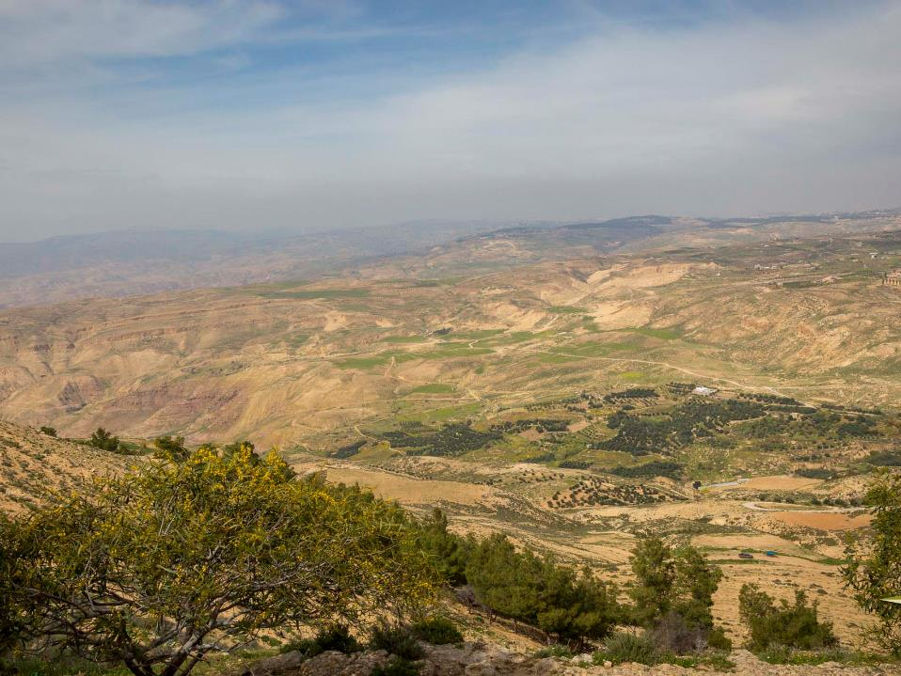
Therefore we do not lose heart, but though our outer man is decaying, yet our inner man is being renewed day by day. For momentary, light affliction is producing for us an eternal weight of glory far beyond all comparison, while we look not at the things which are seen, but at the things which are not seen; for the things which are seen are temporal, but the things which are not seen are eternal.
2 Corinthians 4:16-18

