Slide 2
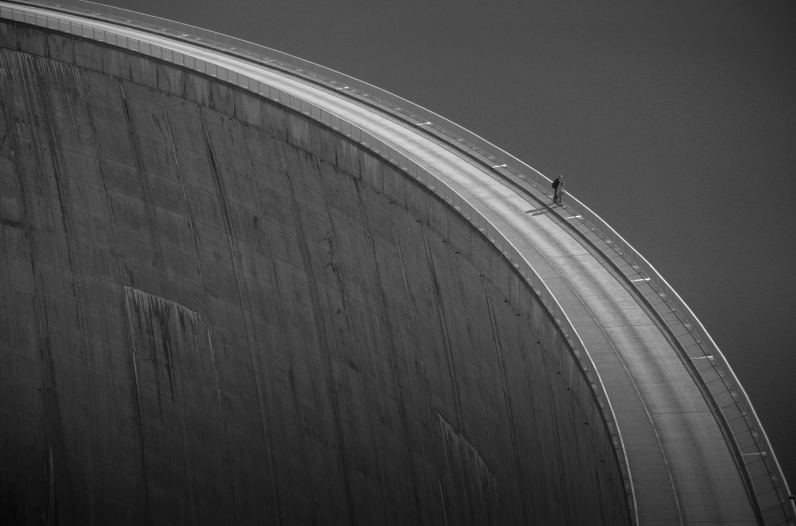

Fundamental Bible Doctrines
Who Is God?

Slide 3
Why Man Needs to Know God
Eternal life is through knowledge of God (John 17:3)
Faith is necessary to please God (Hebrews 11:6)
If we don’t know God, we will suffer punishment (2 Thessalonians 1:7-9)

Slide 4
What We Know About God
Characteristics of the Creator
God demonstrates His power in
1. Creation (Heb. 11:3)
2. Providential Care (Psalm. 145:9)

Slide 5
What We Know About God
What should we do then?
1. Always grow in our understanding of God.
2. Hold faith dear.
3. Take the things He has given us, rejoice in them, and learn (Deuteronomy 29:29)
4. Trust Him, and commit our works to Him.

Slide 6
What We Would Not Know Without God
Where we came from (Genesis 1:26-27; 2:7)
Why we are here (Ecclesiastes 12:13)
What is right and wrong (John 17:17)
God’s immeasurable love

