Slide 1
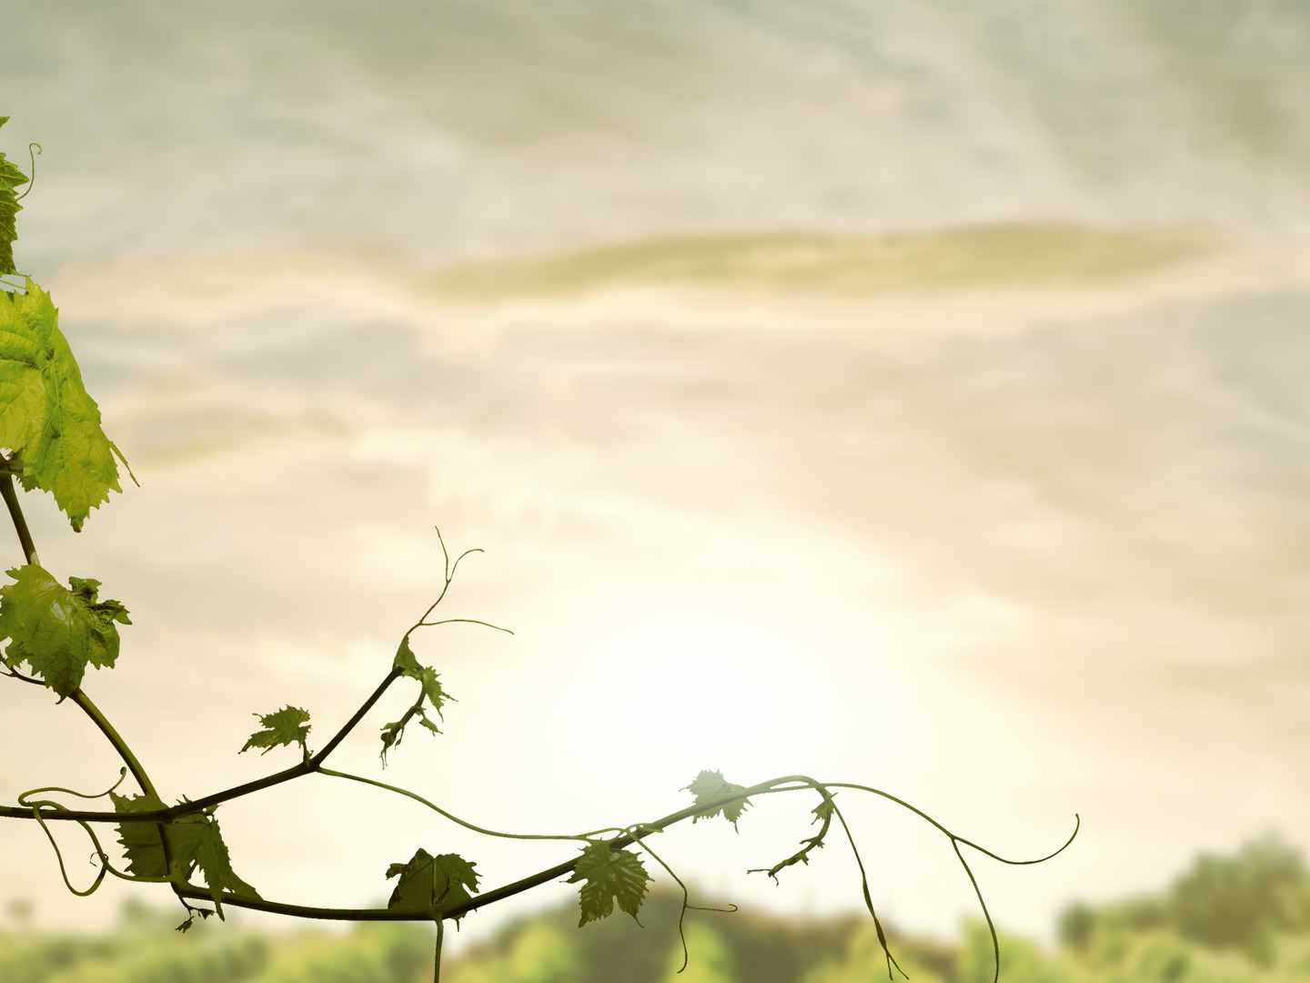
I am the true vine, and my Father is the vinedresser. Every branch in me that does not bear fruit he takes away, and every branch that does bear fruit he prunes, that it may bear more fruit. Already you are clean because of the word that I have spoken to you. Abide in me, and I in you. As the branch cannot bear fruit by itself, unless it abides in the vine, neither can you, unless you abide in me. I am the vine; you are the branches…
John 15:1-11

Slide 2
…Whoever abides in me and I in him, he it is that bears much fruit, for apart from me you can do nothing. If anyone does not abide in me he is thrown away like a branch and withers; and the branches are gathered, thrown into the fire, and burned. If you abide in me, and my words abide in you, ask whatever you wish, and it will be done for you. By this my Father is glorified, that you bear much fruit and so prove to be my disciples… John 15:1-11

Slide 3
…As the Father has loved me, so have I loved you. Abide in my love. If you keep my commandments, you will abide in my love, just as I have kept my Father’s commandments and abide in his love. These things I have spoken to you, that my joy may be in you, and that your joy may be full.
John 15:1-11

Slide 4
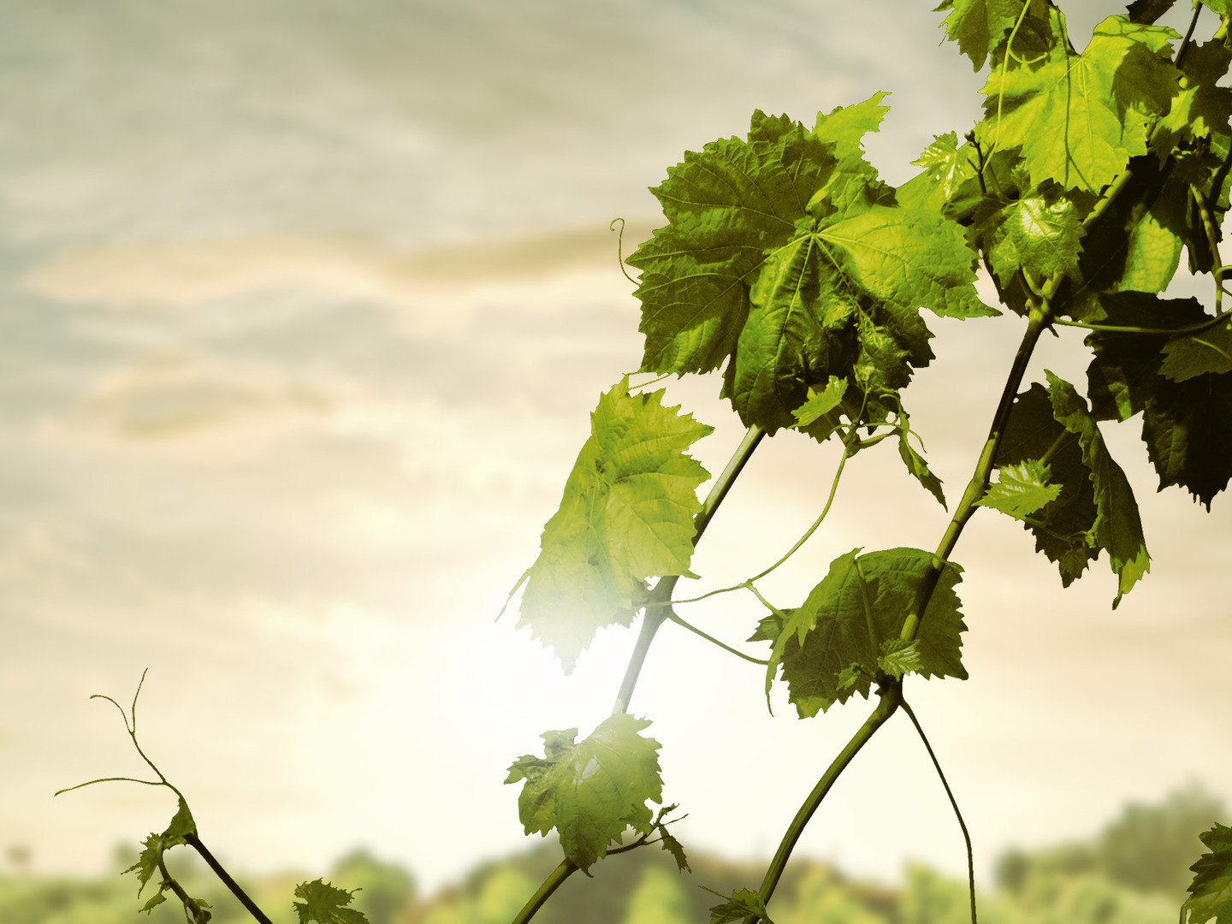
I’m
just a
Branch

Slide 5
I am the vine, you are the branches. Whoever abides in me and I in him, he it is that bears much fruit, for apart from me you can do nothing.
John 15:5

Slide 6
“Son of man, how does the wood of the vine surpass any wood, the vine branch that is among the trees of the forest? Is wood taken from it to make anything? Do people take a peg from it to hang any vessel on it? Behold, it is given to the fire for fuel. When the fire has consumed both ends of it, and the middle of it is charred, is it useful for anything?”
Ezekiel 15:2-4

Slide 7
I am the vine, you are the branches. Whoever abides in me and I in him, he it is that bears much fruit, for apart from me you can do nothing.
John 15:5

Slide 8
By this my Father is glorified, that you bear much fruit and so prove to be my disciples.
John 15:8
I am the true vine, and my Father is the vinedresser.
John 15:1

Slide 9
How do I Abide in the Vine?
Abide in the Word

Slide 10
If you abide in me, and my words abide in you...
John 15:7

Slide 11
You search the Scriptures because you think that in them you have eternal life; and it is they that bear witness about me, yet you refuse to come to me that you may have life.
John 5:39-40

Slide 12
How do I Abide in the Vine?
Abide in the Word
Abide in Prayer

Slide 13
If you abide in me, and my words abide in you, ask whatever you wish, and it will be done for you.
John 15:7
“True prayer is the fruit of helplessness and faith.”
Ole Hallesby, Prayer

Slide 14
How do I Abide in the Vine?
Abide in the Word
Abide in Prayer
Abide in Love

Slide 15
As the Father has loved me, so have I loved you. Abide in my love.
John 15:9

Slide 16
Greater love has no one than this, that someone lay down his life for his friends.
John 15:13
By this we know love, that he laid down his life for us…
1 John 3:16

Slide 17
Greater love has no one than this, that someone lay down his life for his friends.
John 15:13
For God so loved the world, that he gave his only Son, that whoever believes in him should not perish but have eternal life.
John 3:16

Slide 18
As the Father has loved me, so have I loved you. Abide in my love.
John 15:9
If you keep my commandments, you will abide in my love, just as I have kept my Father’s commandments and abide in his love.
John 15:10

Slide 19
If you love me, you will keep my commandments.
John 14:15

Slide 20
Whoever has my commandments and keeps them, he it is who loves me. And he who loves me will be loved by my Father, and I will love him and manifest myself to him…If anyone loves me, he will keep my word, and my Father will love him, and we will come to him and make our home with him. Whoever does not love me does not keep my words.
John 14:21-24

Slide 21
And by this we know that we have come to know him, if we keep his commandments. Whoever says “I know him” but does not keep his commandments is a liar, and the truth is not in him, but whoever keeps his word, in him truly the love of God is perfected. By this we may know that we are in him: whoever says he abides in him ought to walk in the same way in which he walked.
1 John 2:3-6

Slide 22
By this we know that we love the children of God, when we love God and obey His commandments. For this is the love of God, that we keep his commandments. And his commandments are not burdensome.
1 John 5:2-3

Slide 23
And this is love, that we walk according to his commandments; this is the commandment, just as you have heard from the beginning, so that you should walk in it.
2 John 6

Slide 24
If you keep my commandments, you will abide in my love, just as I have kept my Father’s commandments and abide in his love.
John 15:10
The Father who sent me has himself given me a commandment…And I know that his commandment is eternal life.
John 12:49-50

Slide 25
I am the true vine, and my Father is the vinedresser. Every branch in me that does not bear fruit he takes away, and every branch that does bear fruit he prunes, that it may bear fruit. Already you are clean because of the word that I have spoken to you.
John 15:1-3
pruned

Slide 26
How do I Abide in the Vine?
Abide in the Word
Abide in Prayer
Abide in Love

Slide 27
I’m
just a
Branch

Slide 28
Truly, truly, I say to you, unless a grain of wheat falls into the earth and dies, it remains alone; but if it dies, it bears much fruit. Whoever loves his life loses it, and whoever hates his life in this world will keep it for eternal life. If anyone serves me, he must follow me; and where I am, there will my servant be also. If anyone serves me, the Father will honor him.
John 12:24-26

Slide 29
I’m
just a
Branch

