Slide 1
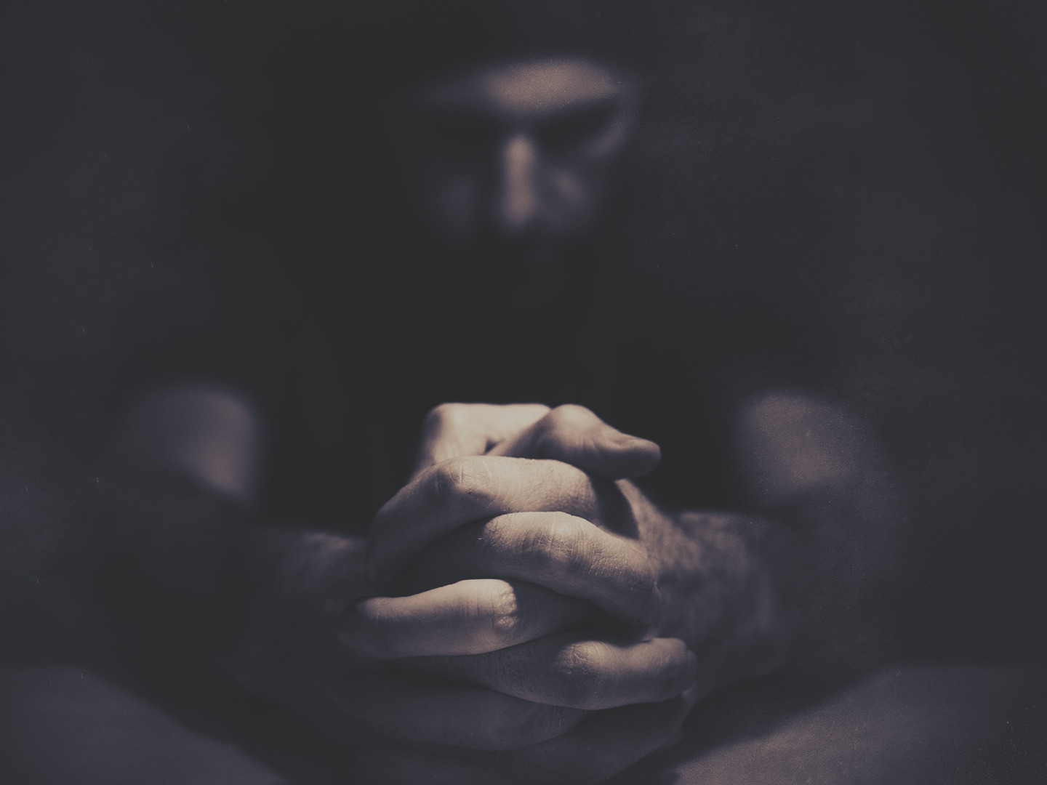
“Pray then like this”
Matthew 6:9

Slide 2
“Pray then like this”
Matthew 6:9
Mistake #1
We are prohibited from reciting this prayer
Two Mistakes to Avoid

Slide 3
“Pray then like this”
Matthew 6:9
Mistake #2
We are required to recite this prayer
Two Mistakes to Avoid

Slide 4
“Pray then like this”
Matthew 6:9
Contrast #1
Don’t pray like the hypocrites
In Contrast to What

Slide 5
“Pray then like this”
Matthew 6:9
Contrast #2
Don’t pray like the Gentiles
In Contrast to What

Slide 6
Kingdom First
Praying

Slide 7
“Pray then like this”
Matthew 6:9
Our Father in heaven,
hallowed be your name.
Your kingdom come,
your will be done,
on earth as it is in heaven.
A Kingdom First Prayer

Slide 8
“Pray then like this”
Matthew 6:9
Our Father in the heavens,
your name be hallowed,
your kingdom come,
your will be done,
as in heaven, so on earth.
Matthew 6:9-10 (ALV)
A Kingdom First Prayer

Slide 9
“Pray then like this”
Matthew 6:9
Give us this day our daily bread
A Kingdom First Prayer

Slide 10
“Pray then like this”
Matthew 6:9
…give me neither poverty nor riches; feed me with the food that is needful for me, lest I be full and deny you and say, “Who is the Lord?” or lest I be poor and steal and profane the name of my God.
Proverbs 30:8-9 (ESV)
A Kingdom First Prayer

Slide 11
“Pray then like this”
Matthew 6:9
Give us this day our daily bread
Our Father in heaven,
hallowed be your name.
A Kingdom First Prayer

Slide 12
“Pray then like this”
Matthew 6:9
Give us this day our daily bread
Kingdom
Motivation
A Kingdom First Prayer

Slide 13
“Pray then like this”
Matthew 6:9
And forgive us our debts,
as we also have forgiven our debtors.
Our Father in heaven,
…your kingdom come…
A Kingdom First Prayer

Slide 14
“Pray then like this”
Matthew 6:9
And forgive us our debts,
as we also have forgiven our debtors.
Kingdom
Submission
A Kingdom First Prayer

Slide 15
“Pray then like this”
Matthew 6:9
And lead us not into temptation,
but deliver us from evil
Lord, I’m following Your lead. I’m going wherever you take me.
Lord, I don’t want to do wrong. I want to do right.
Lord, if You don’t lead me in your paths, I’m going to wander off.
A Kingdom First Prayer

Slide 16
“Pray then like this”
Matthew 6:9
But each person is tempted when he is lured and enticed by his own desire.
James 1:14 (ESV)
A Kingdom First Prayer

Slide 17
“Pray then like this”
Matthew 6:9
And lead us not into temptation,
but deliver us from evil
Our Father in heaven,
…your will be done…
A Kingdom First Prayer

Slide 18
“Pray then like this”
Matthew 6:9
And lead us not into temptation,
but deliver us from evil
Kingdom
Purpose
A Kingdom First Prayer

Slide 19
Kingdom First
Praying

Slide 20
“Pray then like this”
Matthew 6:9
For yours is the kingdom
and the power
and the glory,
forever,
Amen.
A Kingdom First Prayer

Slide 21
“Pray then like this”
Matthew 6:9
Yours, O LORD, is the greatness and the power and the glory and the victory and the majesty, for all that is in the heavens and in the earth is yours. Yours is the kingdom, O LORD, and you are exalted as head above all.
1 Chronicles 29:10-11
A Kingdom First Prayer

Slide 22
Kingdom First
Praying

