Slide 1
2021 Theme - Spiritual Growth
August
Eph.4:13-16 - “Until we all attain to the unity of the faith … and of the knowledge of the Son of God … to mature manhood … to the measure of the stature of the fullness of Christ … so that we may no longer be children … tossed to and fro by the waves … and carried about by every wind of doctrine … by human cunning … by craftiness in deceitful schemes .… Rather, speaking the truth in love … we are to grow up in every way … into him who is the head … into Christ, from whom the whole body … joined and held together by every joint with which it is equipped … when each part is working properly … makes the body grow so that it builds itself up in love.”

Slide 2
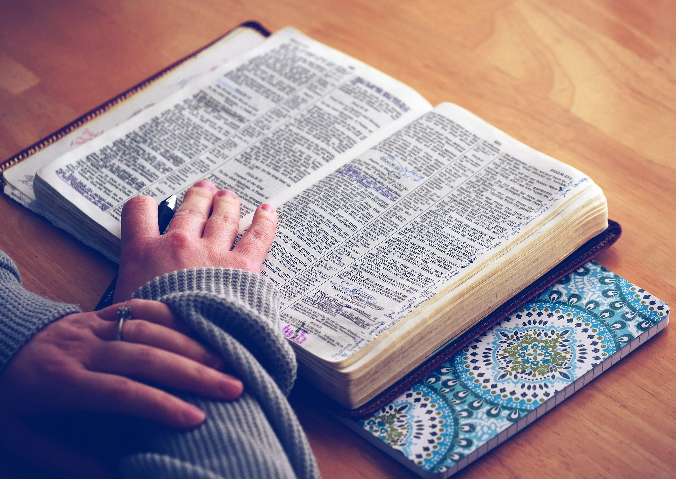
Opening Prayer…

Slide 3
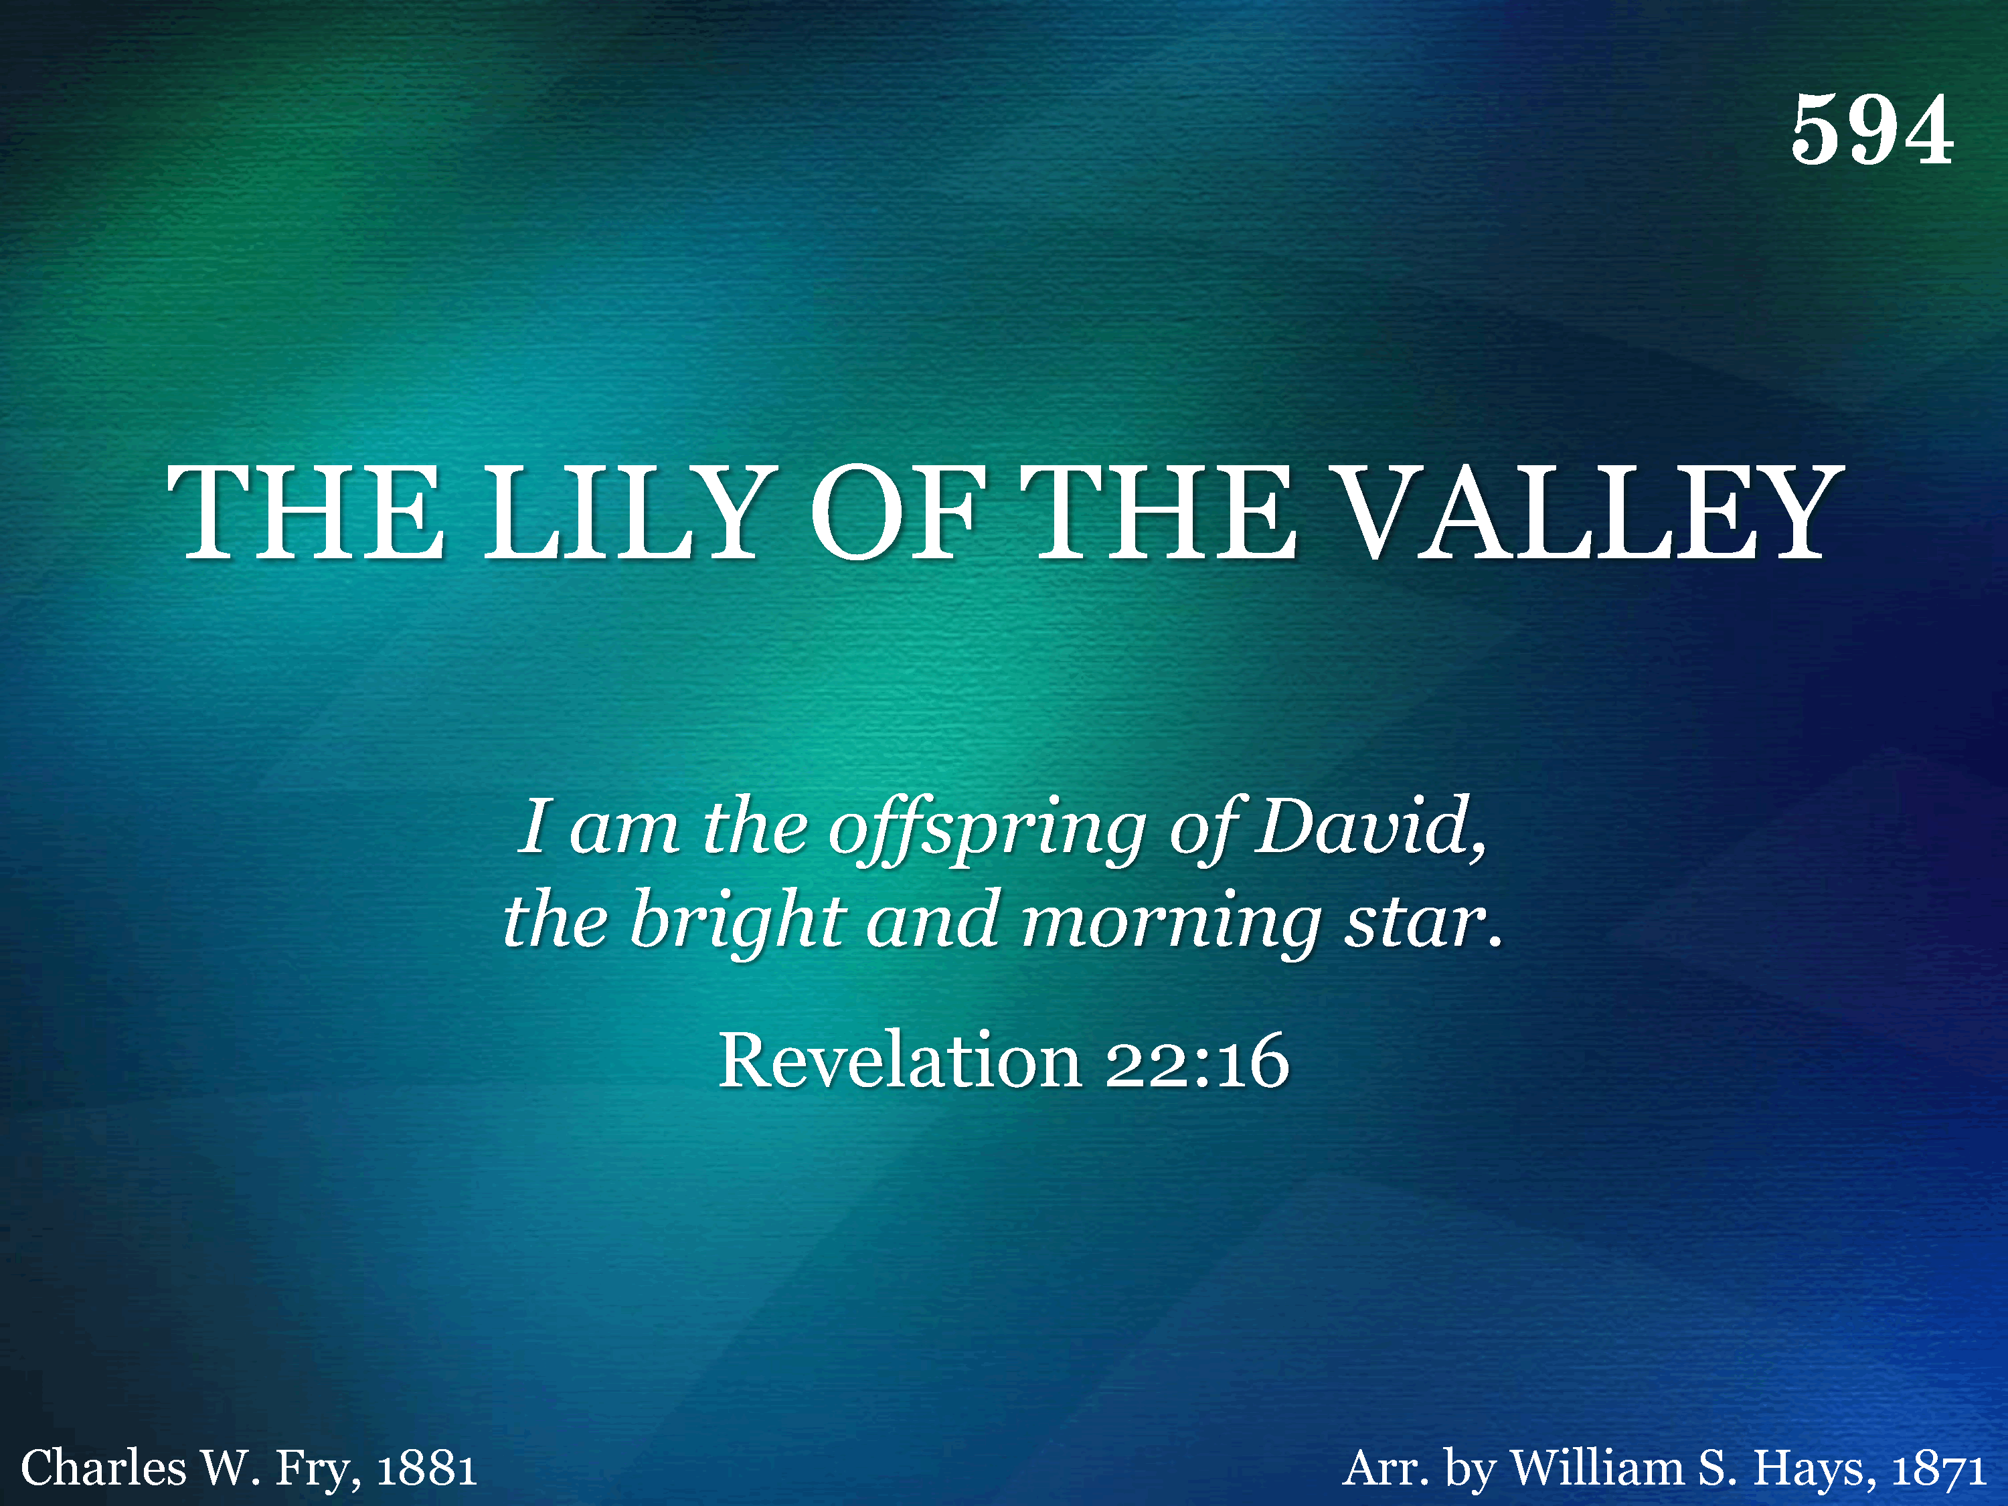
594 - The Lily Of The Valley - Title

Slide 4
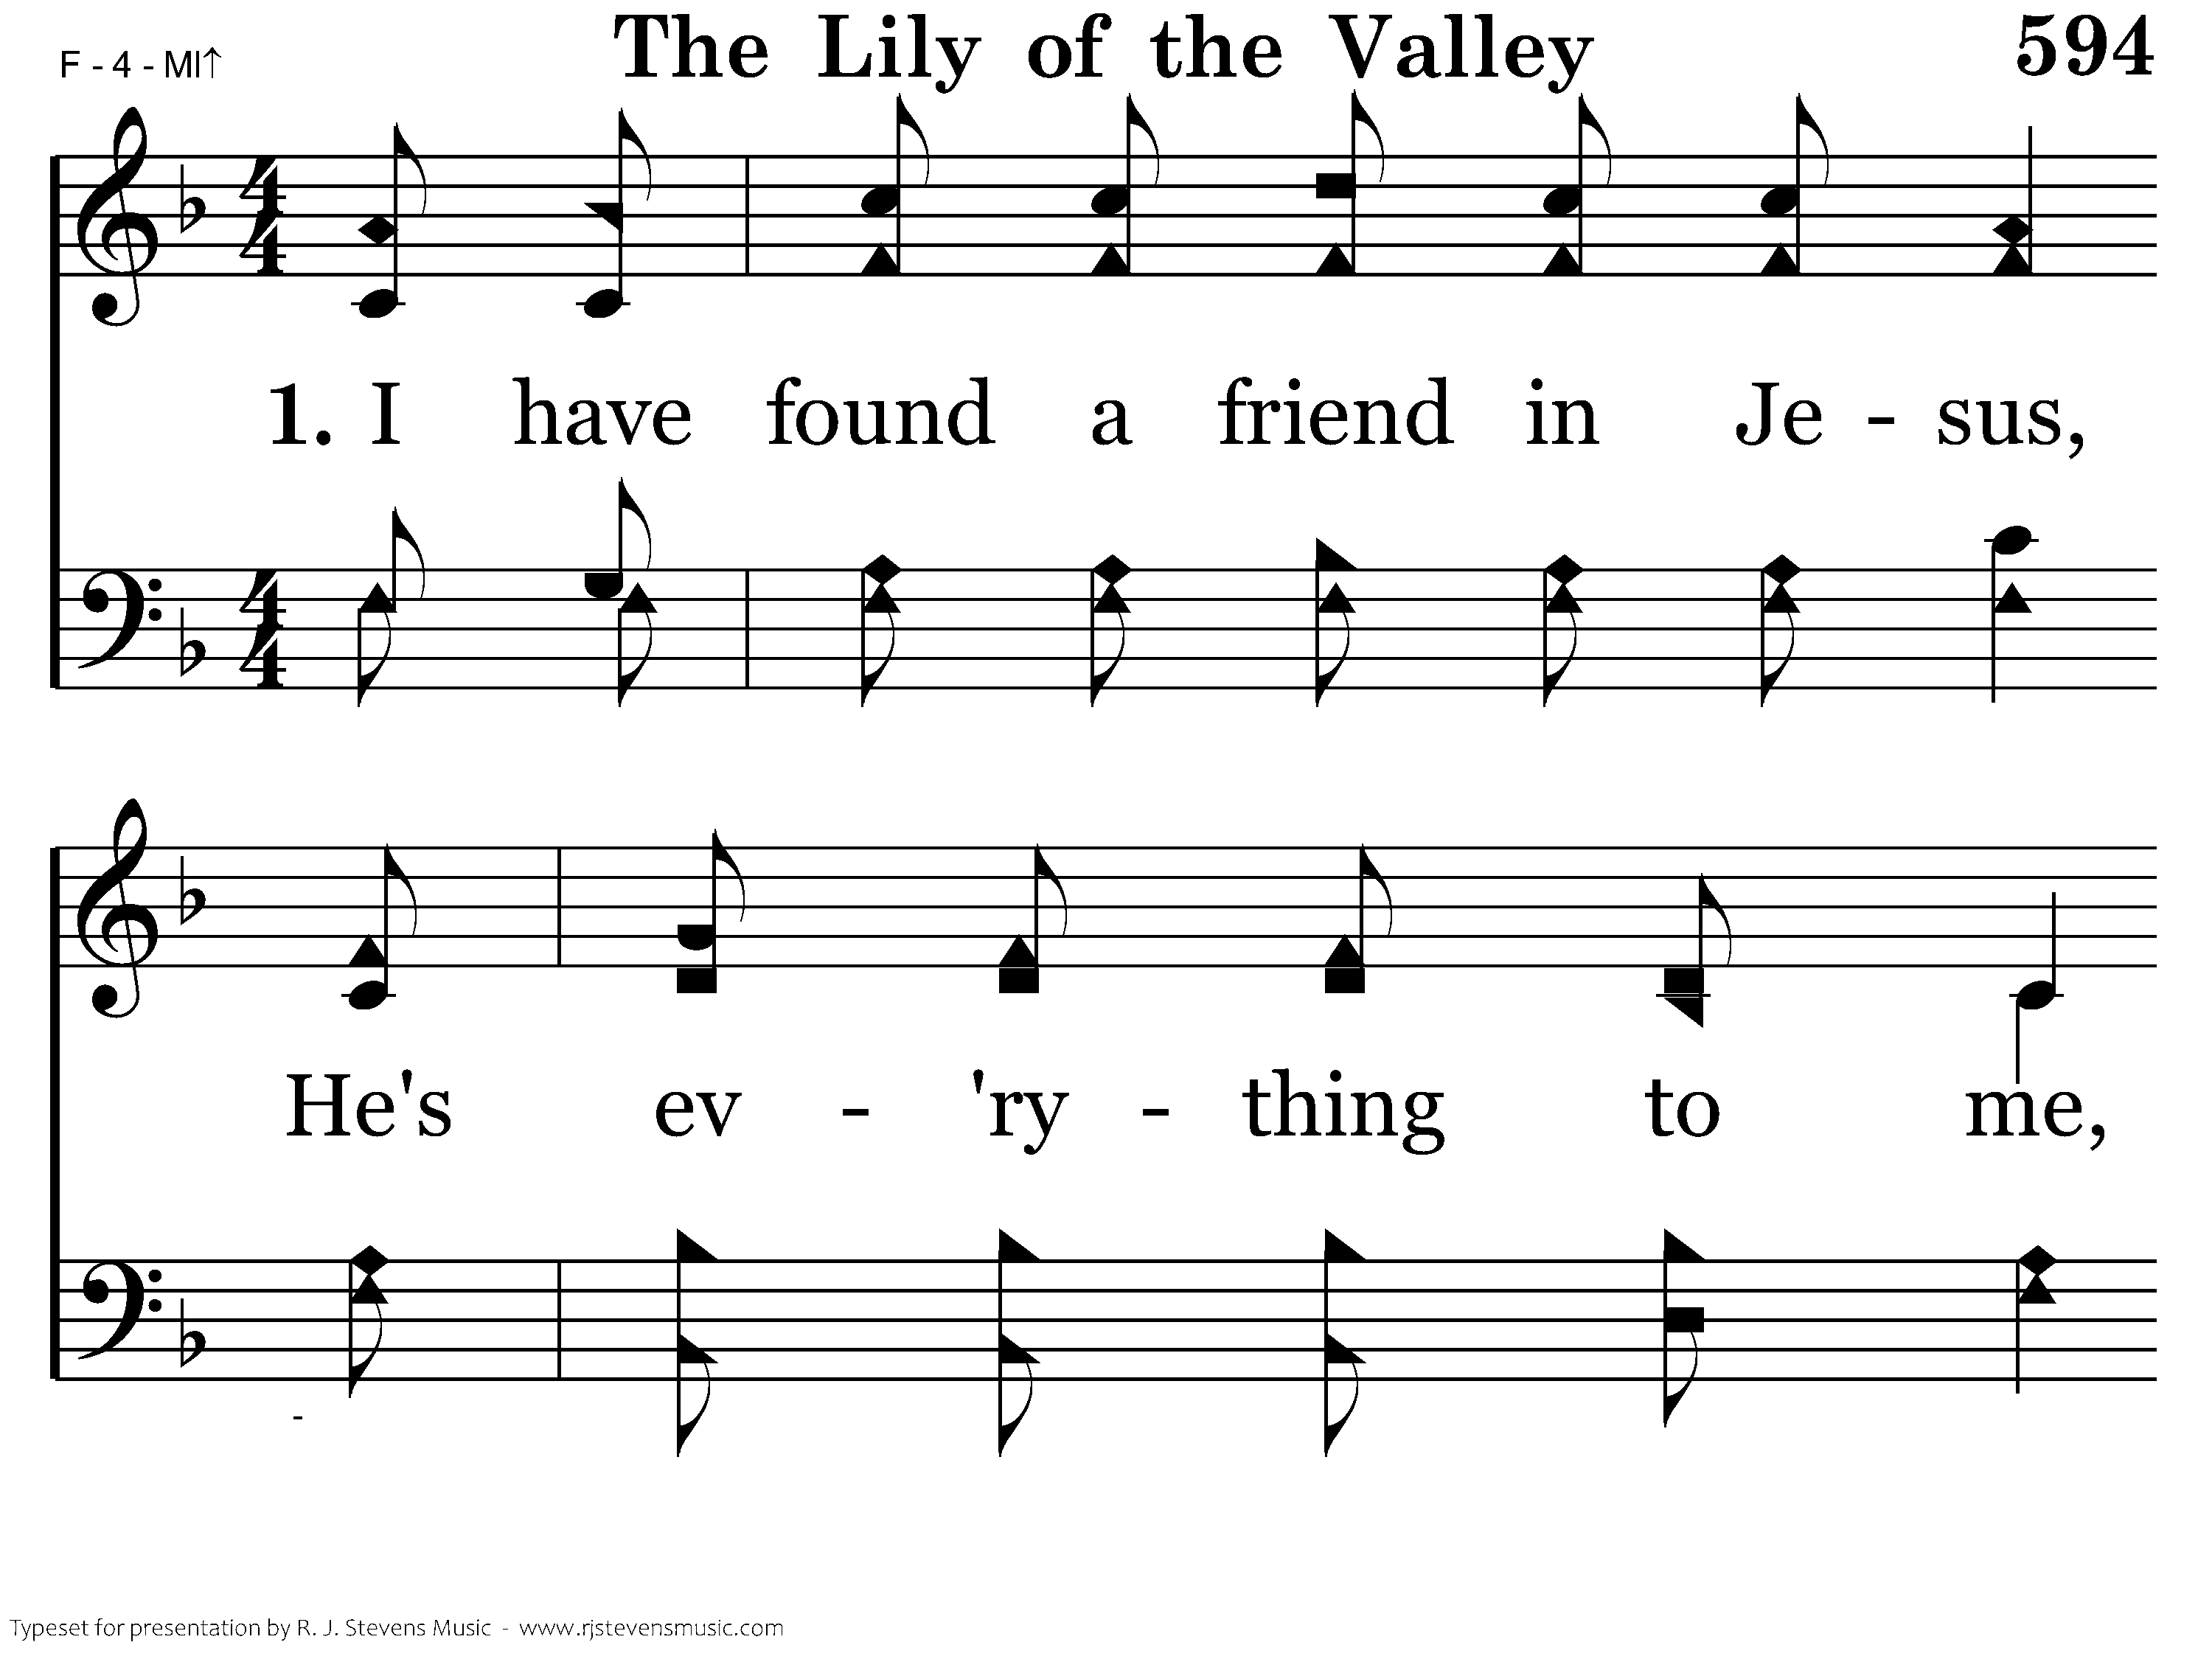
594 - The Lily Of The Valley - 1.1

Slide 5
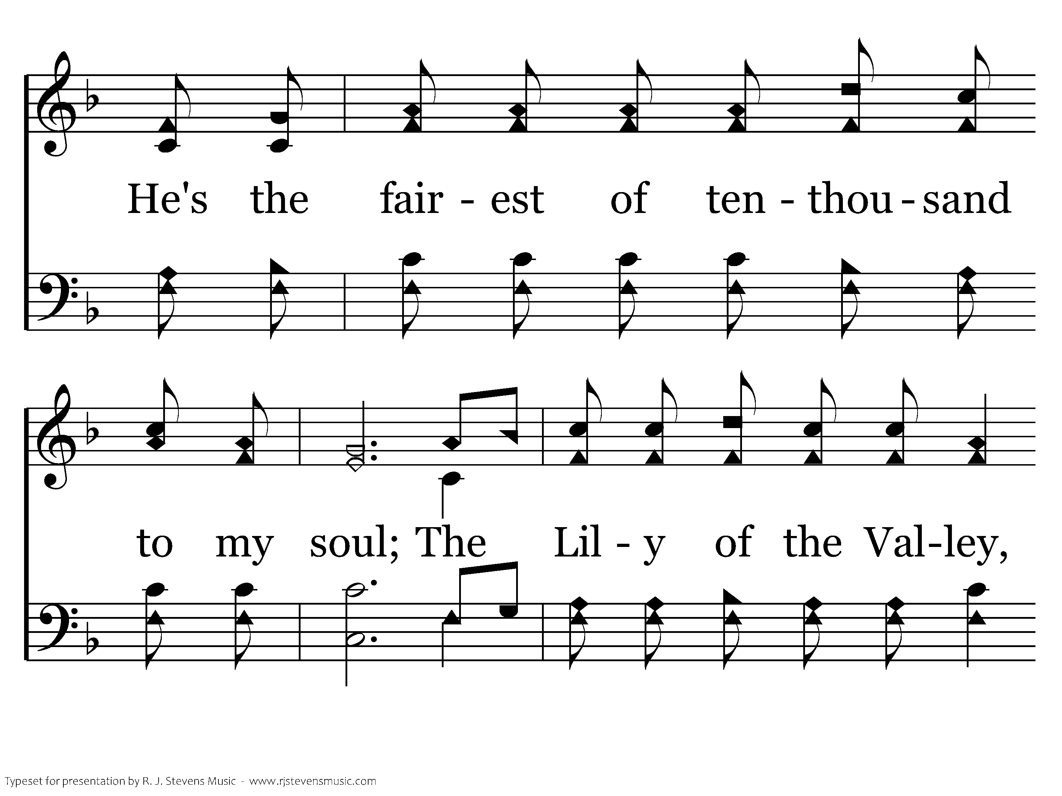
594 - The Lily Of The Valley - 1.2

Slide 6
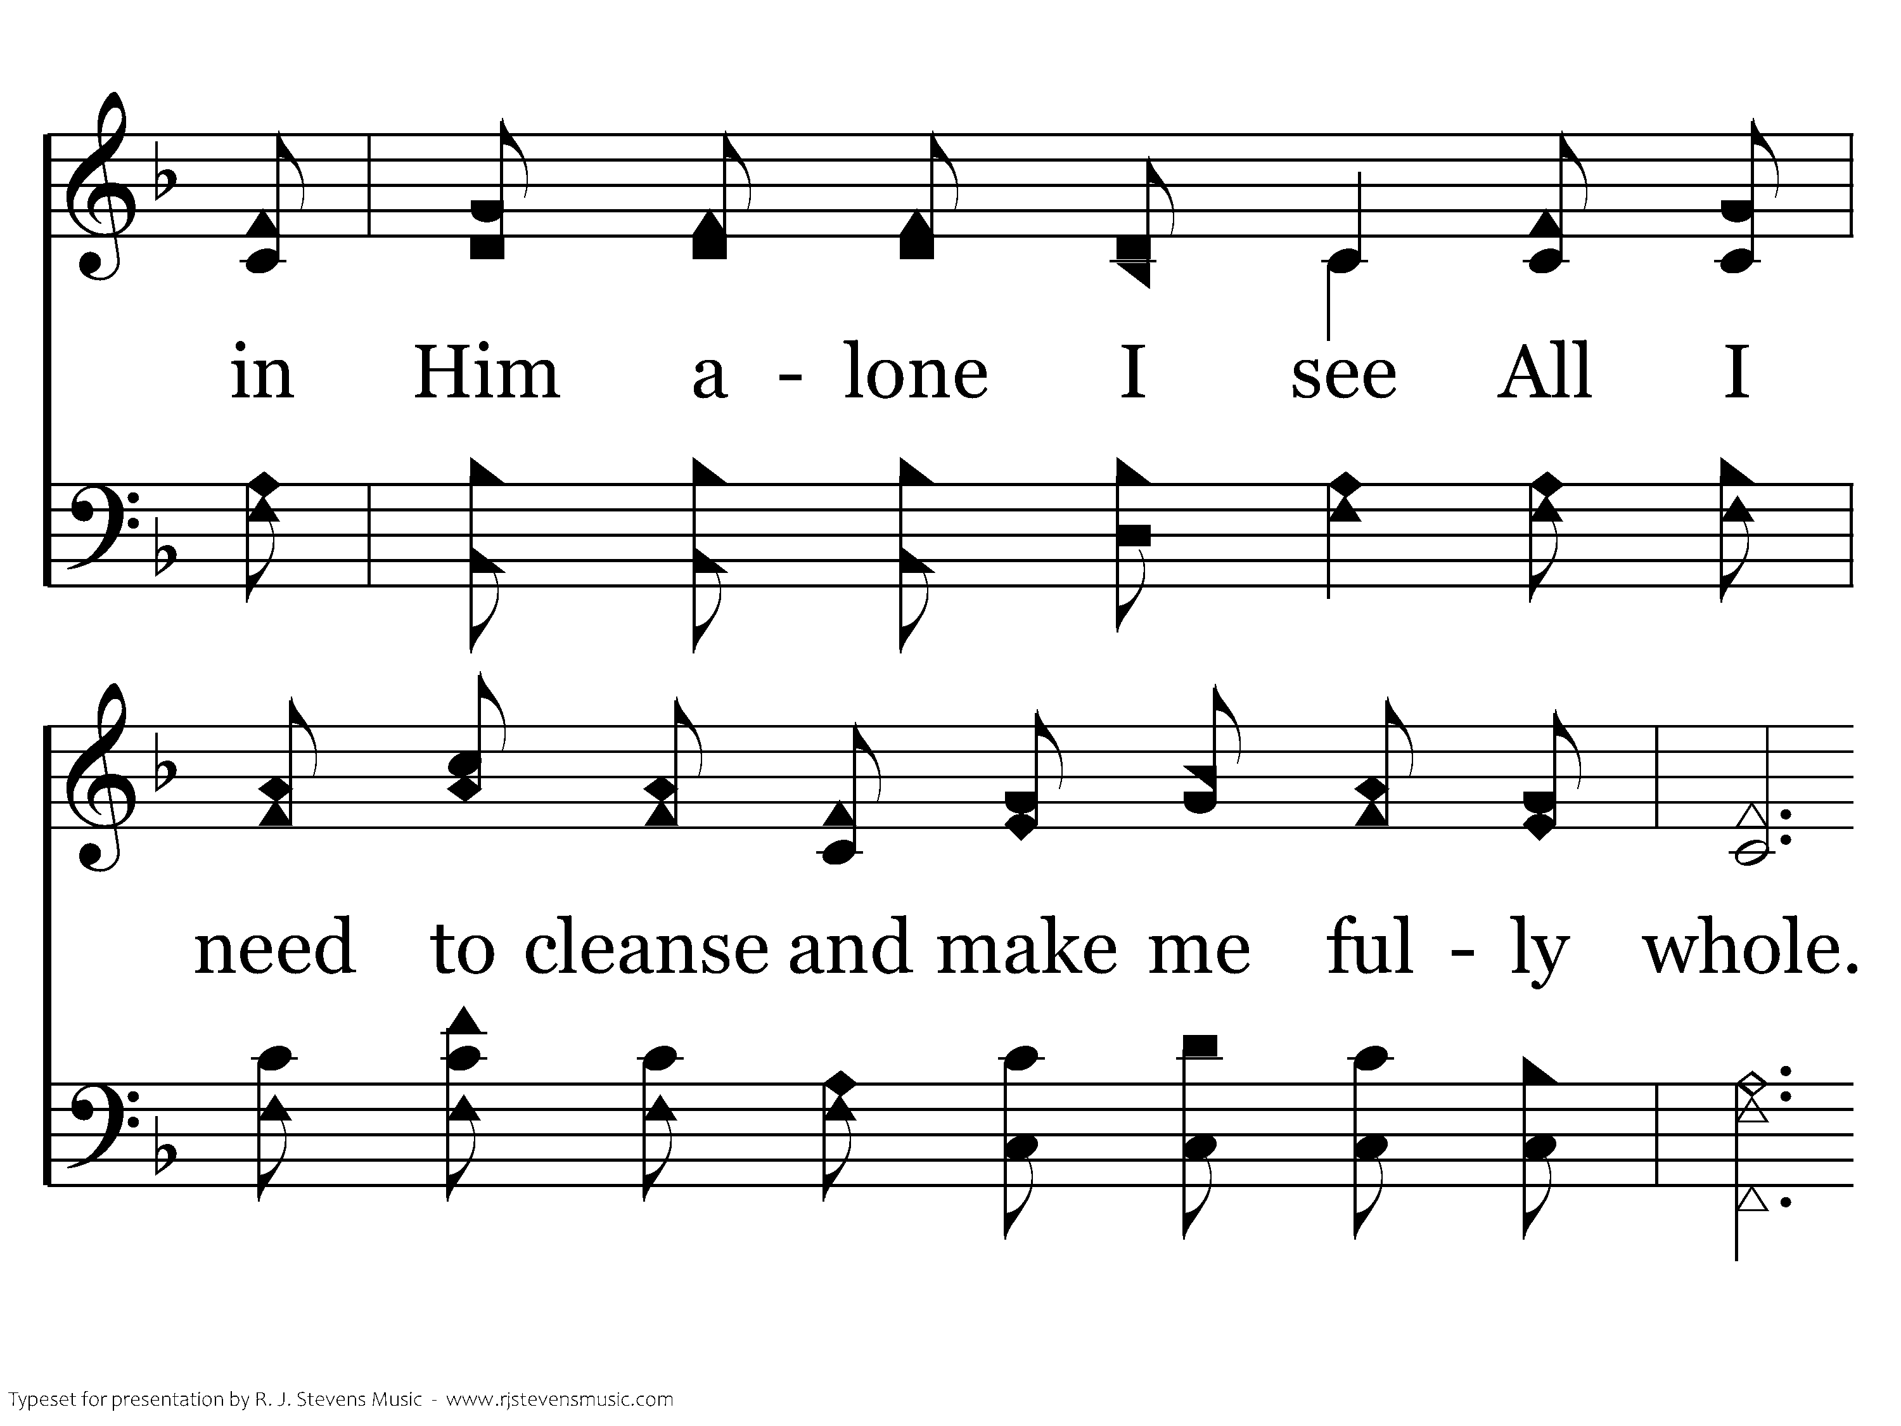
594 - The Lily Of The Valley - 1.3

Slide 7
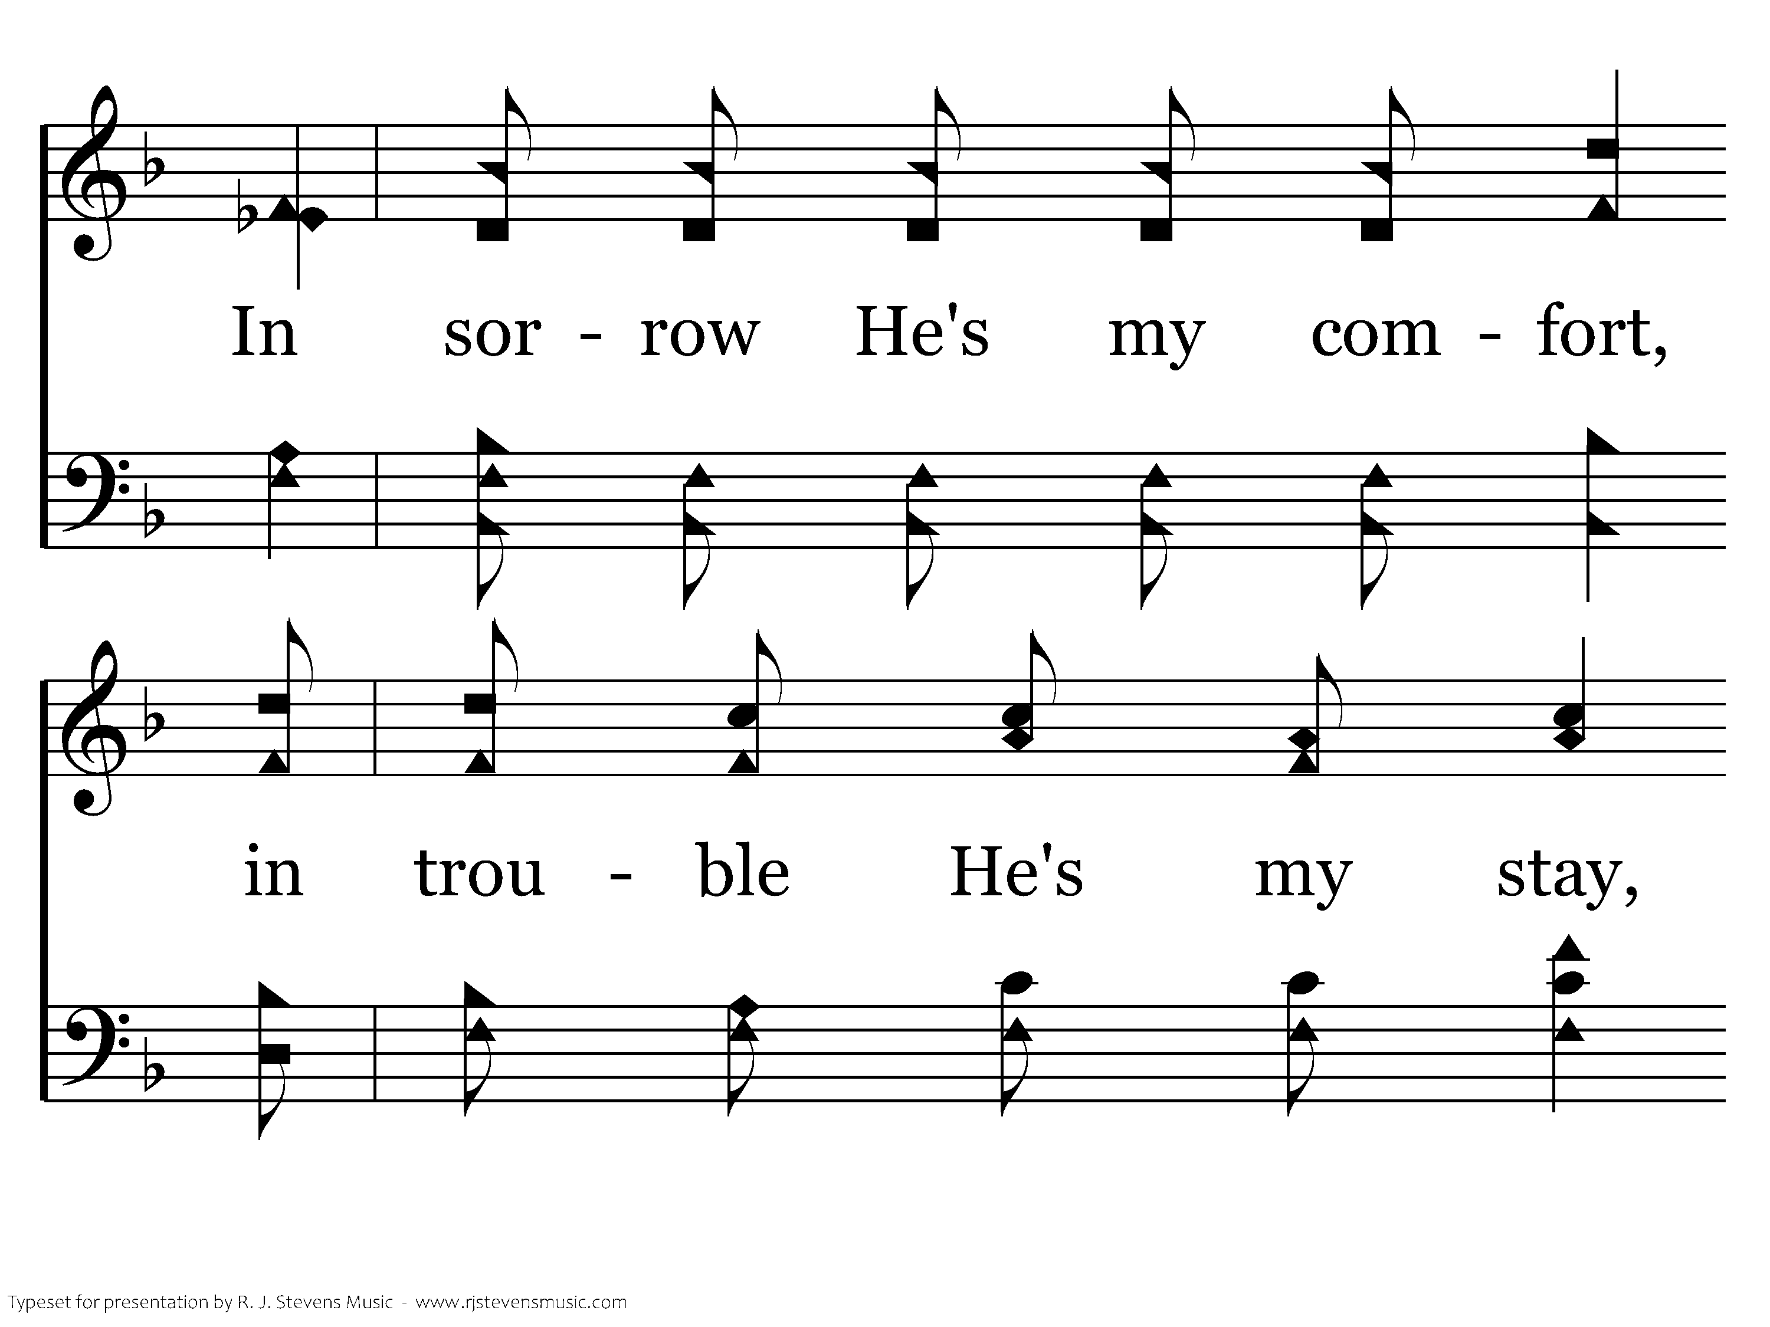
594 - The Lily Of The Valley - 1.4

Slide 8
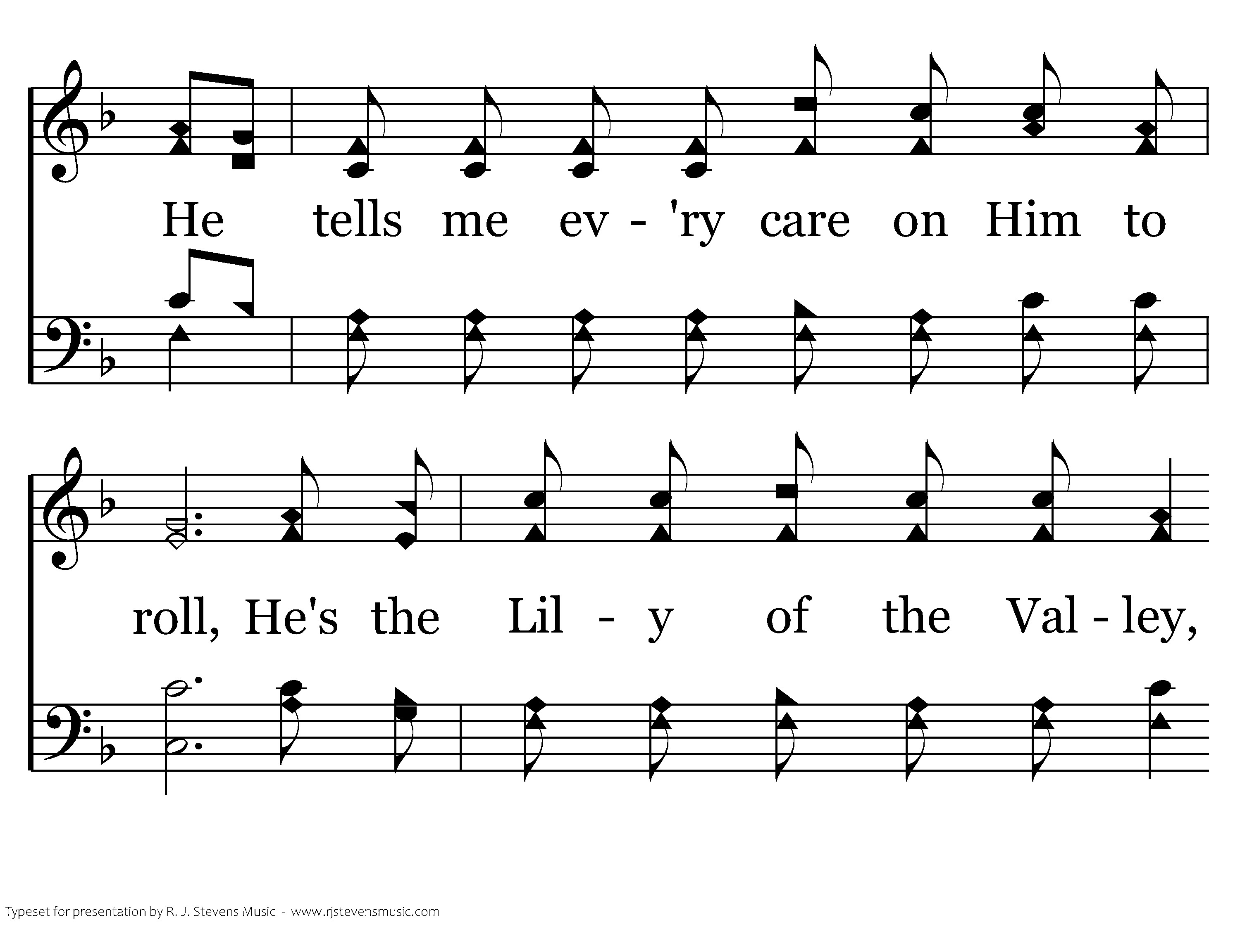
594 - The Lily Of The Valley - 1.5

Slide 9
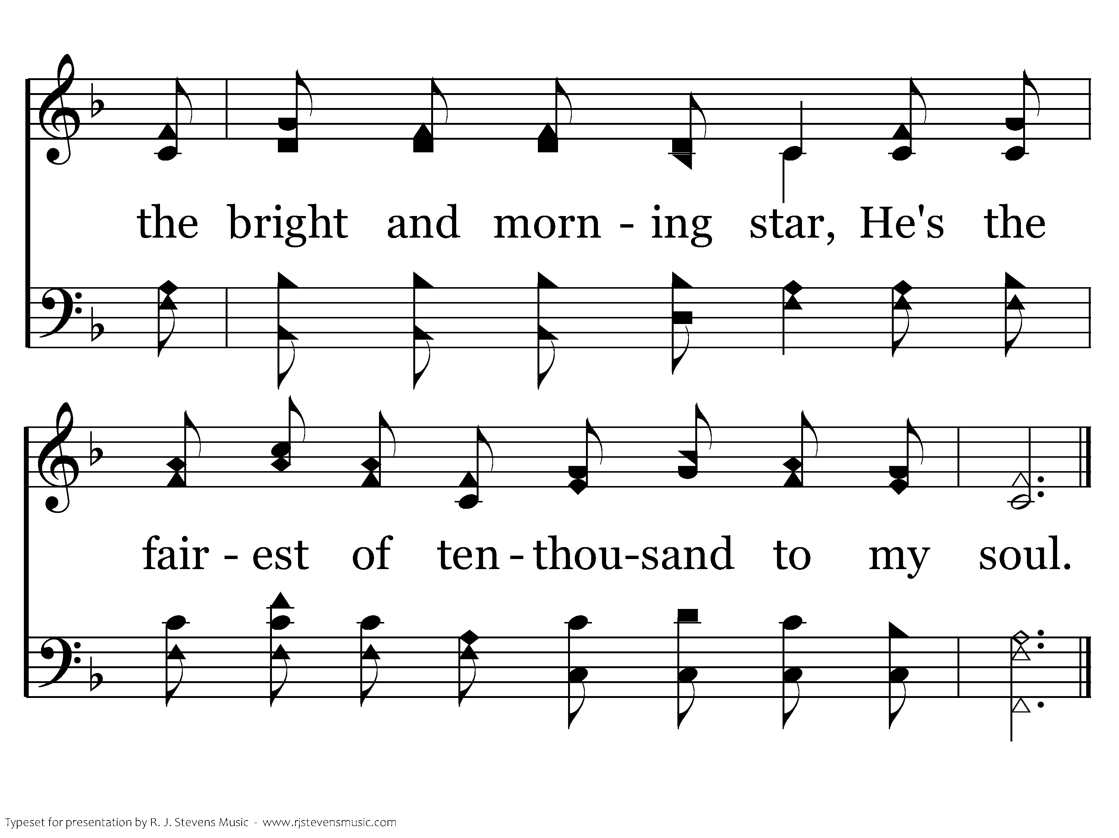
594 - The Lily Of The Valley - 1.6
End of Verse 1

Slide 10
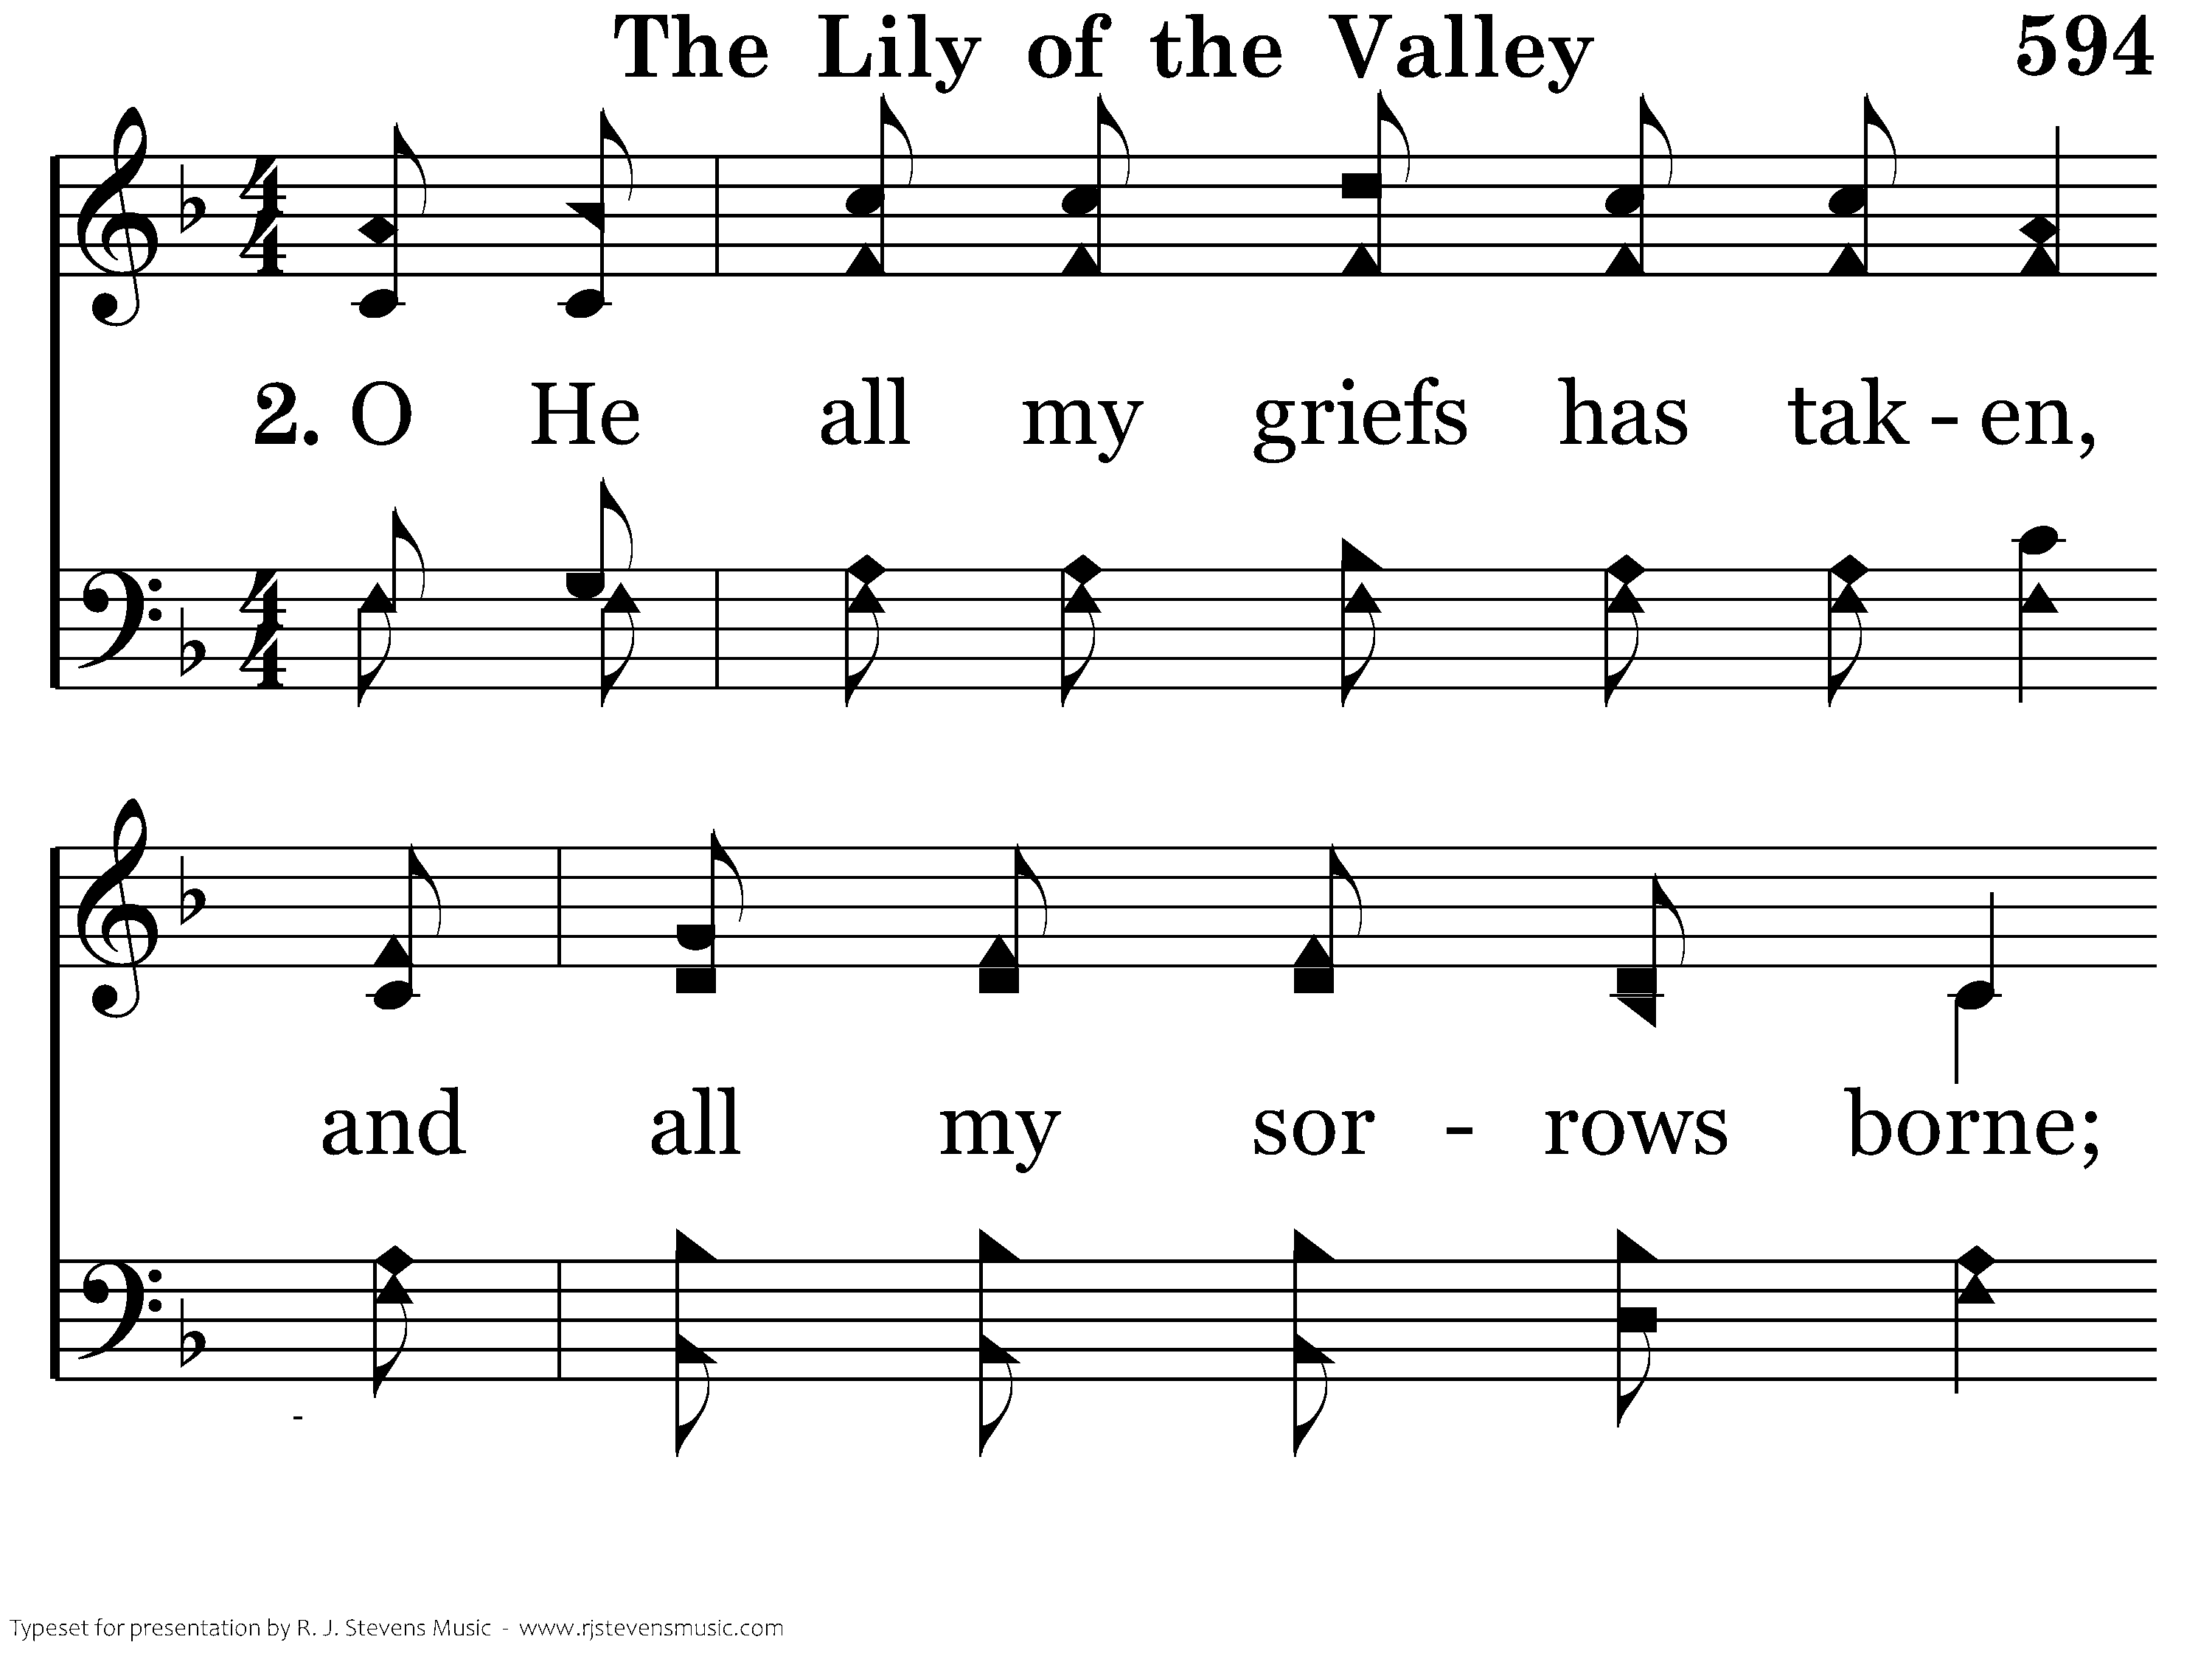
594 - The Lily Of The Valley - 2.1

Slide 11
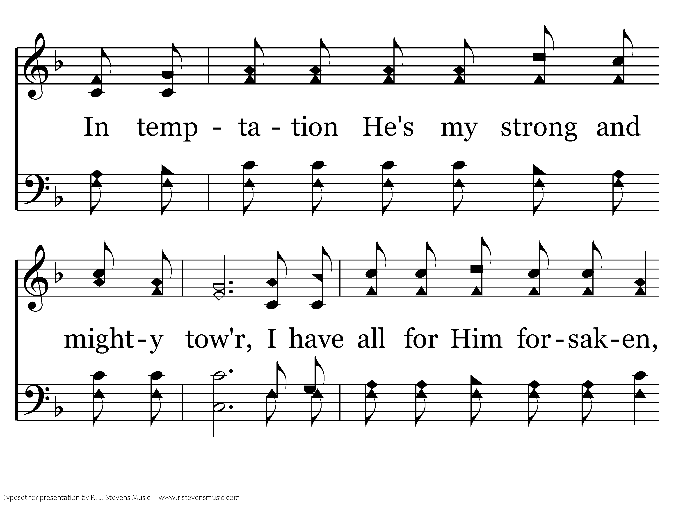
594 - The Lily Of The Valley - 2.2

Slide 12
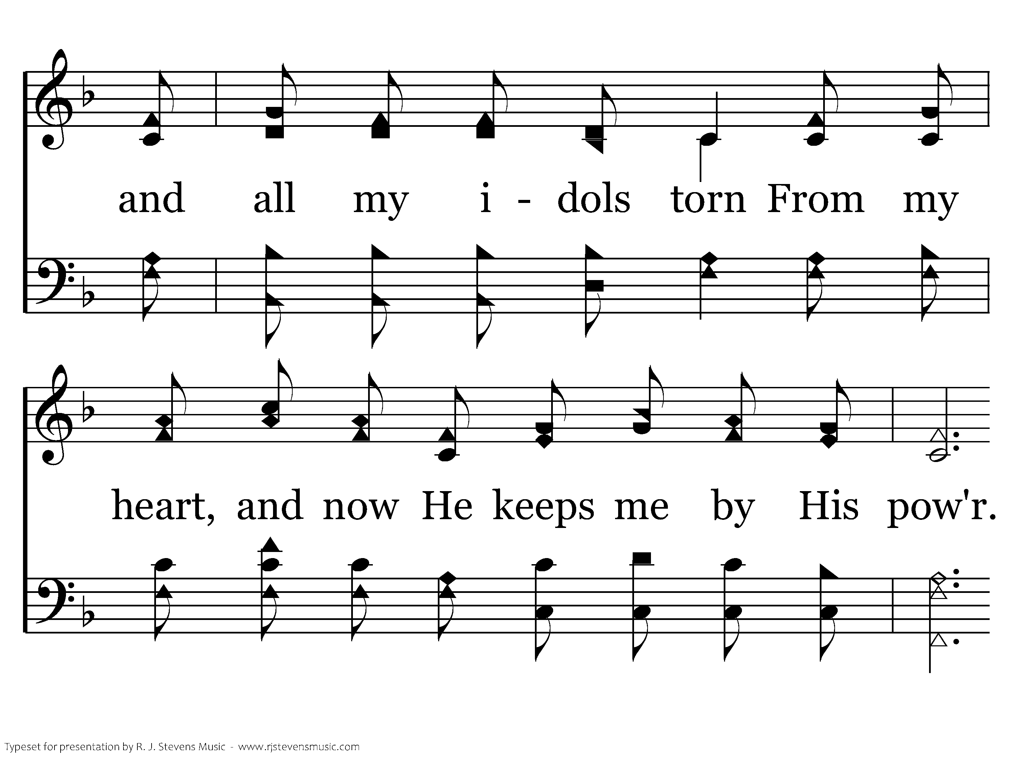
594 - The Lily Of The Valley - 2.3

Slide 13
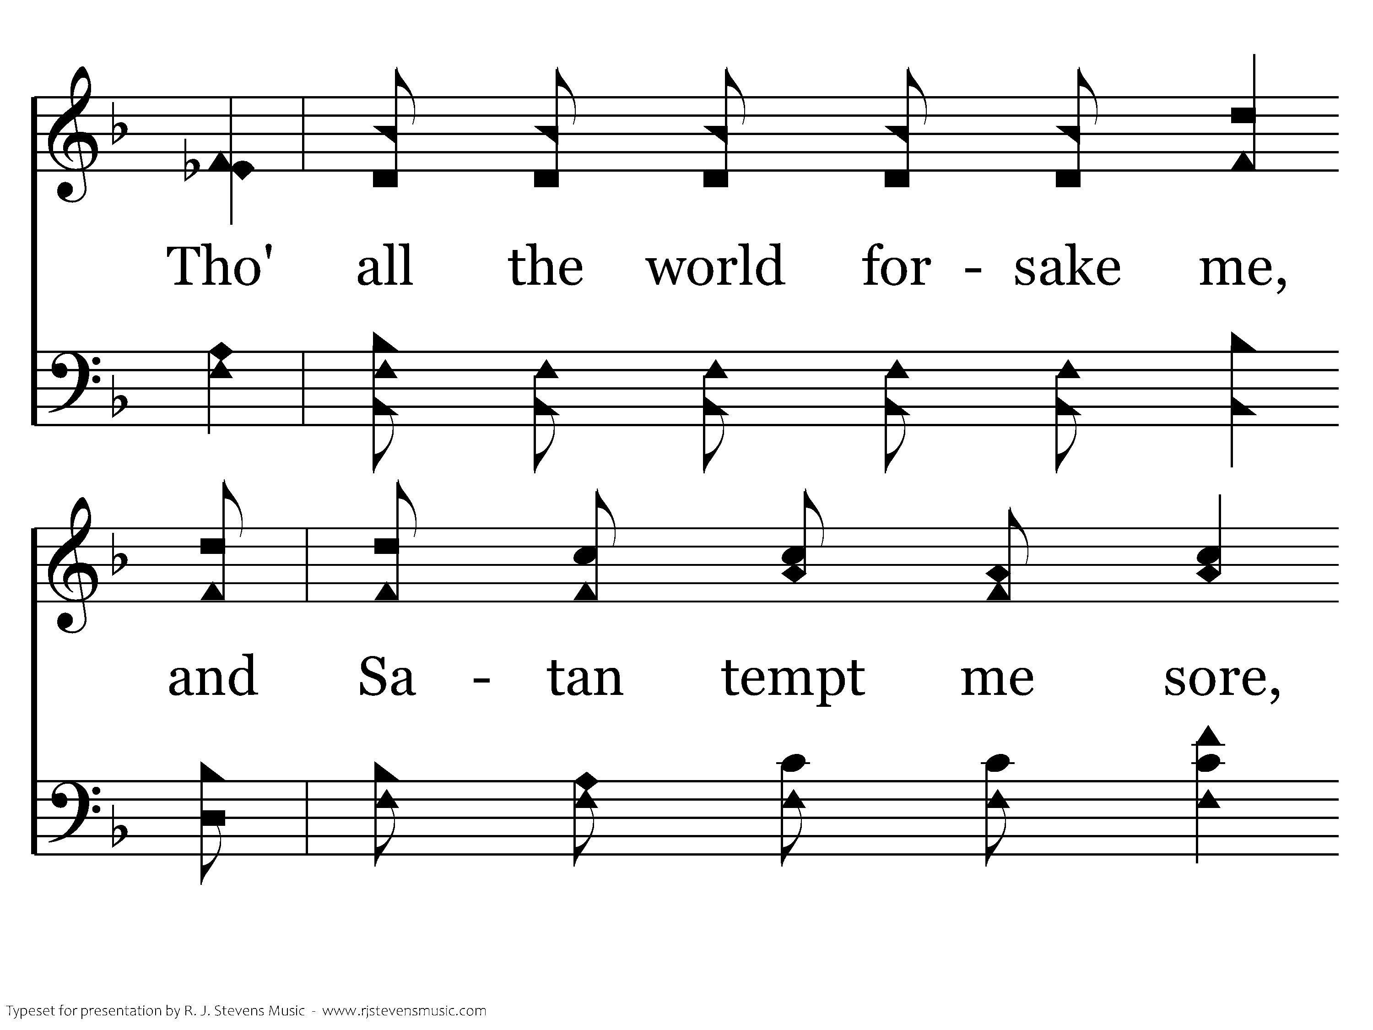
594 - The Lily Of The Valley - 2.4

Slide 14
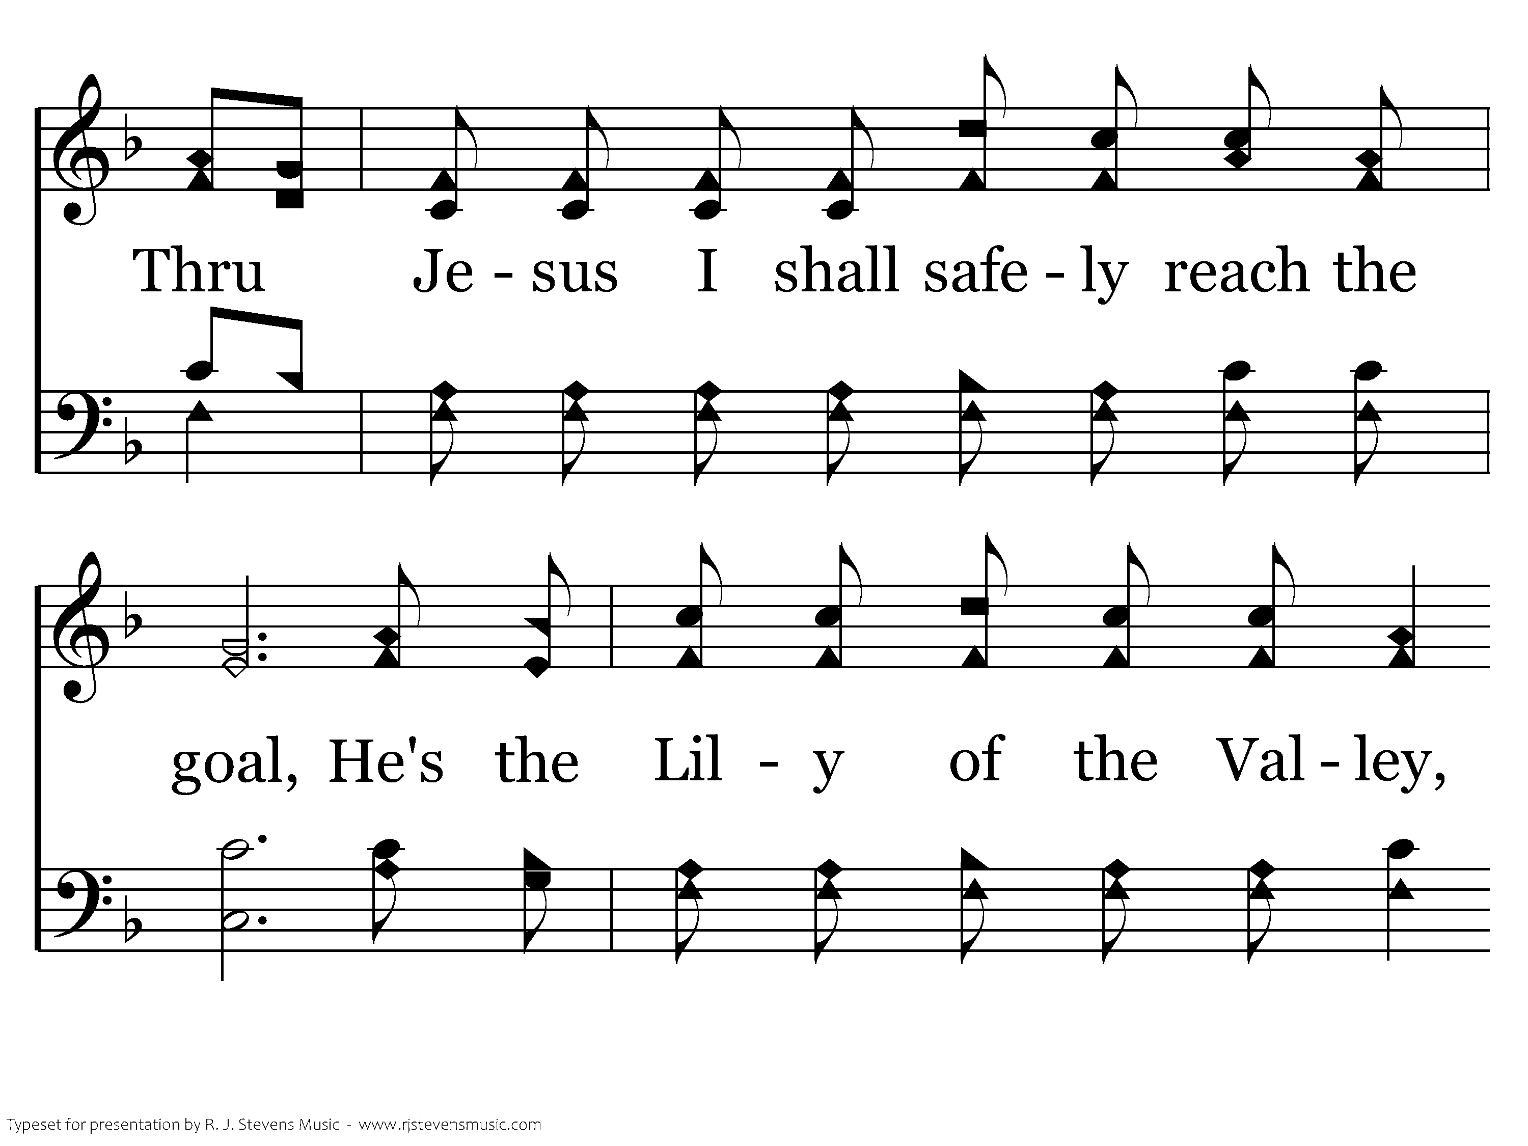
594 - The Lily Of The Valley - 2.5

Slide 15
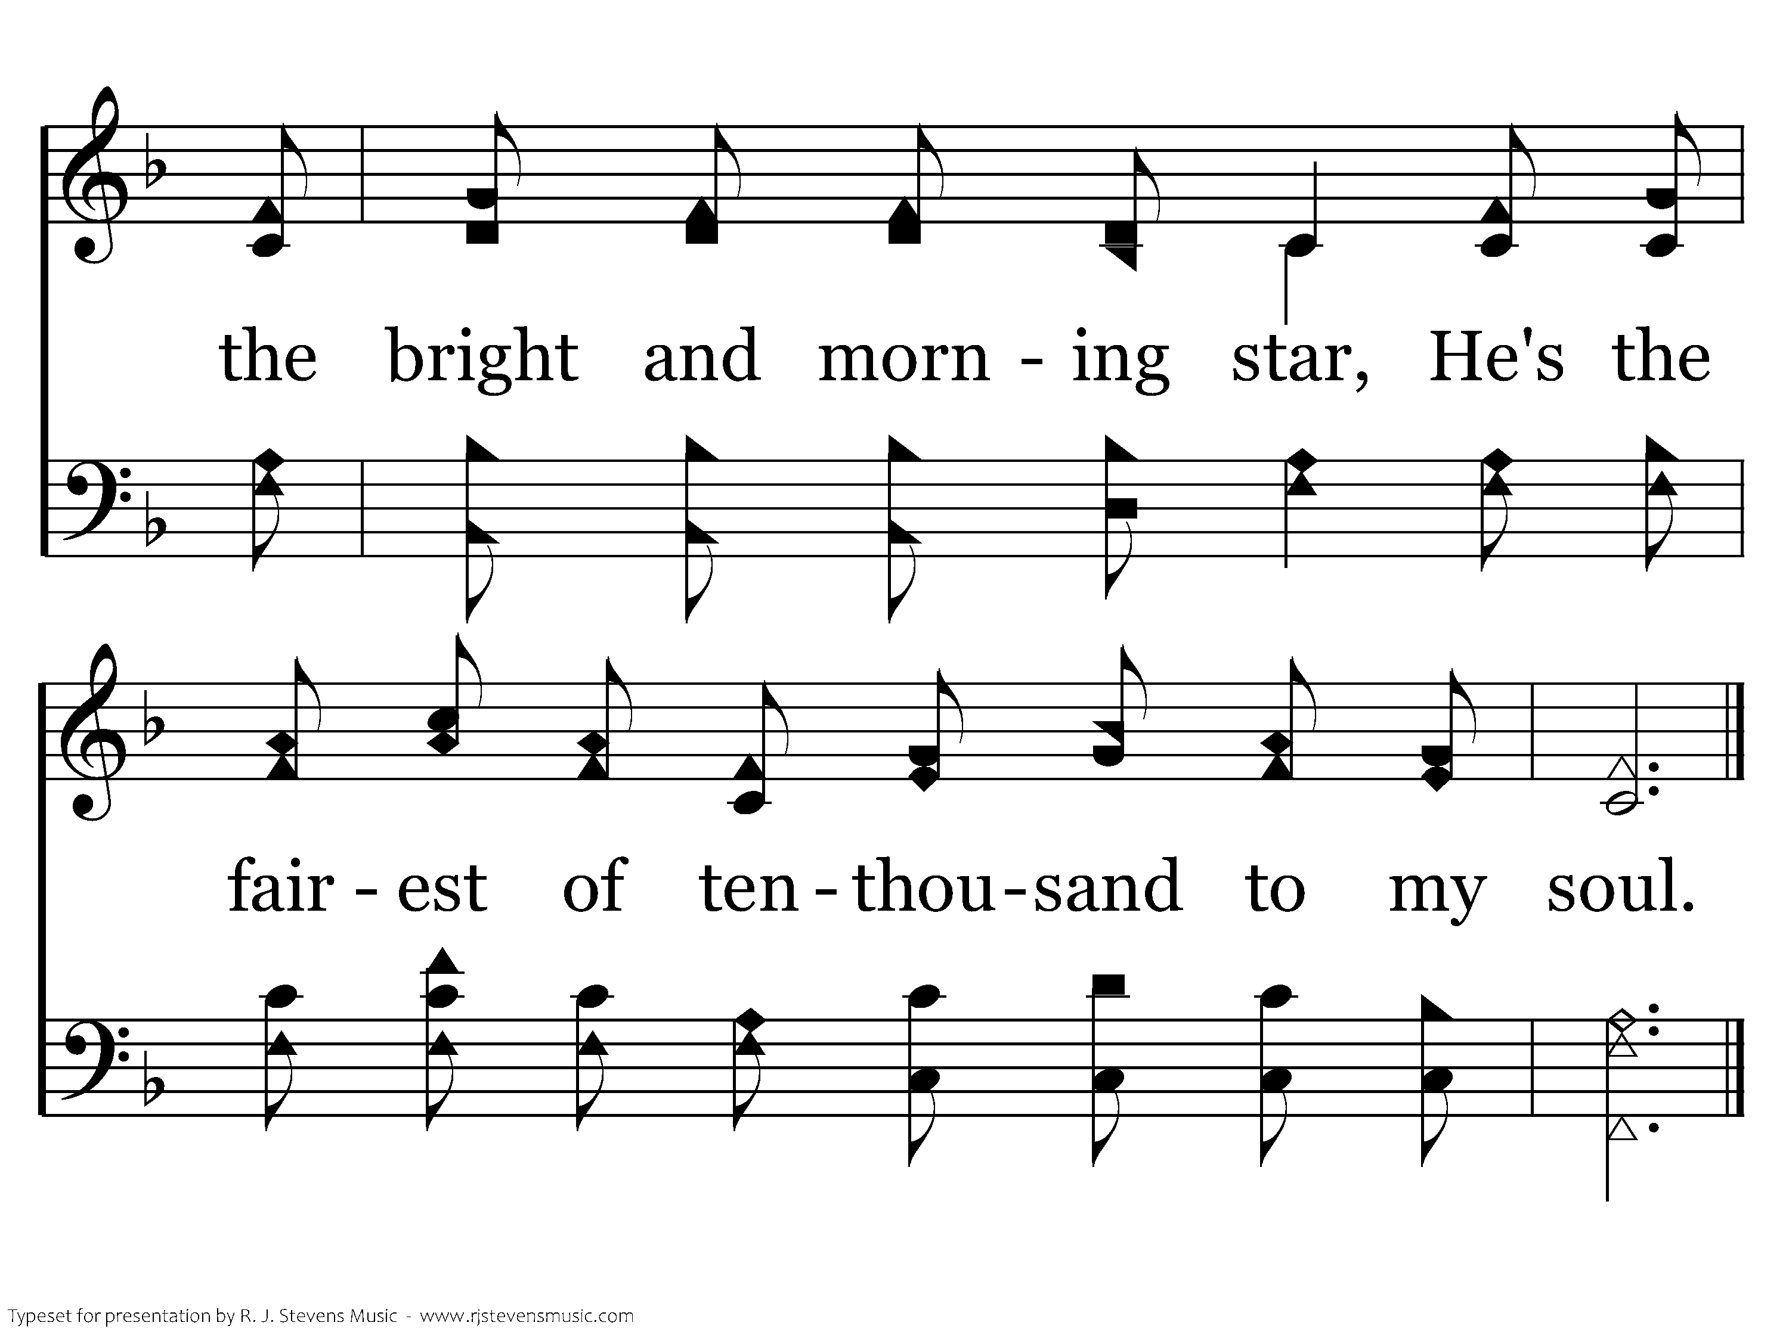
594 - The Lily Of The Valley - 2.6
End of Verse 2

Slide 16
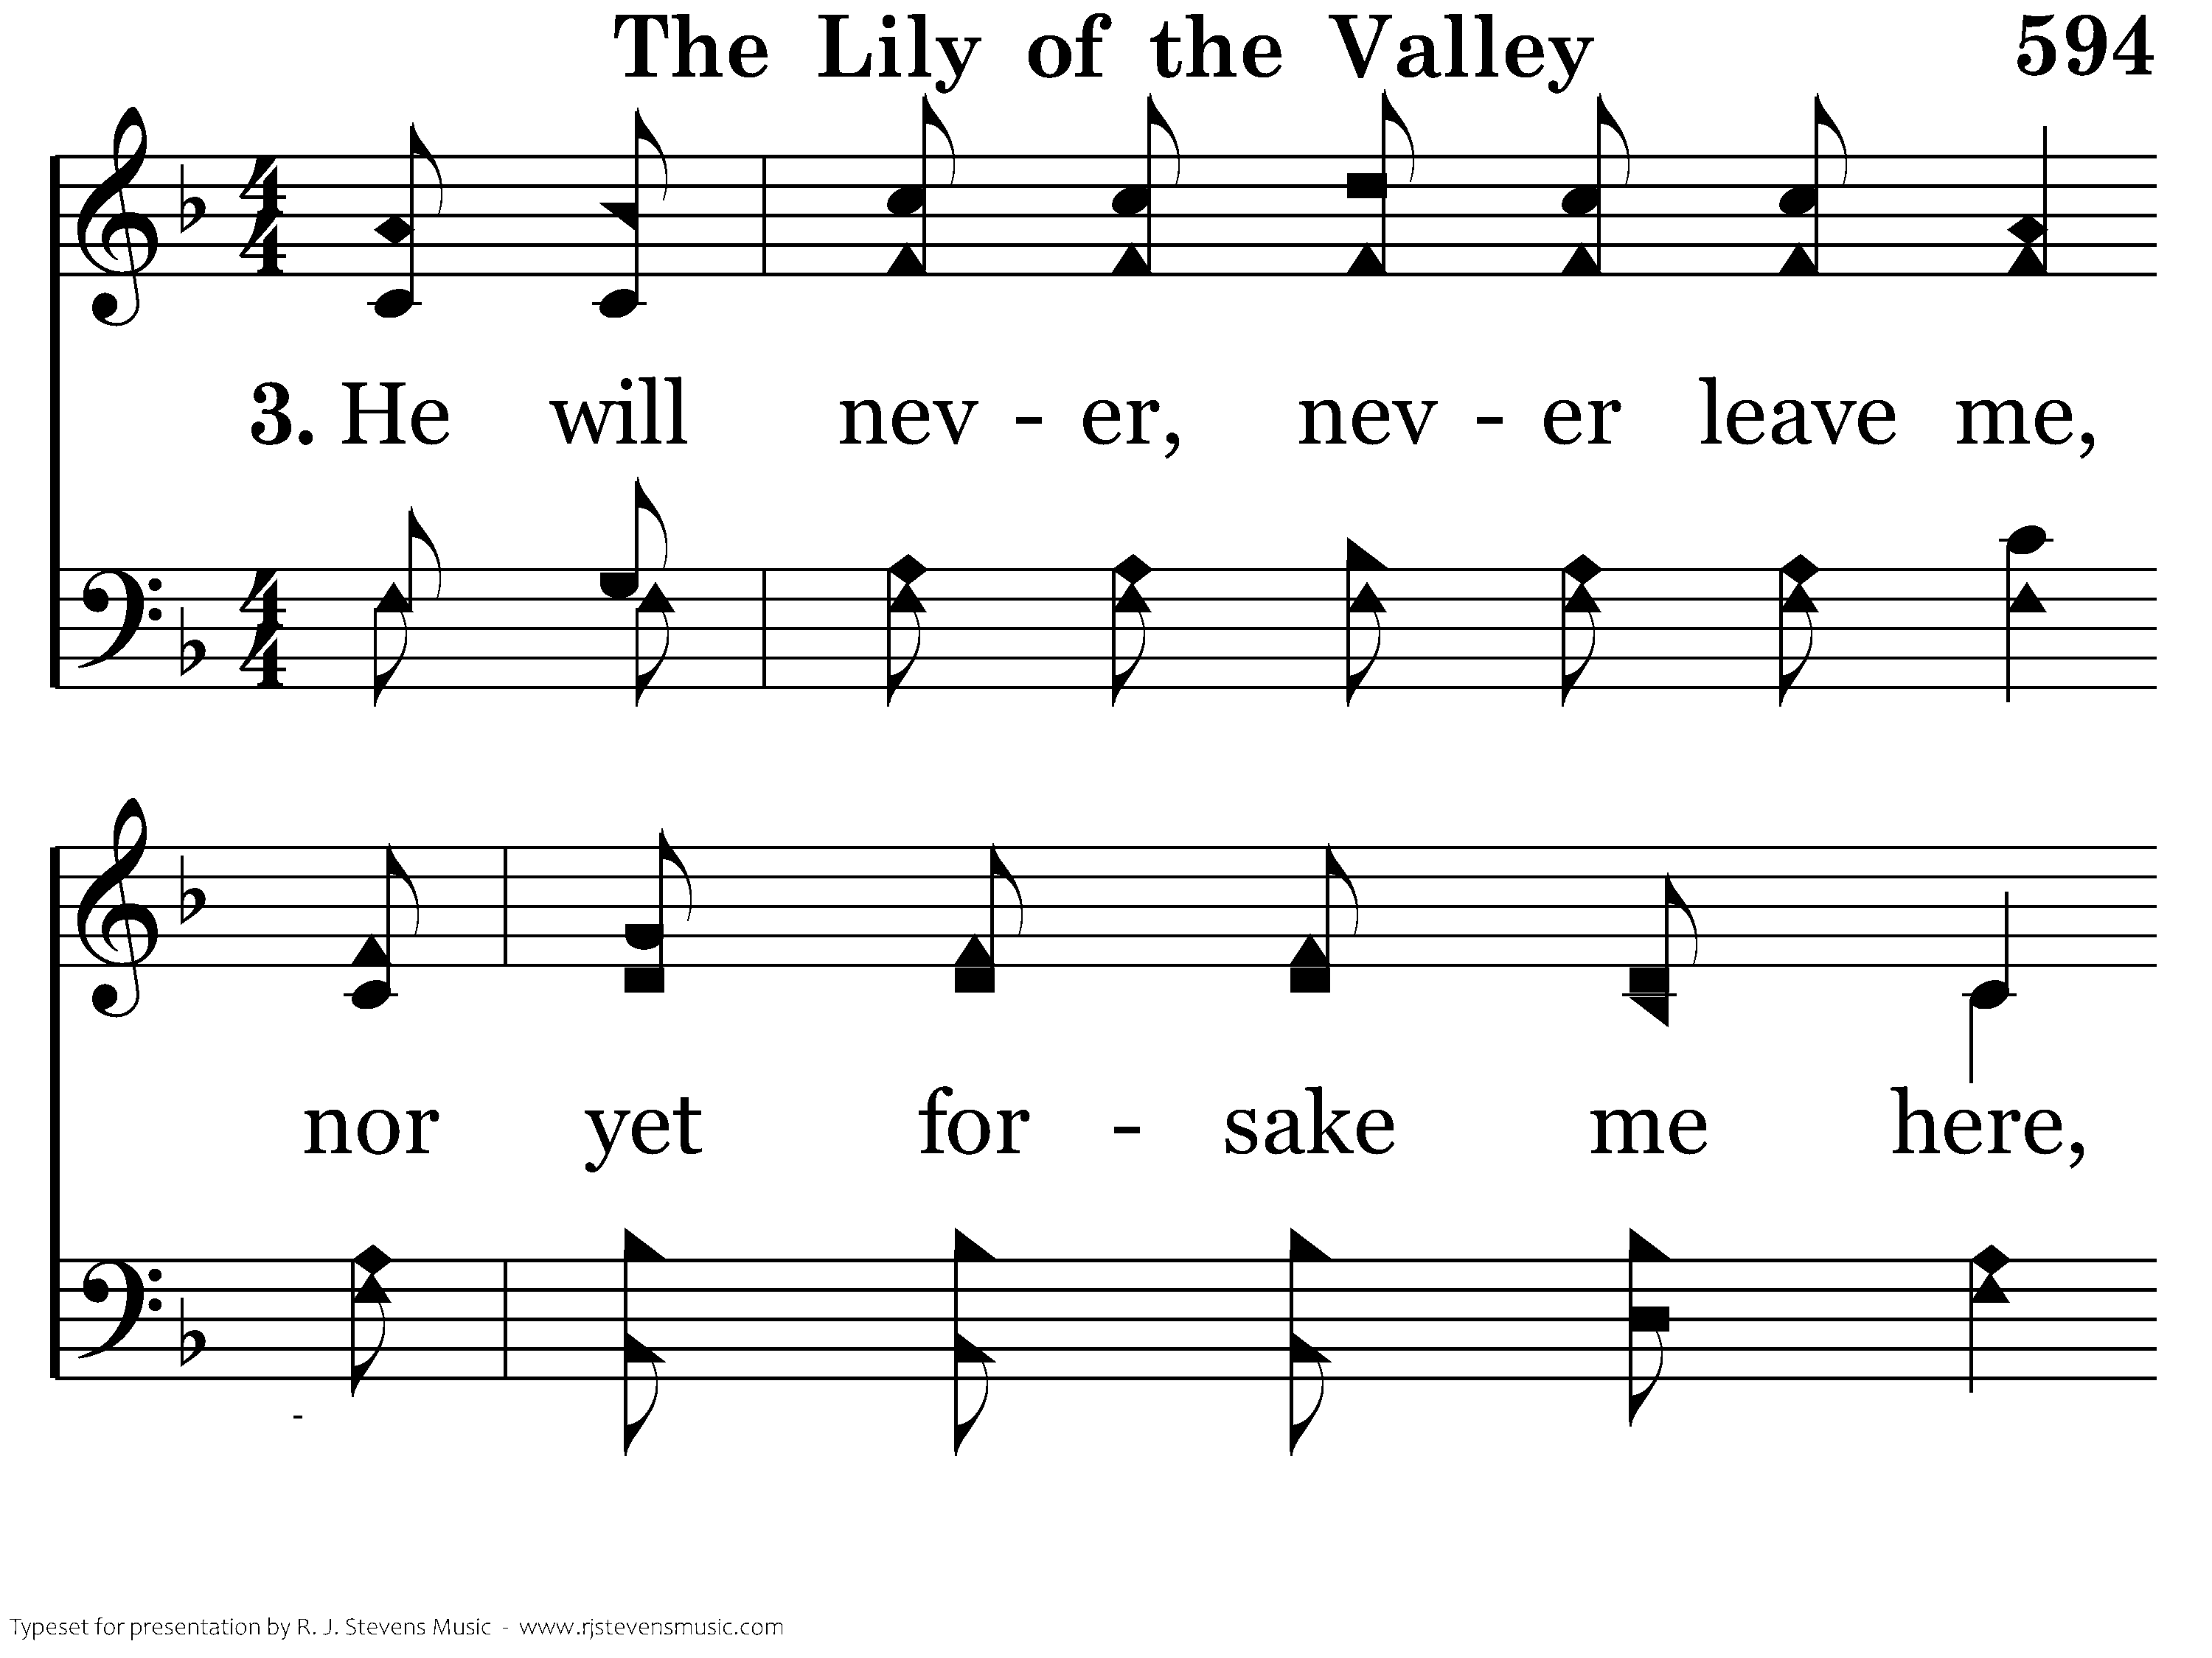
594 - The Lily Of The Valley - 3.1

Slide 17
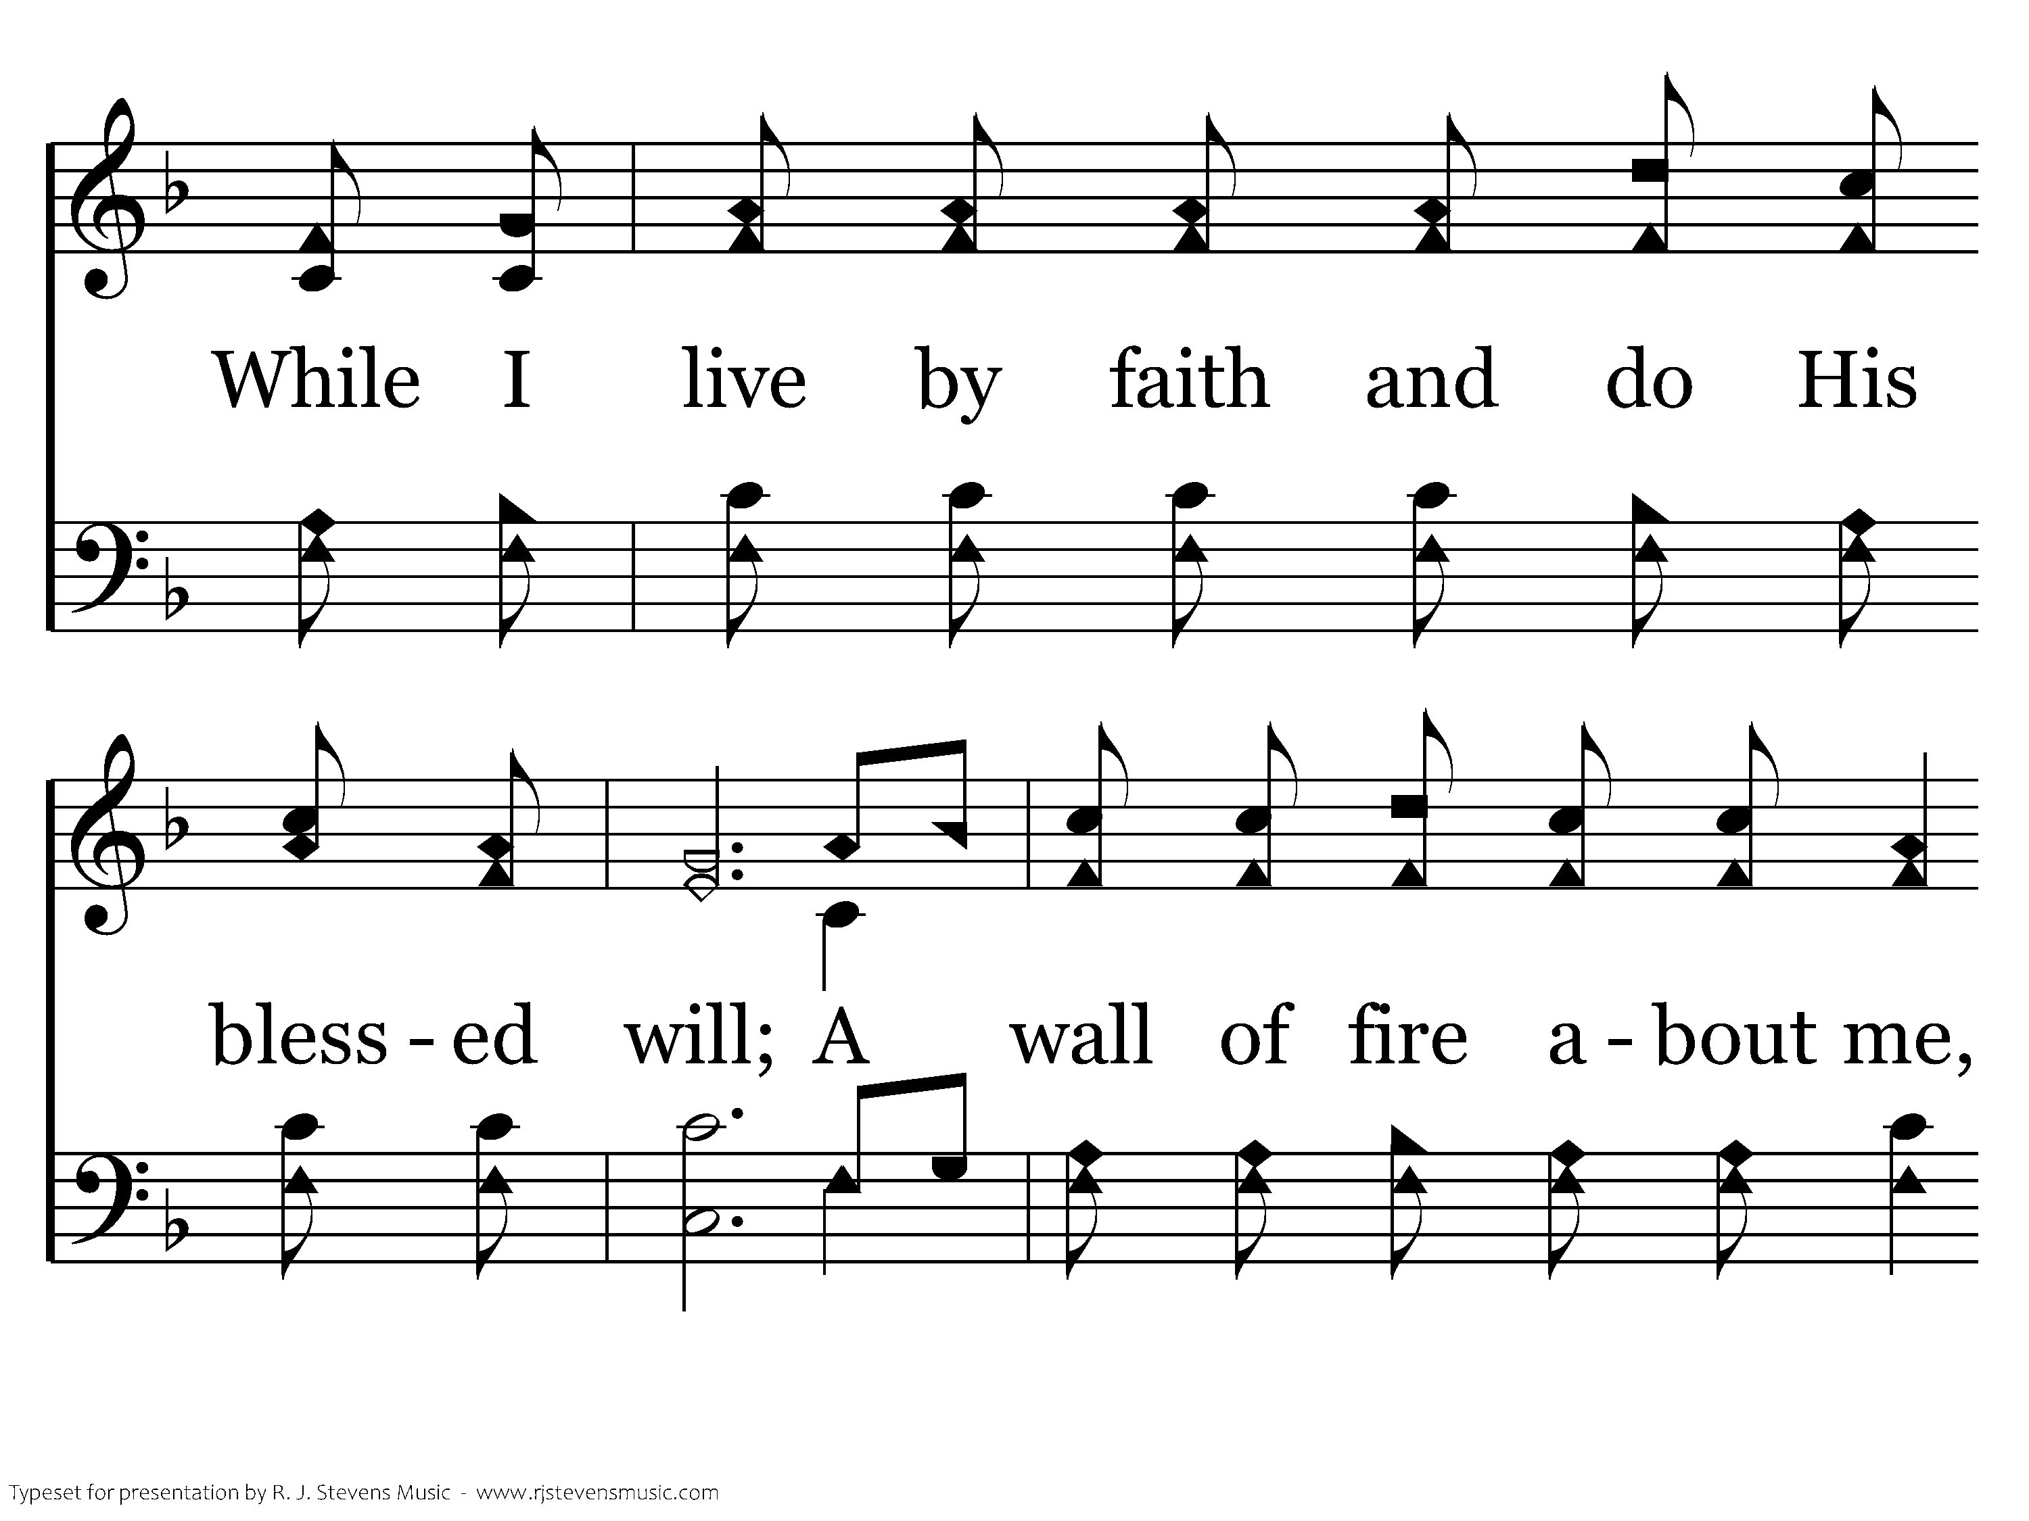
594 - The Lily Of The Valley - 3.2

Slide 18
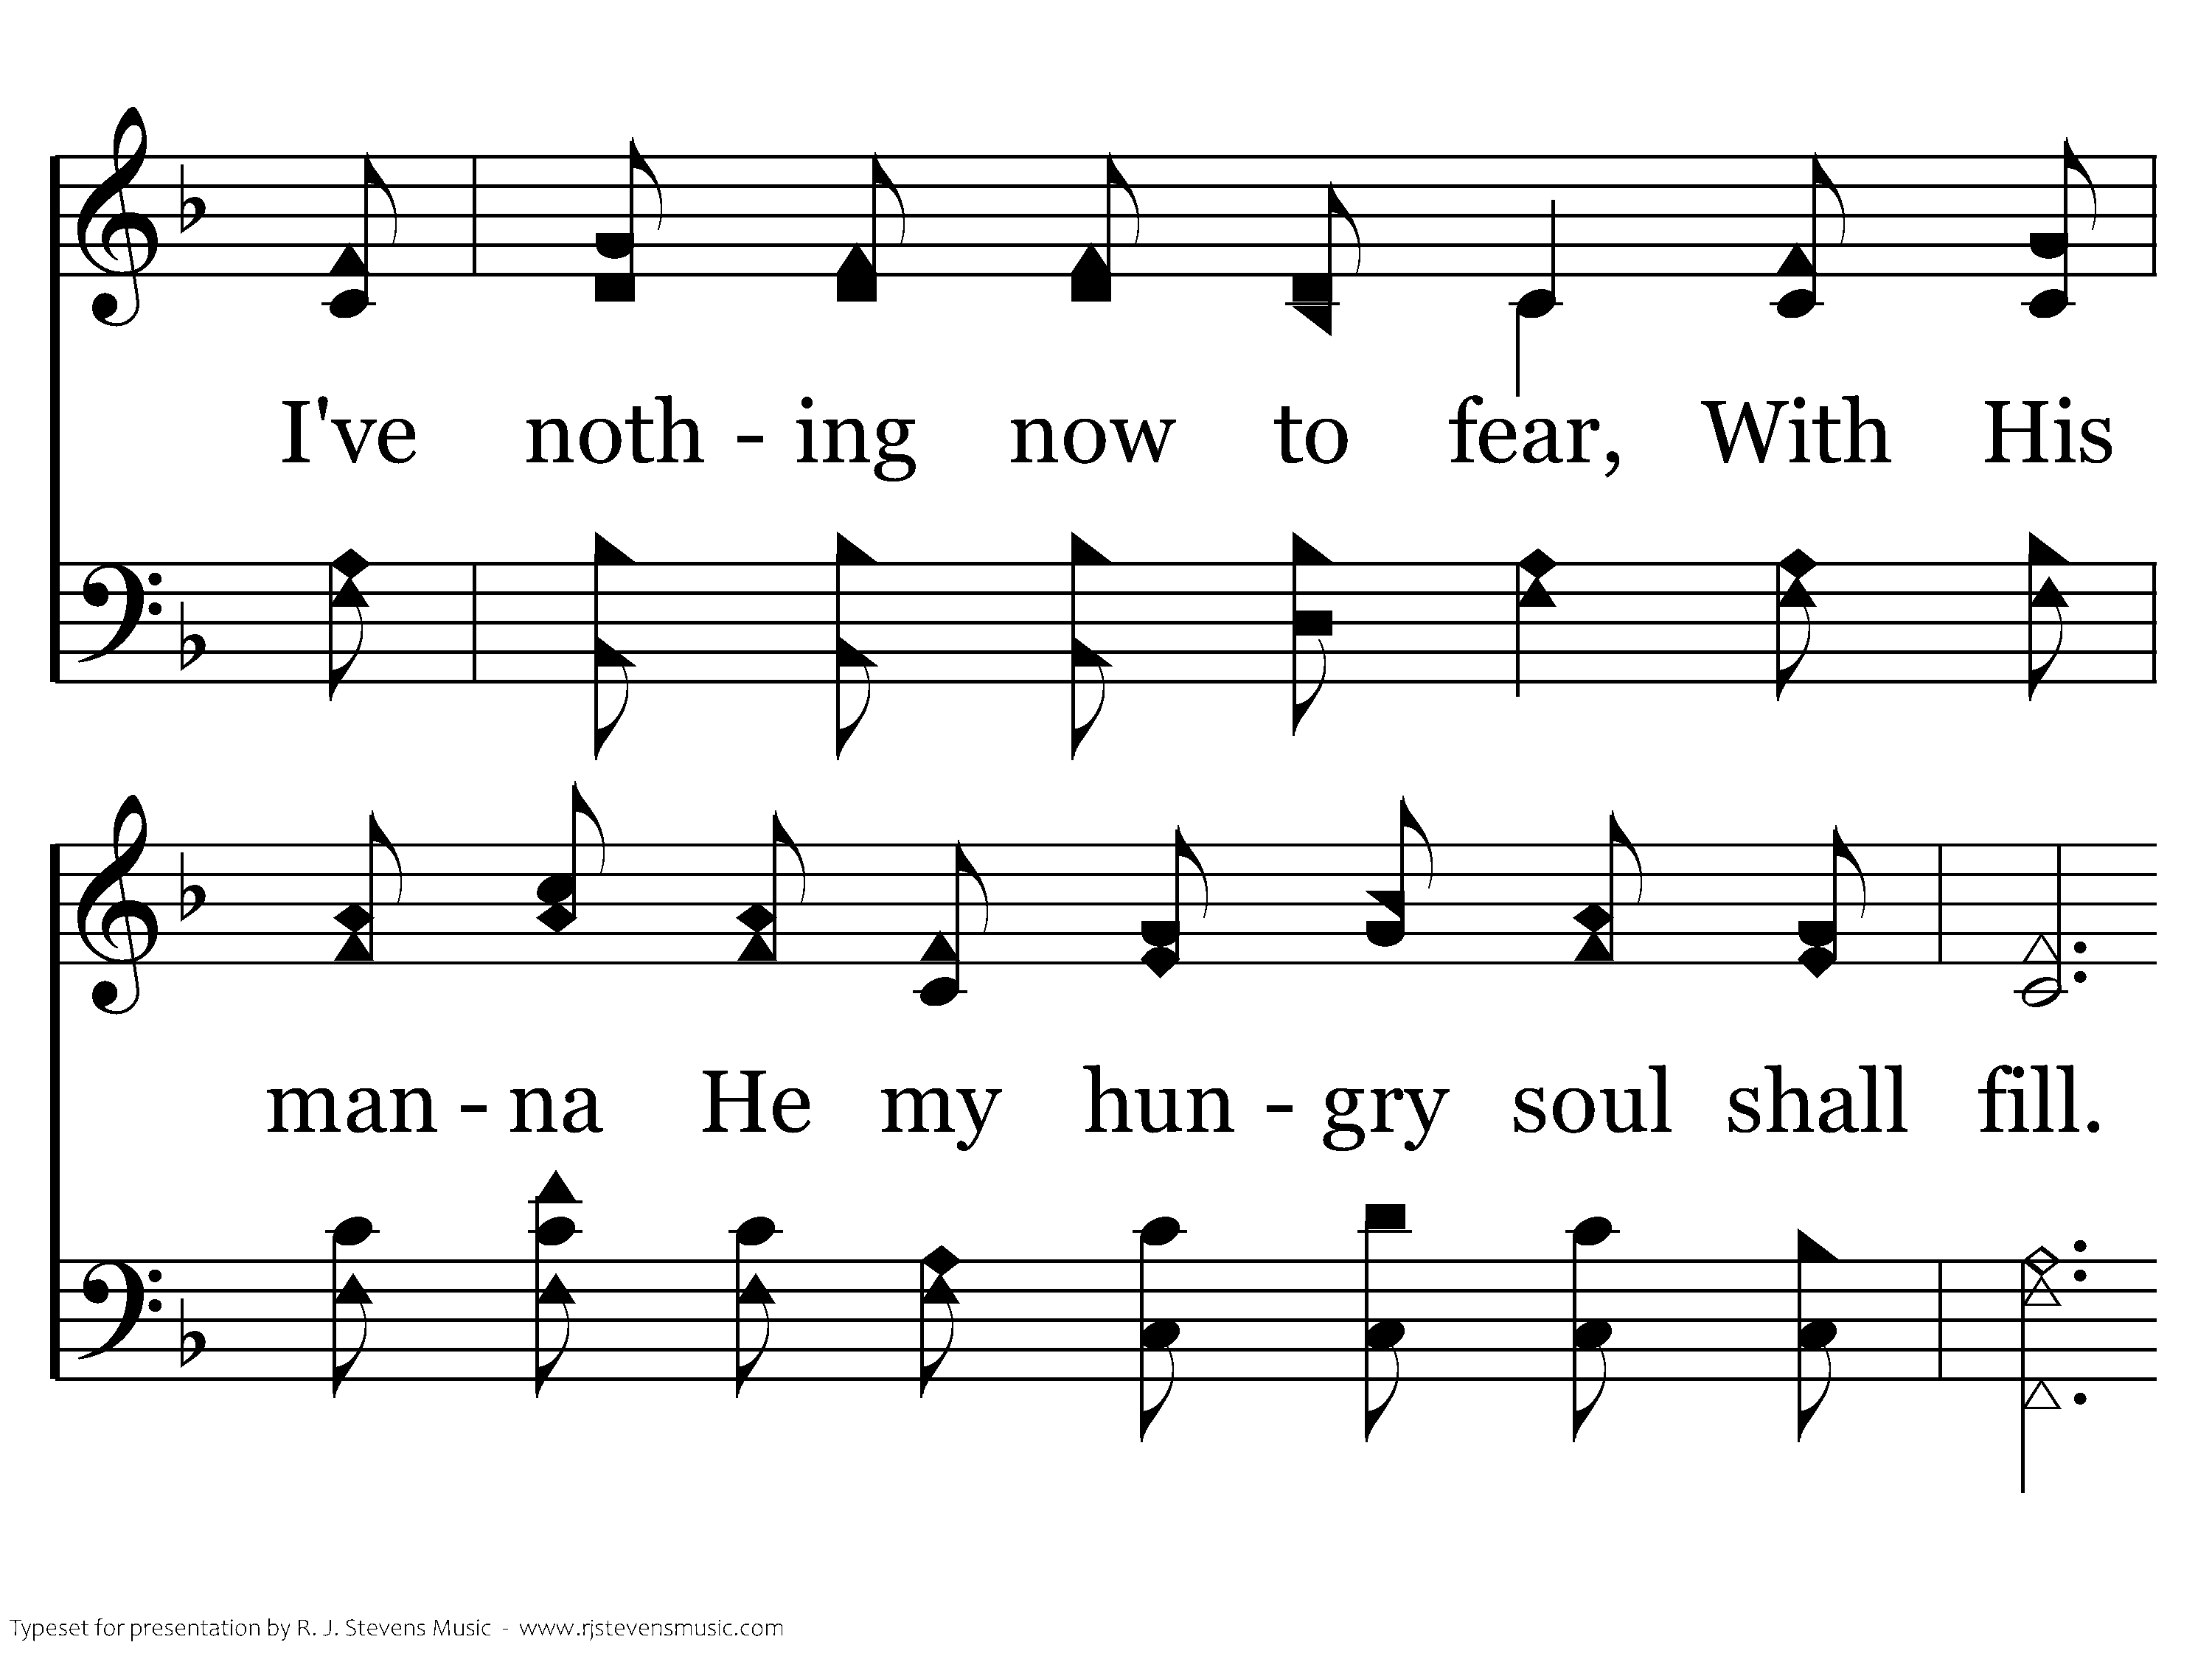
594 - The Lily Of The Valley - 3.3

Slide 19
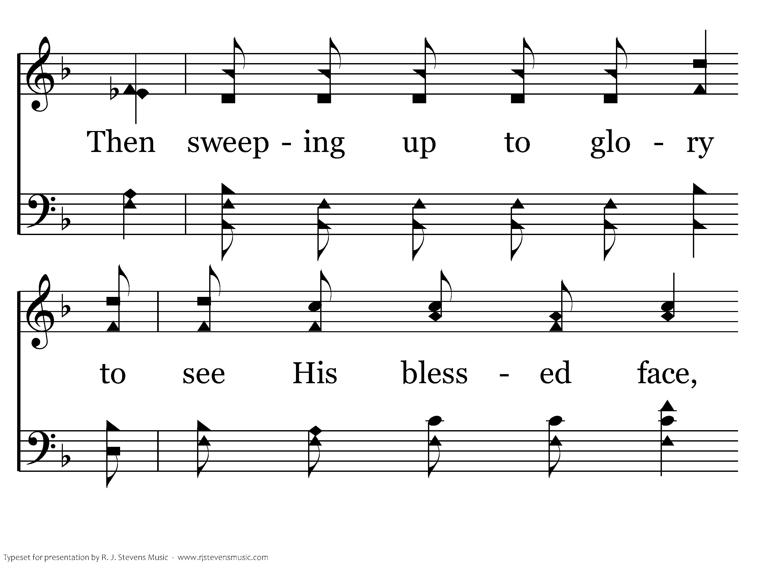
594 - The Lily Of The Valley - 3.4

Slide 20
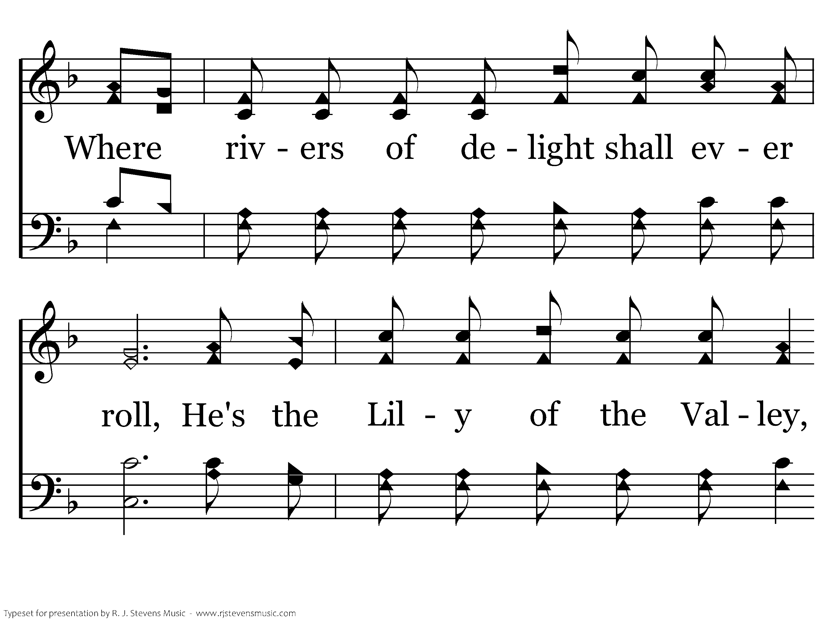
594 - The Lily Of The Valley - 3.5

Slide 21
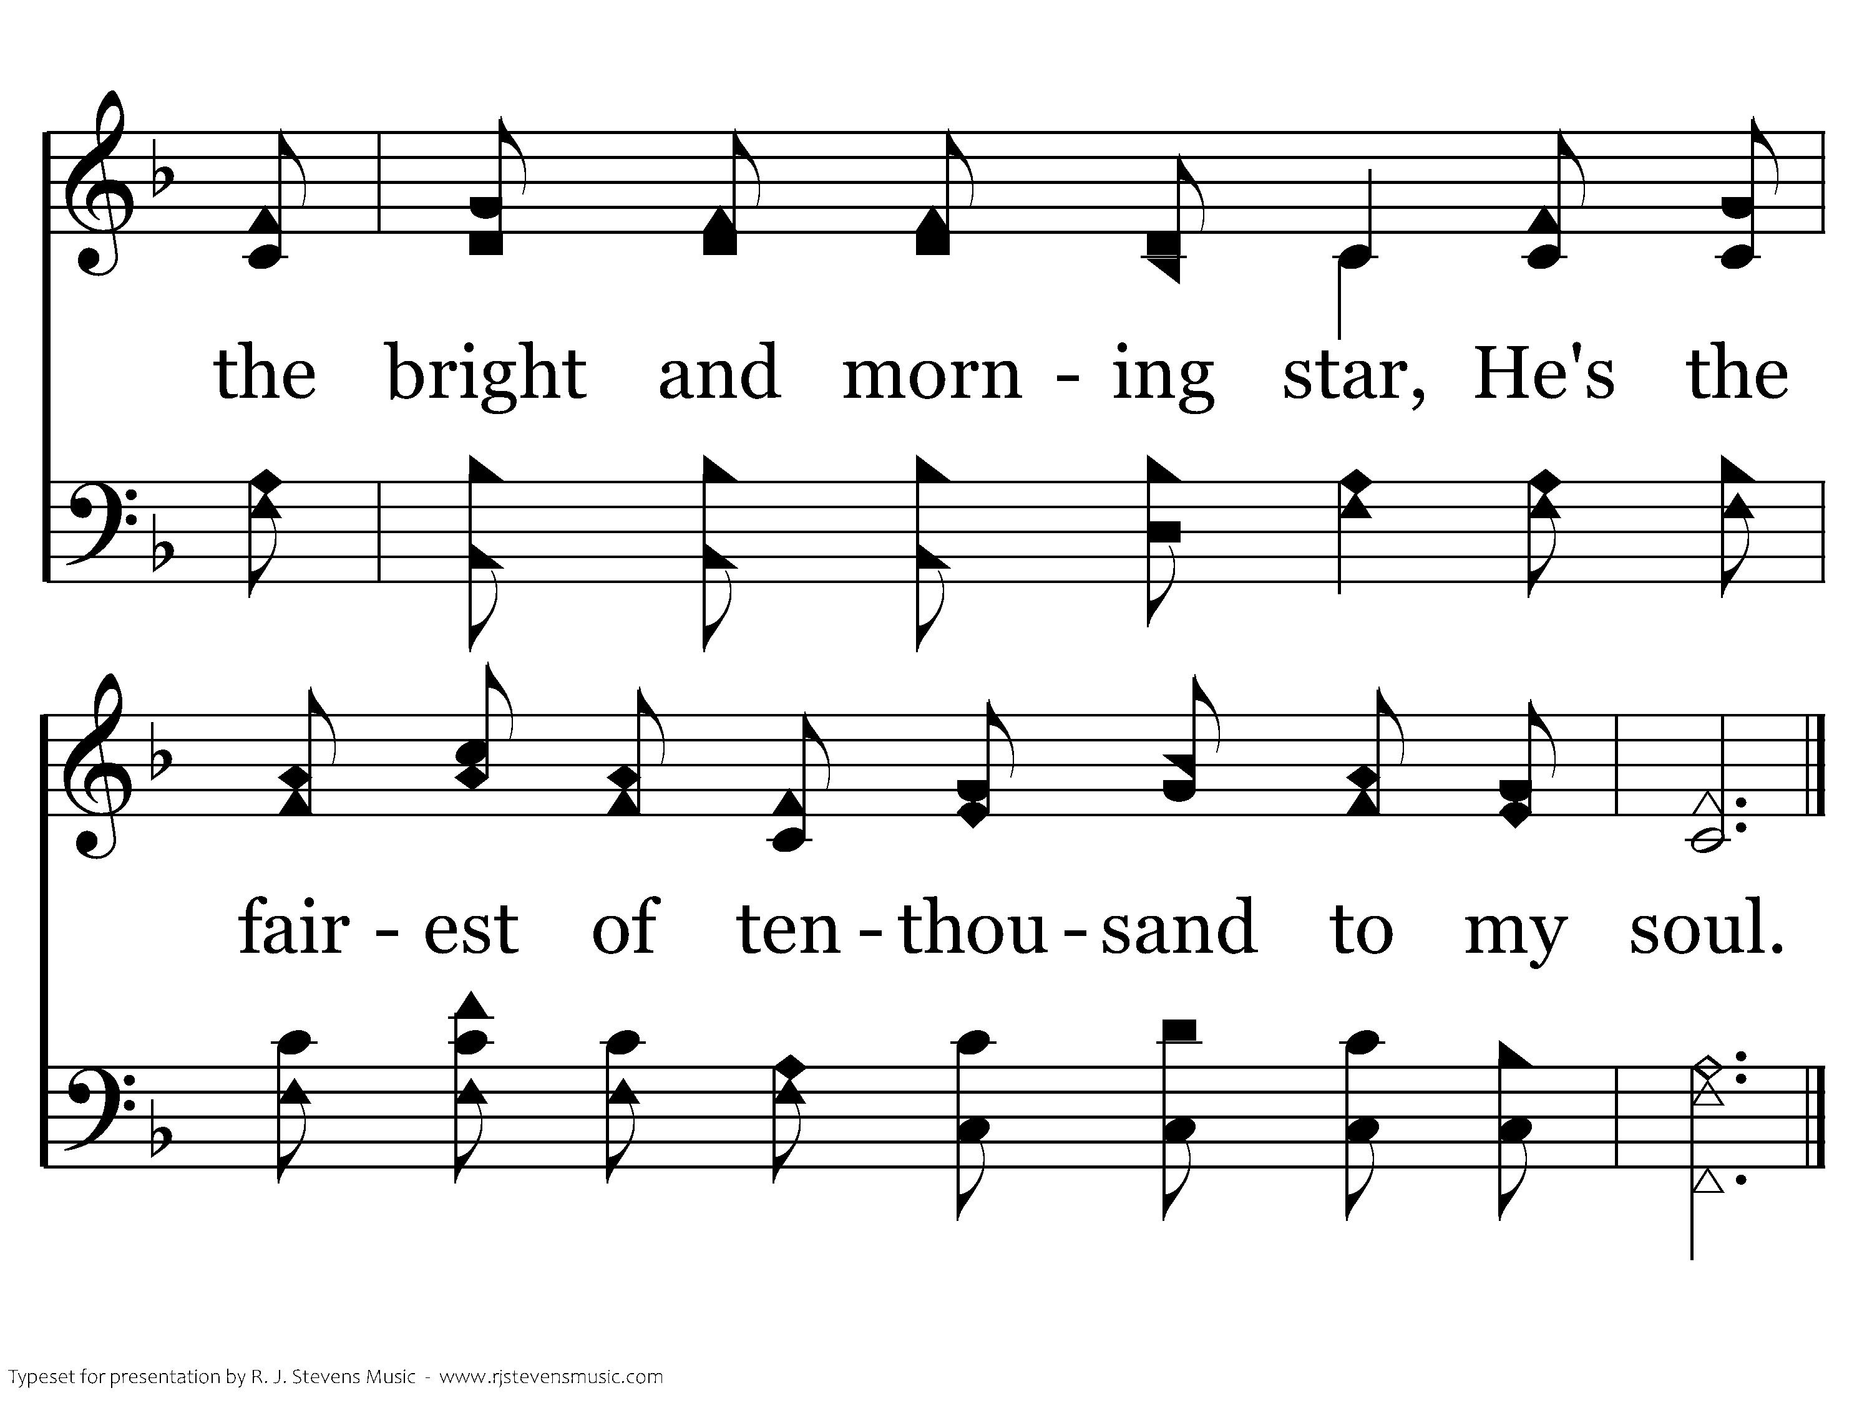
594 - The Lily Of The Valley - 3.6
End of Song

Slide 23
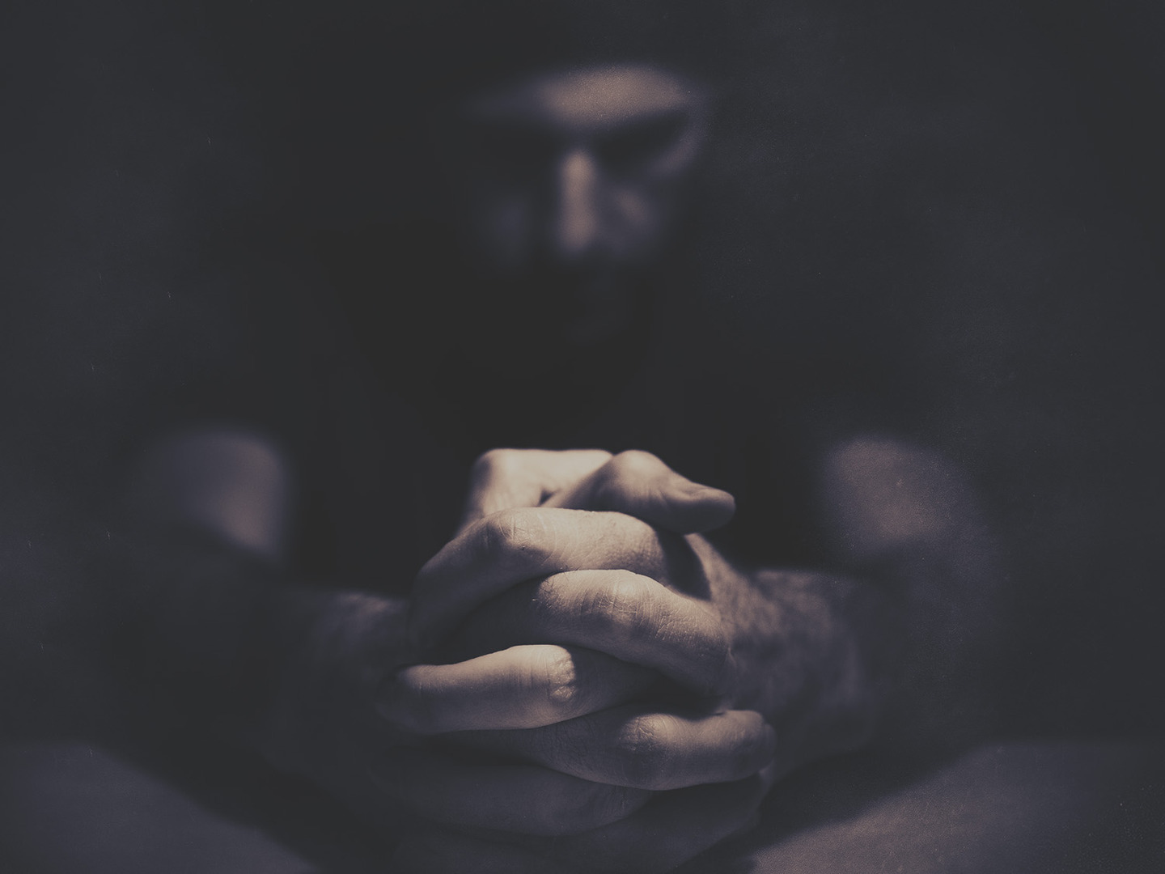
Kingdom-first
Praying

Slide 24

Kingdom-first Praying
We Need the
Father First

Slide 25
Kingdom-first Praying
The Struggle

Slide 26
Kingdom-first Praying
Casting all your care upon Him, for He cares for you.
1 Peter 5:7 (NKJV)
The Struggle

Slide 27
Kingdom-first Praying
The Struggle

Slide 28
Kingdom-first Praying
The Cop-out

Slide 29
Kingdom-first Praying
Now is my soul troubled. And what shall I say? “Father, save me from this hour”? But for this purpose I have come to this hour. Father, glorify your name.
John 12:27-28 (ESV)
The Cop-out

Slide 30
You’ve known the frustration, I’m sure, in the experiences of human friendship and love, of saying to someone, “I just wish I could find the words to tell you what you mean to me” or “what our friendship means to me.” So it is that the psalmist wants a “new song.” And his exuberance is such that he calls on everyone else to join his choir: “all the earth,” “all the peoples.”
J. Ellsworth Kalas, Longing to Pray

Slide 31
But our wonderful spiritual ancestor doesn’t say, as we might, “I can’t find the words to express what I feel.” He would see this, I think, as an unholy cop-out. So he launches into rolling phrases of praise, making us the richer for it.
J. Ellsworth Kalas, Longing to Pray

Slide 32
Kingdom-first Praying
Likewise the Spirit helps us in our weakness. For we do not know what to pray for as we ought, but the Spirit himself intercedes for us with groanings too deep for words.
Romans 8:26 (ESV)
The Cop-out

Slide 33
Kingdom-first Praying
Three Keys

Slide 34
Kingdom-first Praying
Our Father in heaven, hallowed be your name. Your kingdom come, your will be done, on earth as it is in heaven.
Give us this day our daily bread, and forgive us our debts, as we also have forgiven our debtors. And lead us not into temptation, but deliver us from evil.
Matthew 6:9-13 (ESV)
Key #1

Slide 35
Kingdom-first Praying
Give God a reason to respond
Key #1

Slide 36
Kingdom-first Praying
If you abide in me, and my words abide in you, ask whatever you wish, and it will be done for you.
John 15:7 (ESV)
Key #2

Slide 37
Kingdom-first Praying
Abide in God’s word and pray for whatever you want
Key #2

Slide 38
Kingdom-first Praying
My Father, if it be possible, let this cup pass from me; nevertheless, not as I will, but as you will.
Matthew 26:39 (ESV)
Key #3

Slide 39
Kingdom-first Praying
Want God’s will more than you want your own
Key #3

Slide 40
Kingdom-first Praying
Give God a Reason
To Respond

Slide 41
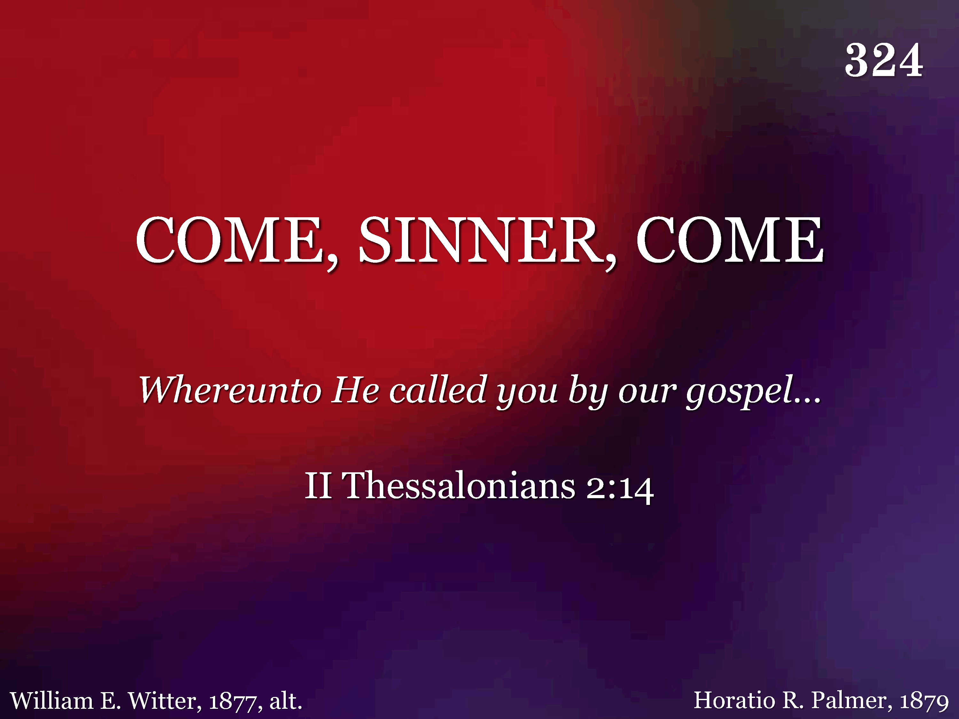
324 - Come, Sinner, Come - Title

Slide 42
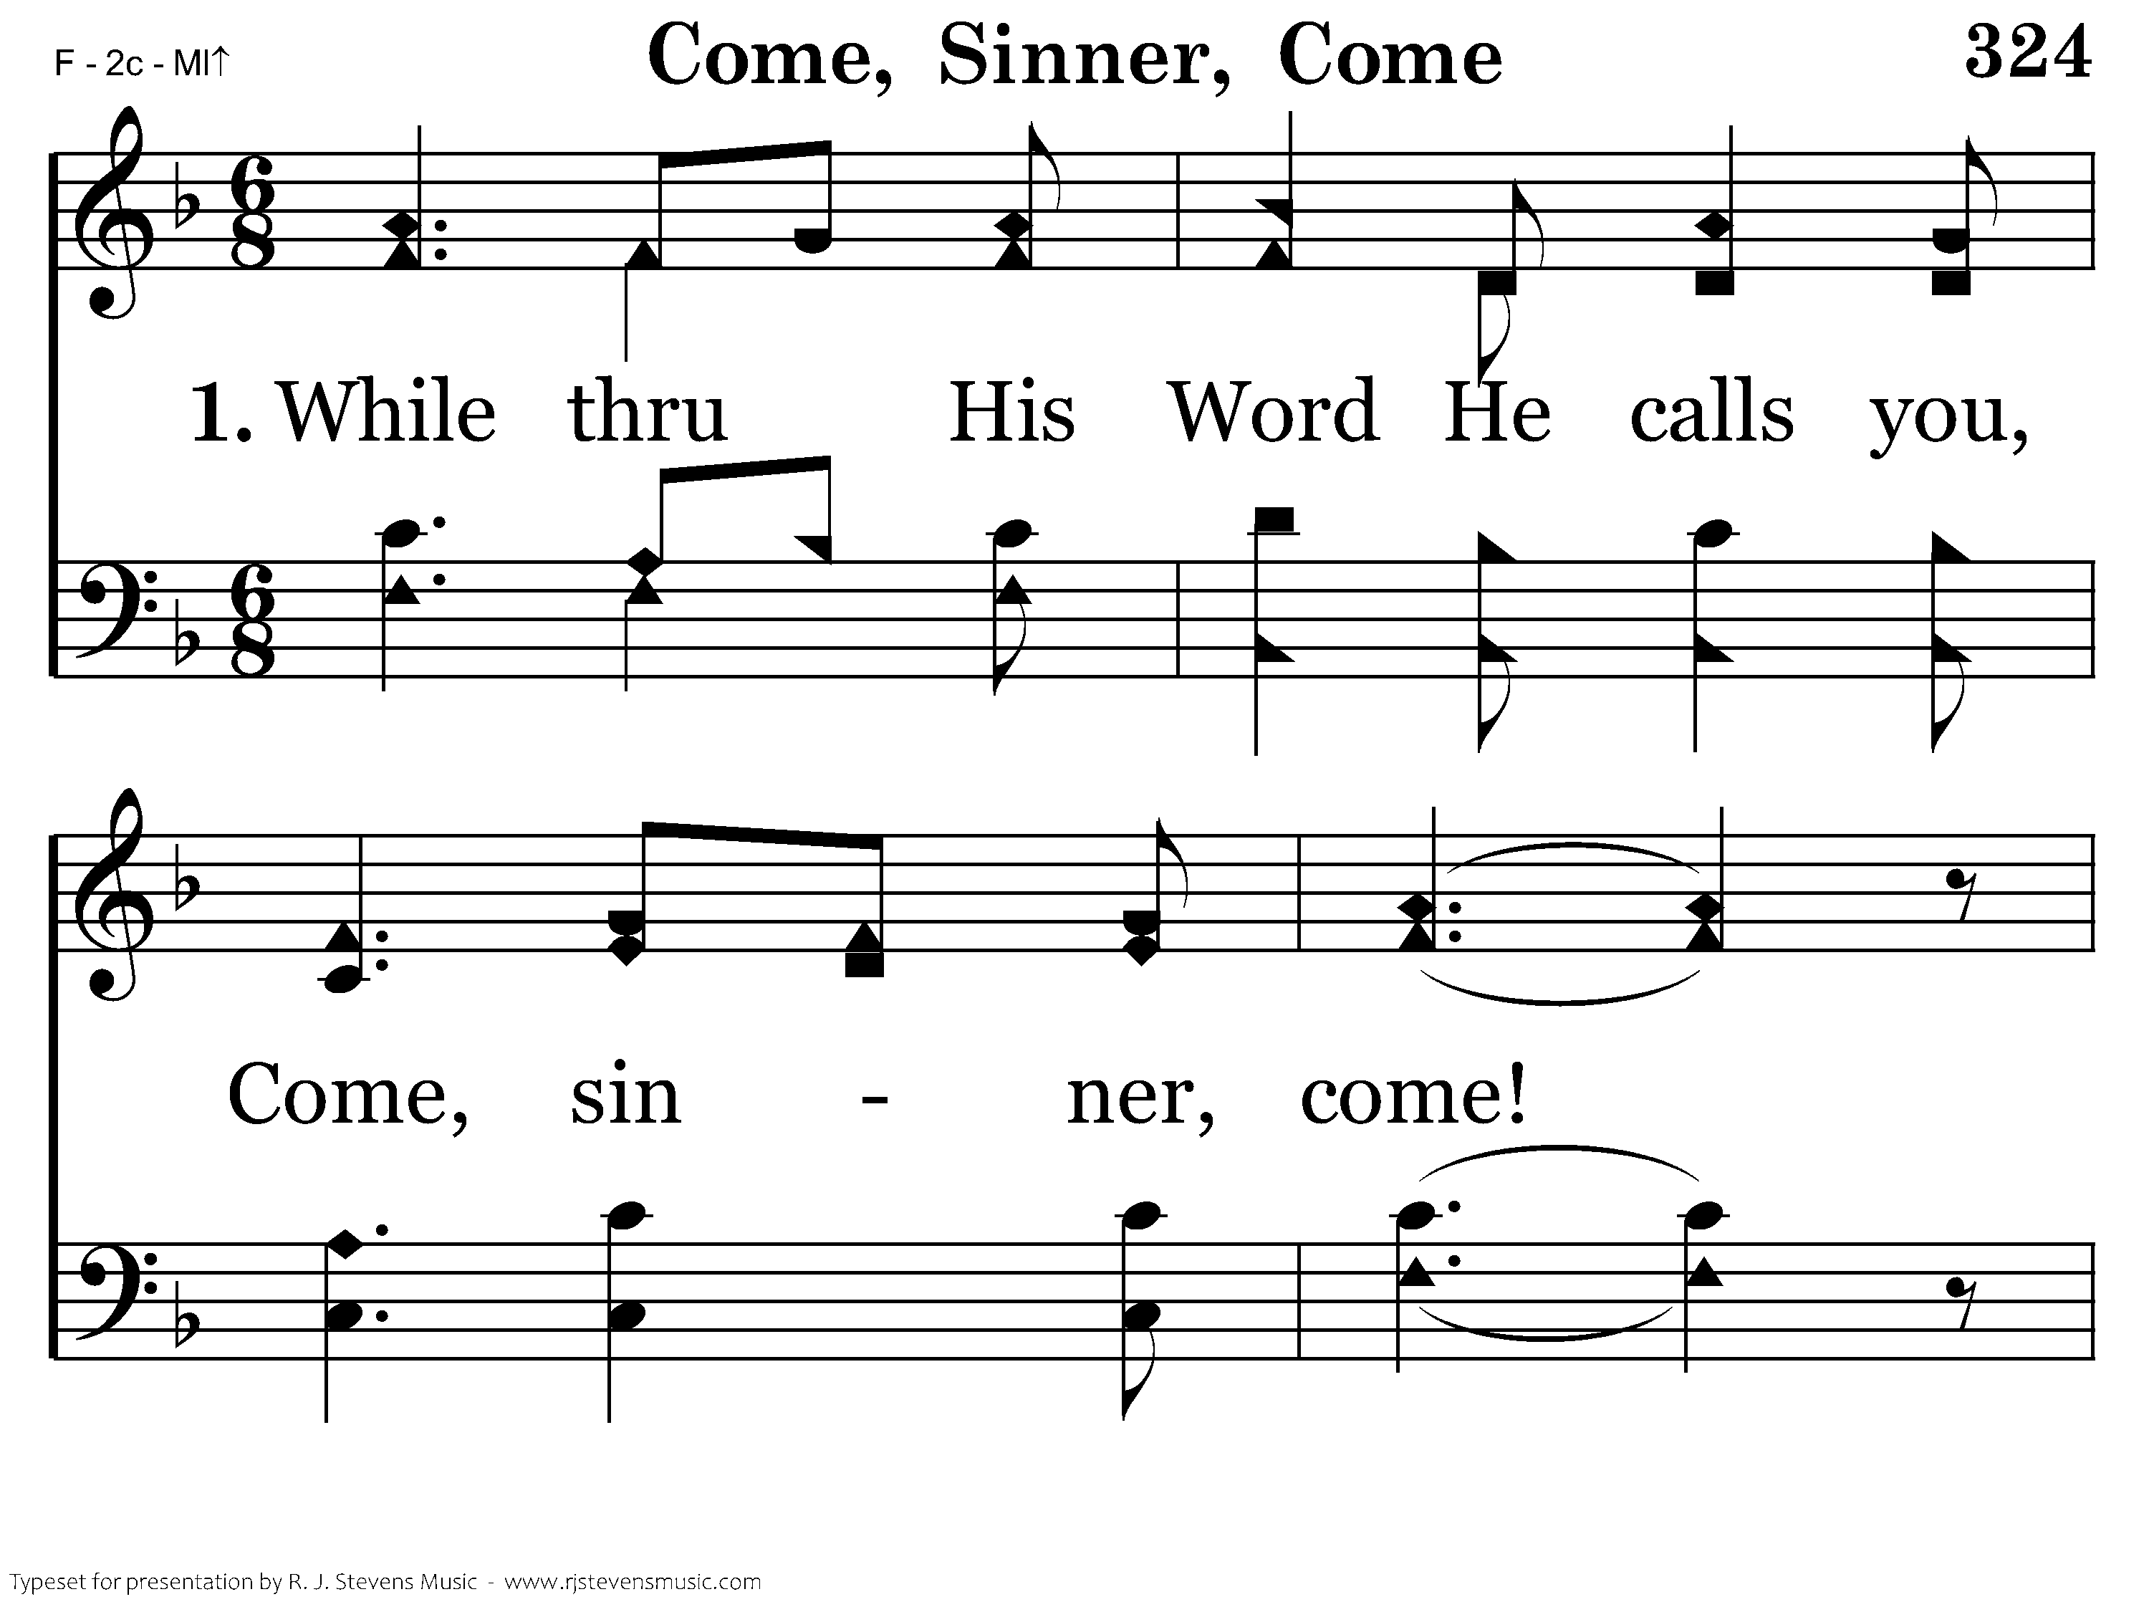
324 - Come, Sinner, Come - 1.1

Slide 43
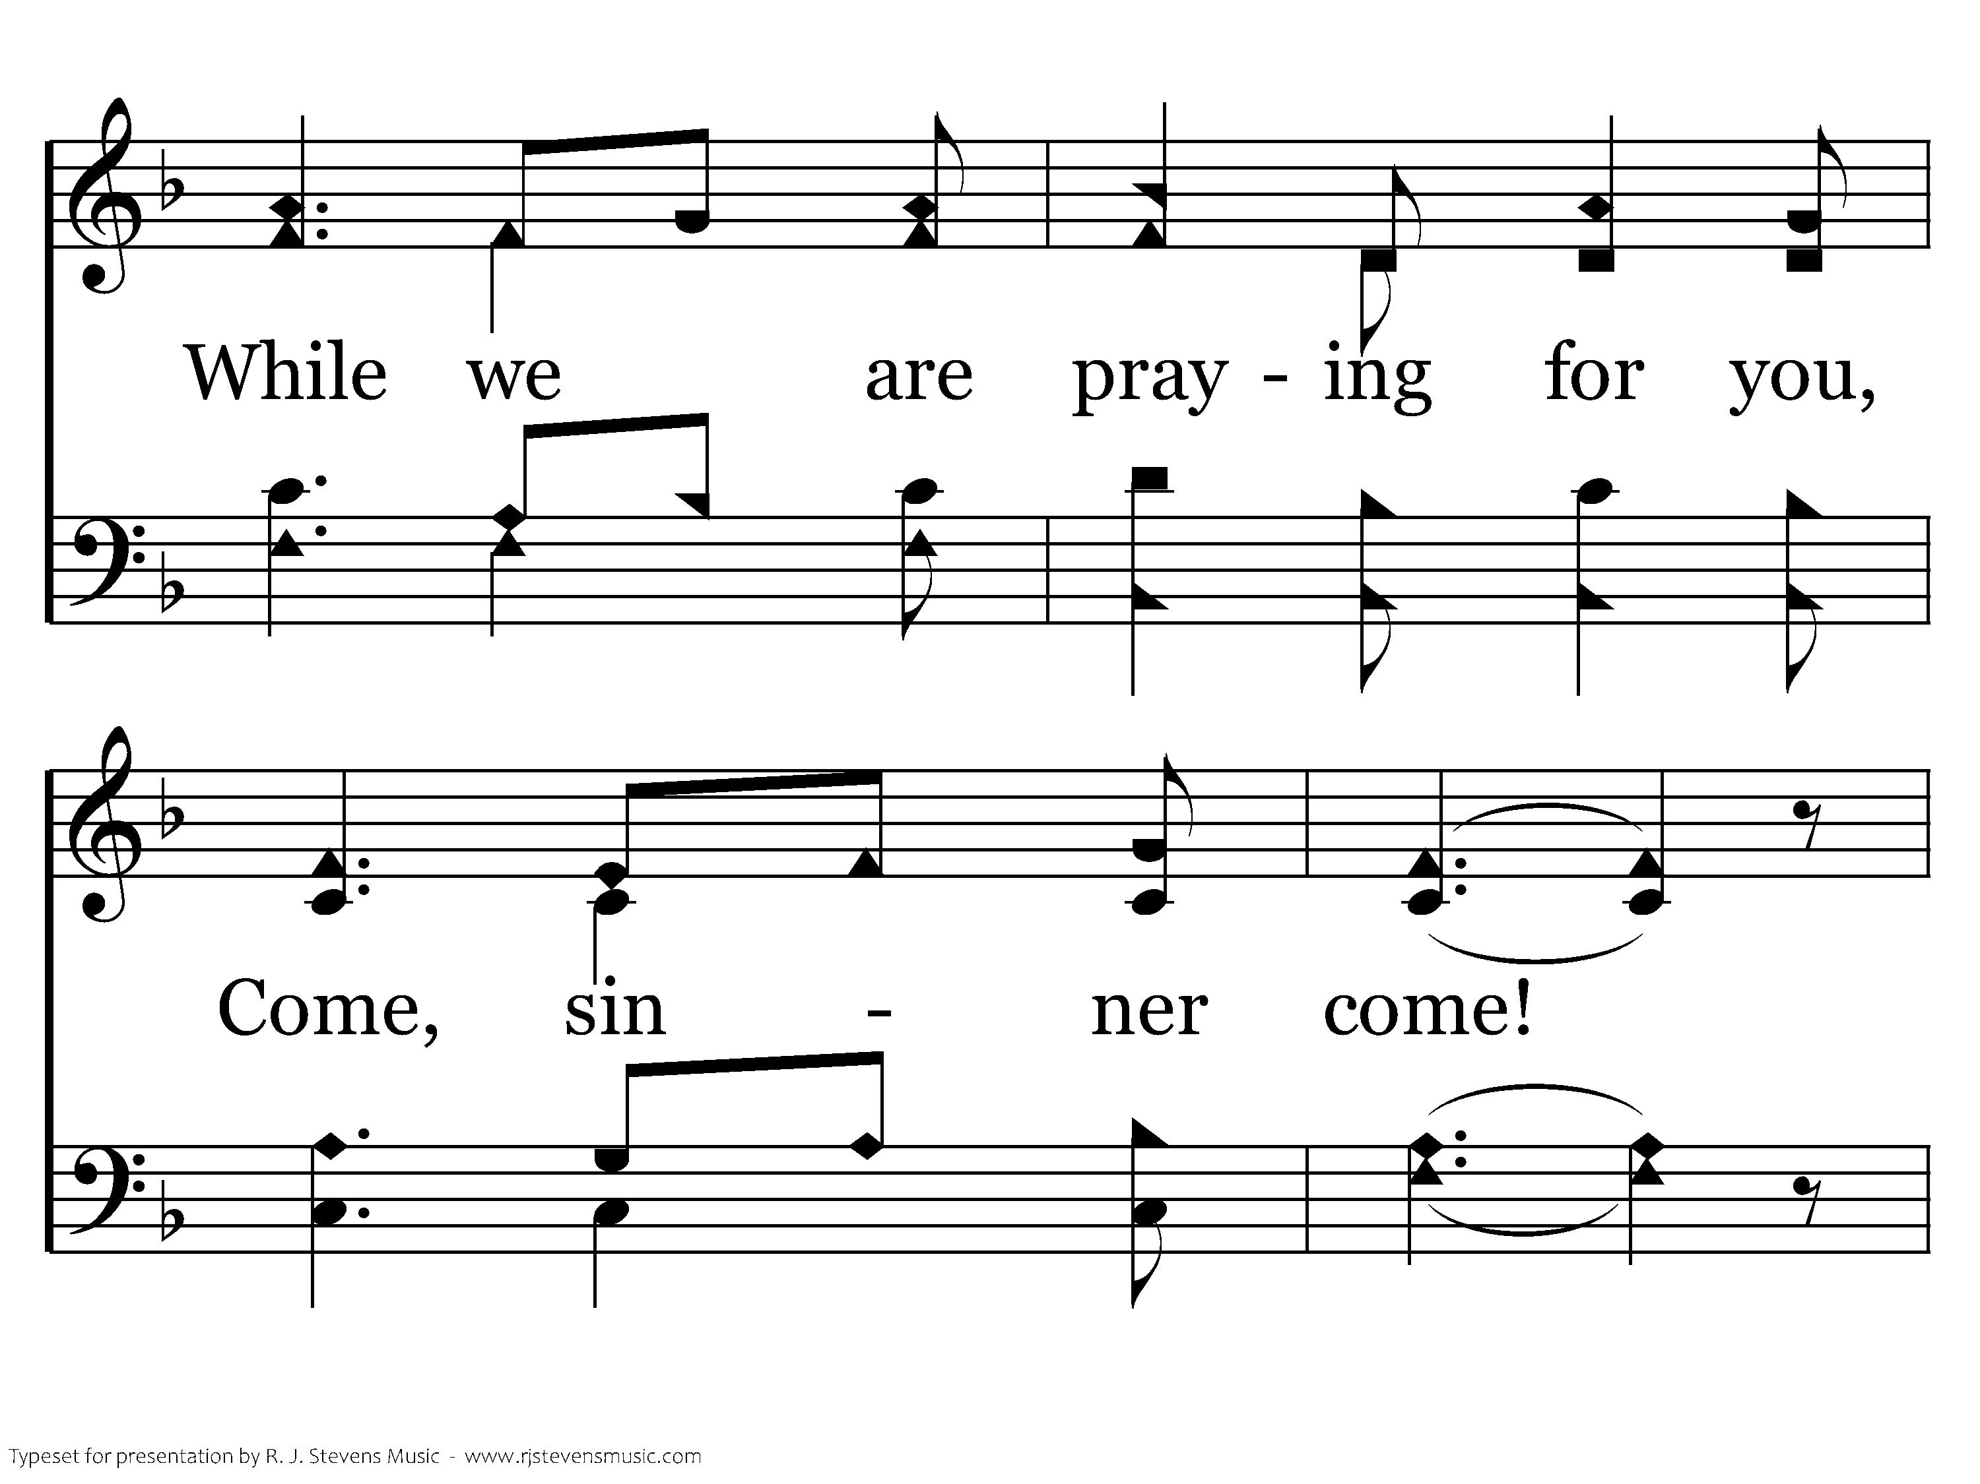
324 - Come, Sinner, Come - 1.2

Slide 44
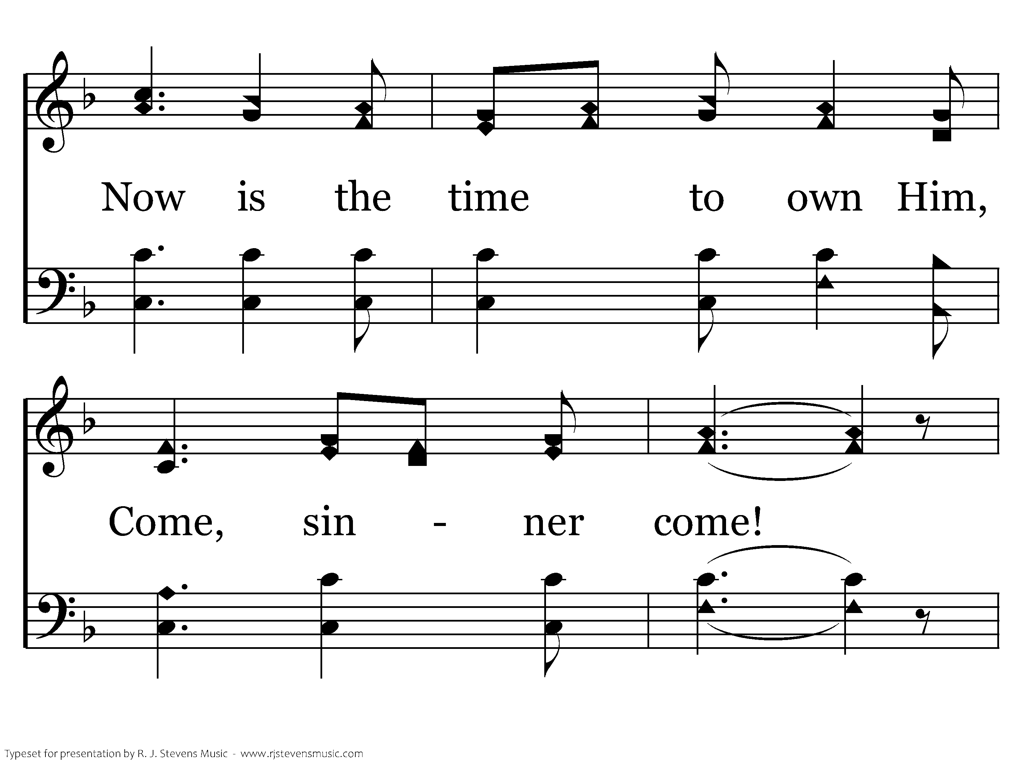
324 - Come, Sinner, Come - 1.3

Slide 45
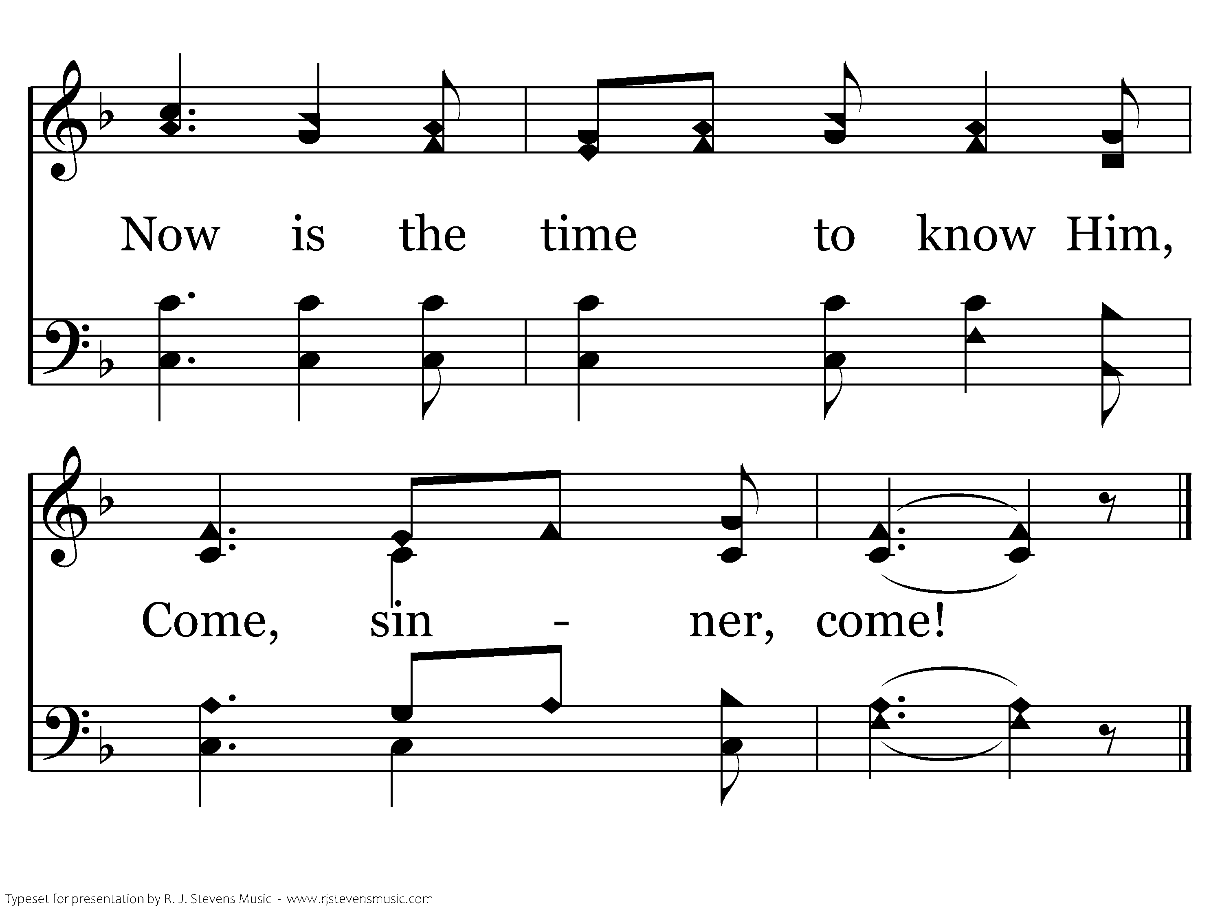
324 - Come, Sinner, Come - 1.4
End of Verse 1

Slide 46
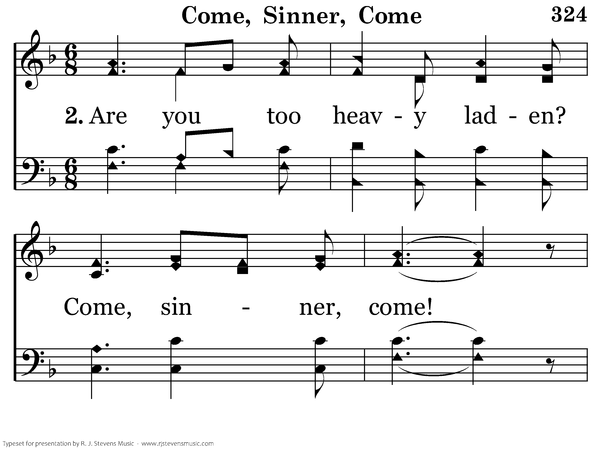
324 - Come, Sinner, Come - 2.1

Slide 47
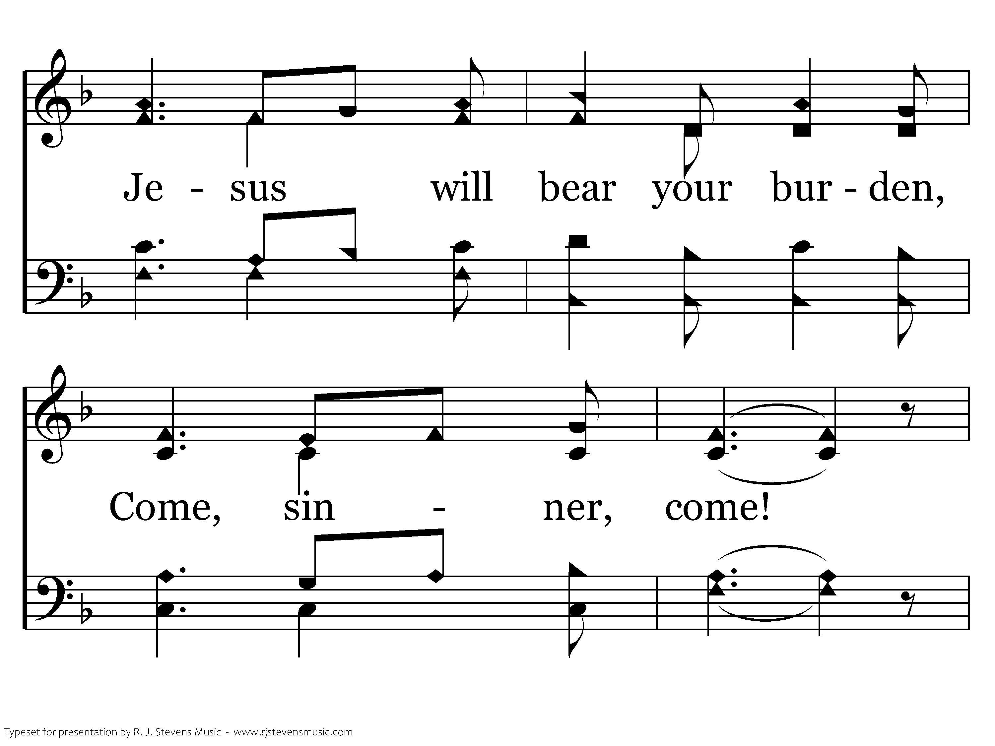
324 - Come, Sinner, Come - 2.2

Slide 48
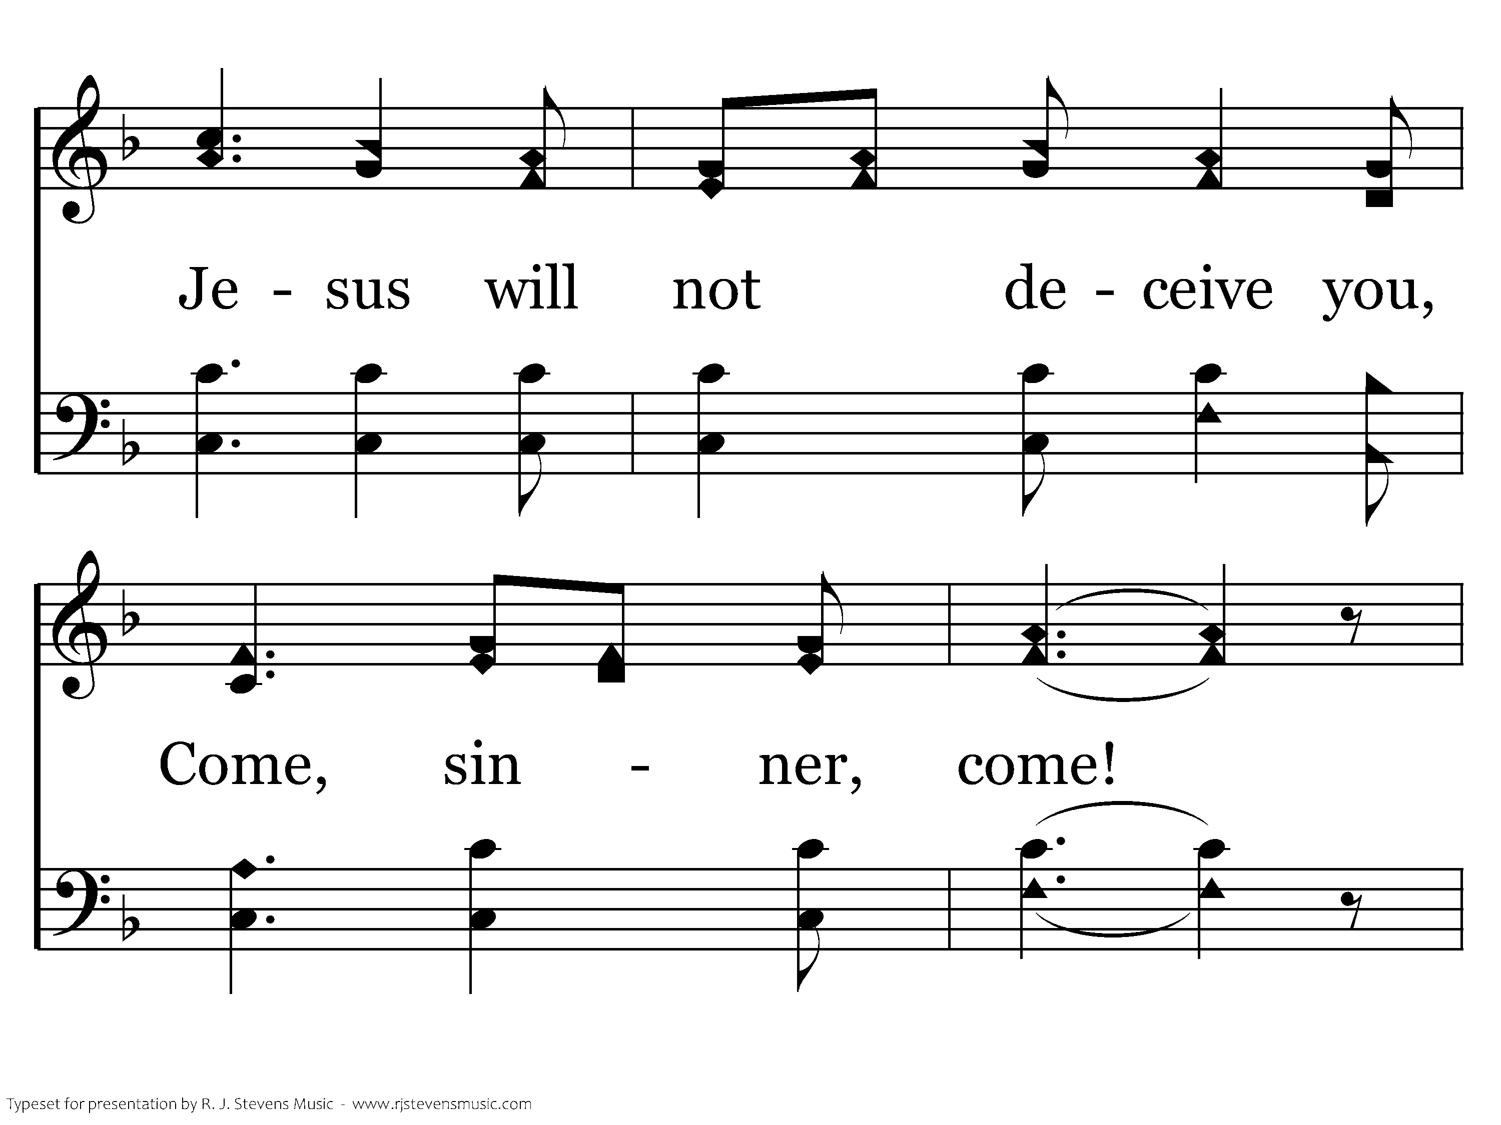
324 - Come, Sinner, Come - 2.3

Slide 49
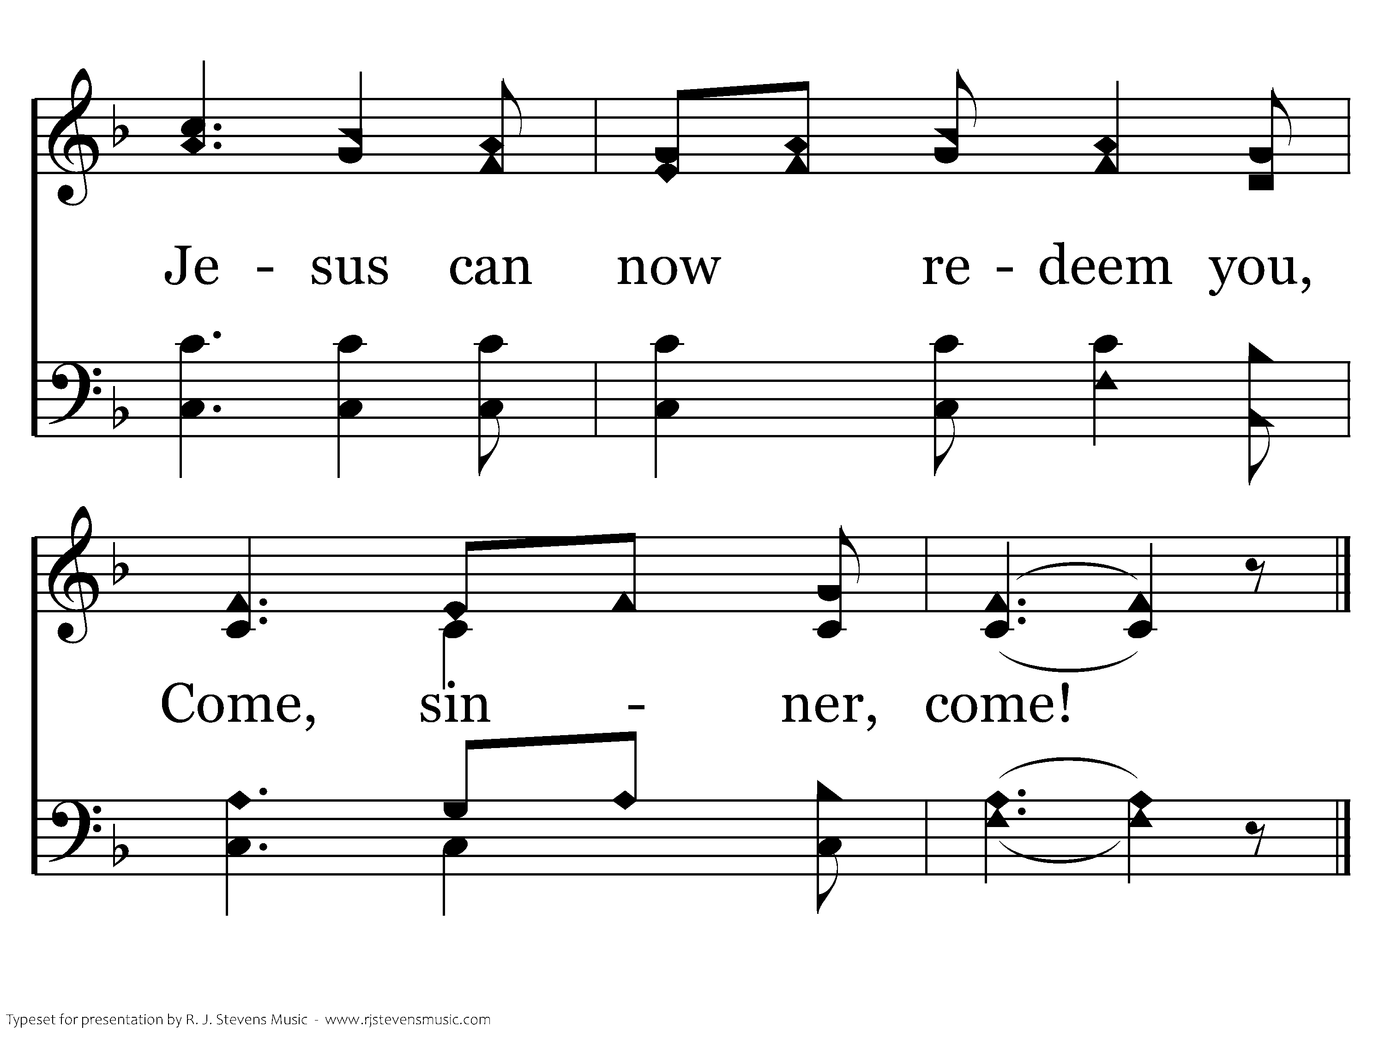
324 - Come, Sinner, Come - 2.4
End of Verse 2

Slide 50

324 - Come, Sinner, Come - 3.1

Slide 51
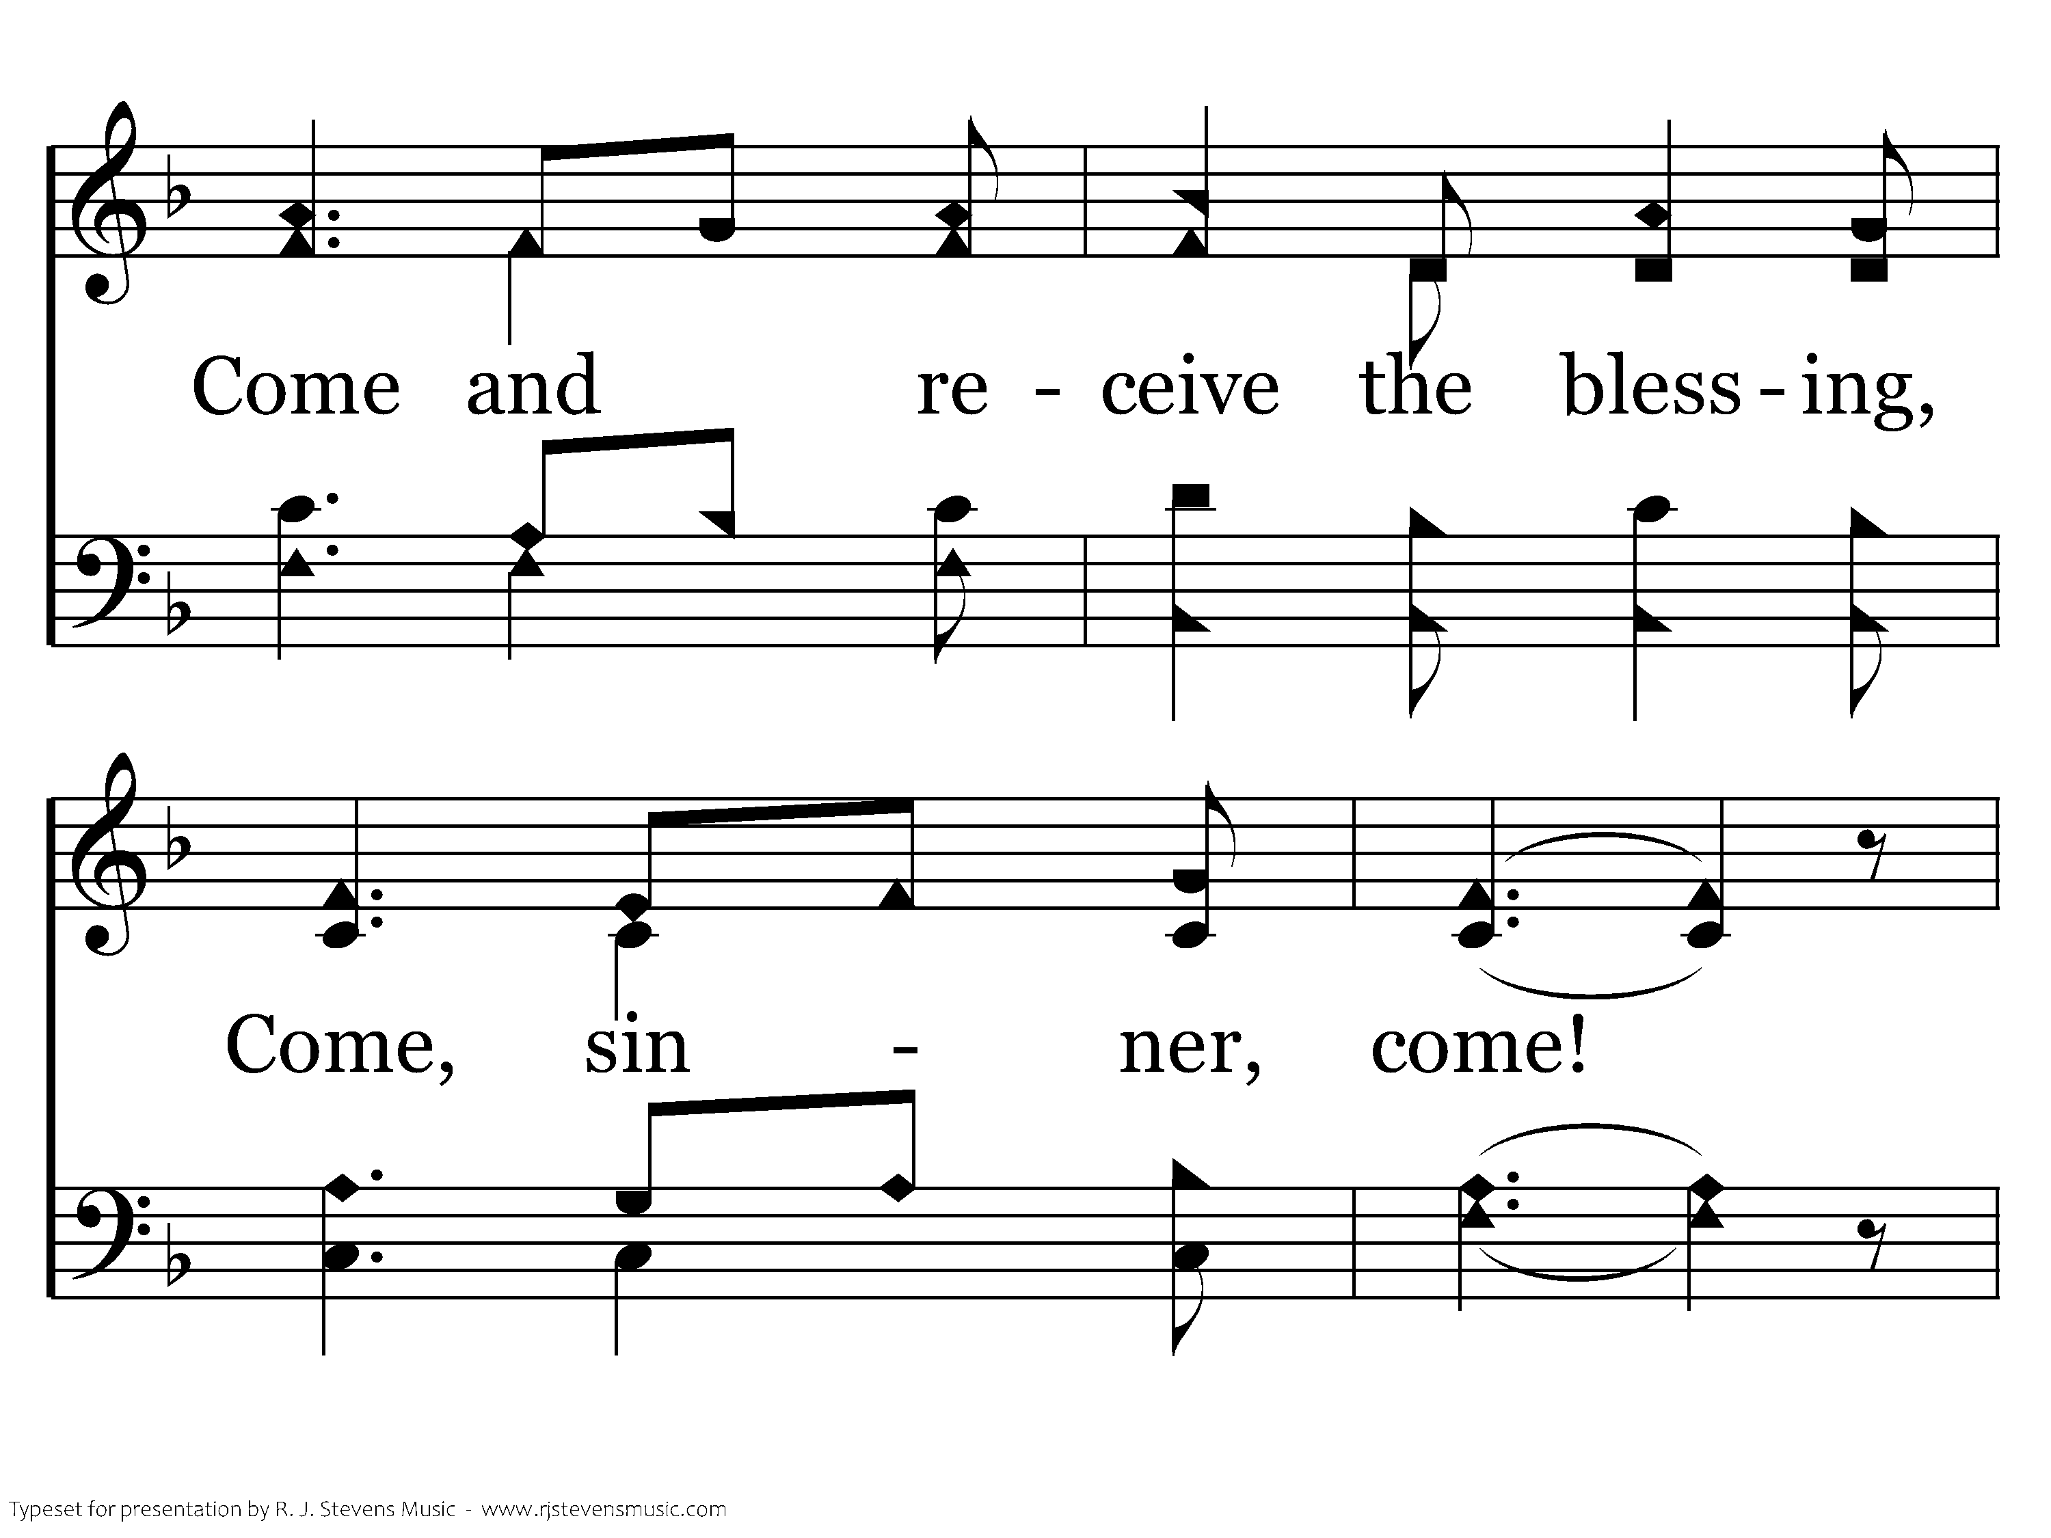
324 - Come, Sinner, Come - 3.2

Slide 52
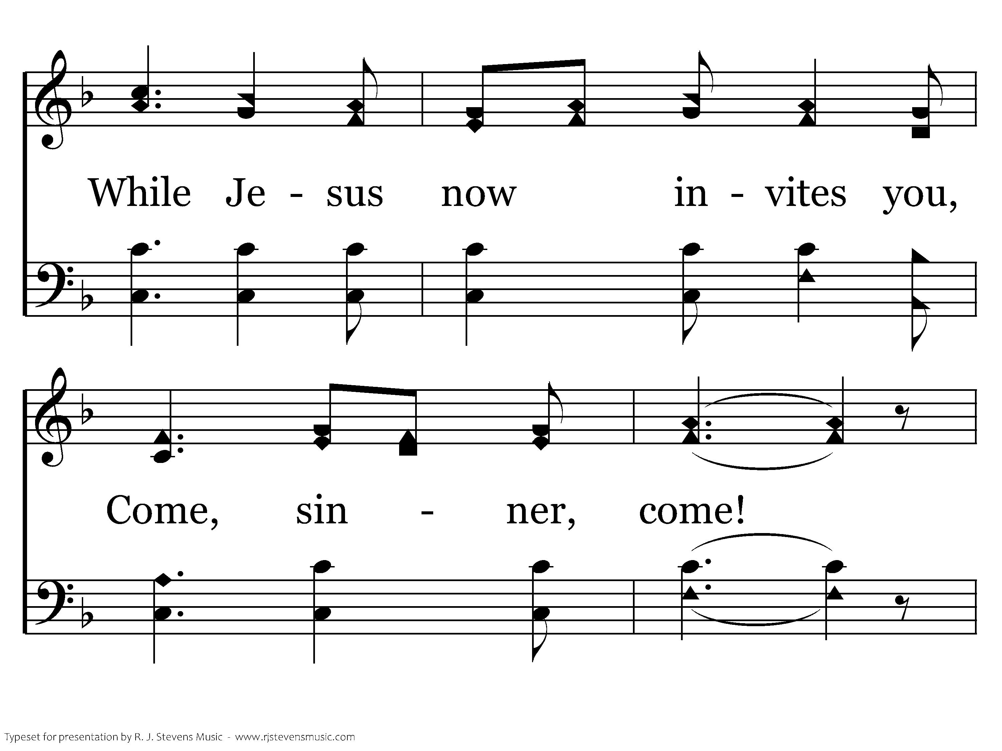
324 - Come, Sinner, Come - 3.3

Slide 53
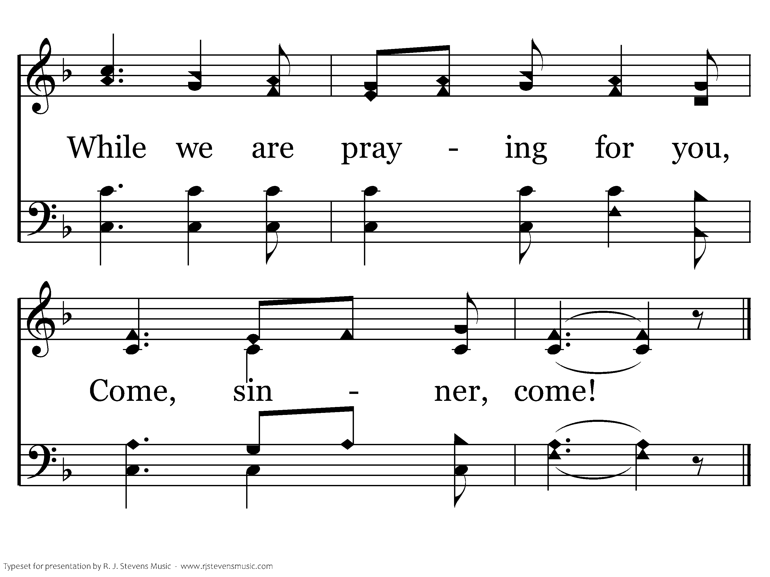
324 - Come, Sinner, Come - 3.4
End of Song

Slide 54
Lord’s Supper

Slide 55
Closing Prayer…

