Slide 2
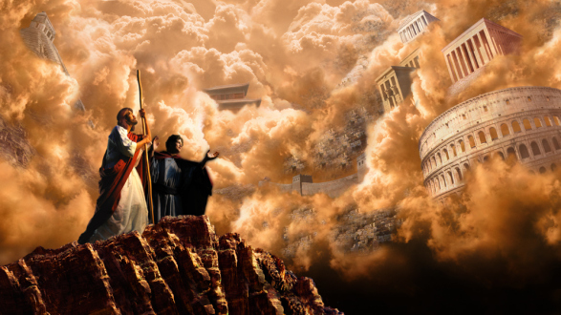
Temptation: Bow Down And Worship Me
Mt. 4:8-10
Mt.4:1-11; Lk.4:1-13
Mk.1:12-13
Rev.12:9
2Tim.3:4
Jn.3:19
1Pet.5:8-9

Slide 3
Temptation: Bow Down And Worship Me
Js.4:4
1Jn.2:15-17
1Pet.2:11
Job 1:12
Job 2:6
Lk.22:31
Lk.4:6
Mt.4:1-11; Lk.4:1-13
Mk.1:12-13
Satan offers the “world”
And the devil said to Him, "I will give You all this domain and its glory; for it has been handed over to me, and I give it to whomever I wish

Slide 4
Temptation: Bow Down And Worship Me
Mt.4:1-11; Lk.4:1-13
Mk.1:12-13
1Jn.5:19
“…the whole world lies in the power of the evil one”
Eph.6:12
“Our struggle is not against flesh and blood, but against the rulers, against the powers, against the world forces of this darkness, against the spiritual forces of wickedness….”
Satan offers the “world”

Slide 5
Temptation: Bow Down And Worship Me
Ps.24:1
Rom.14:11-12
Jn.16:11
Jn.12:27-33 (cf.1Cor.15:54-57)
Jn.14:1-3, 15-31 (Jn.13:27)
Gen.3:15
Eph.1:18-23
Mt.4:1-11; Lk.4:1-13
Mk.1:12-13
Satan offers the “world”

Slide 6
Temptation: Bow Down And Worship Me
2Cor.4:4
1Jn.4:4
Acts 26:16-18
Col.1:13-14
Heb.12:1-3
Mt.6:19-21, 33
Lk.10:42
Mt.4:1-11; Lk.4:1-13
Mk.1:12-13
Satan offers the “world”

Slide 7
Temptation: Bow Down And Worship Me
Jn.18:36
Dan.2:44-45
Dan.7:13-14
Lk.24:26
Mt.28:18
Php.2:8-11
Heb.10:12
Heb.4:15
Mt.4:1-11; Lk.4:1-13
Mk.1:12-13
Satan offers a shortcut, path of least resistance

Slide 8
Temptation: Bow Down And Worship Me
Jn.3:14
Lk.22:42-44
Mt.27:46
Deut.6:13
Acts 10:25-26
Rev.19:10
Rev.22:8-9
Mt.4:1-11; Lk.4:1-13
Mk.1:12-13
Satan offers a shortcut, path of least resistance

Slide 9
Temptation: Bow Down And Worship Me
Mt.4:1-11; Lk.4:1-13
Mk.1:12-13
Php.3:18-19
Lk.9:23
2Cor.4:16-18
Rev.2:10
Satan offers a shortcut, path of least resistance

Slide 10
Temptation: Bow Down And Worship Me
God’s treasures are greater!
1Jn.2:17
Mt.16:26
Worship & Service go together Rom.12:1-2
Don’t Bow…
Dan.3:16-18
Acts 4:19-20
Acts 5:29
Mt.4:1-11; Lk.4:1-13
Mk.1:12-13
Satan entices by saying “Do it just this once”

Slide 11
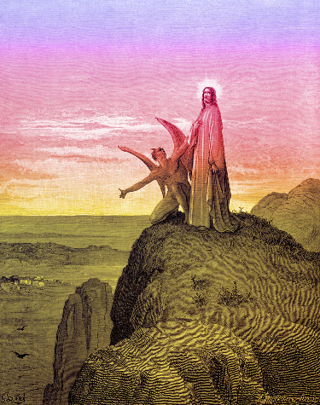
Temptation: Bow Down And Worship Me
1Cor.15:57
1Pet.1:18-19
“It is written…”
Eph.6:10-17
Ps.119:11
Mt.4:8-9
“Your word I have treasured in my heart that I might not sin against You”
2Ths.3:1-5

