Slide 2
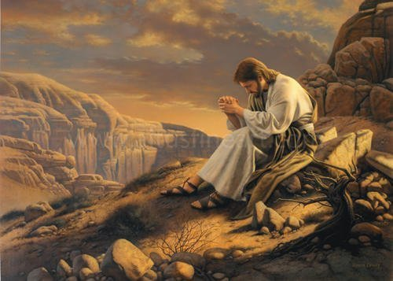
Jesus Tempted…
Mt.4:1-11
Lk.4:1-13
Mk.1:12-13
Jesus’ Baptism
(Mt.3:13-17)
Heb.5:8-9
1Pet.1:6-9
Js.1:2-4

Slide 3
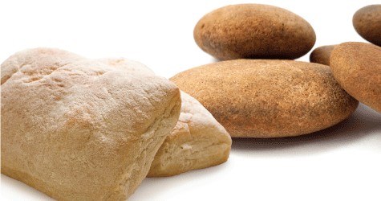
Temptation: Stones To Bread
Matt 4:2 - And after He had fasted forty days and forty nights, He then became hungry.
Luke 4:1 - And He ate nothing during those days, and when they had ended, He became hungry.
“Weakest…”
Eph.5:15

Slide 4
Temptation: Stones To Bread
Jn.2:1-12
Mt.14:13-21; 15:32-39
Prov.20:17
Lk.15:11-32
1Pet.3:10-12
Eccl.2:10-11; 12:13-14
“The Quick Fix…”

Slide 5
Temptation: Stones To Bread
Js.2:19
Mk.5:1-20; Lk.8:31
Deut.8:1-3
Mt.6:25-34
“Man’s #1 Necessity…”
GOD!

Slide 6
Temptation: Stones To Bread
Gen.3:5-6
Jn.5:30; 6:38
Php.2:8-11
Jn.4:34
“Loyalty…”

Slide 7
Temptation: Stones To Bread
Submit therefore to God. Resist the devil and he will flee from you. Draw near to God and He will draw near to you. Cleanse your hands, you sinners; and purify your hearts, you double-minded.
Js.4:7-8

