Slide 2
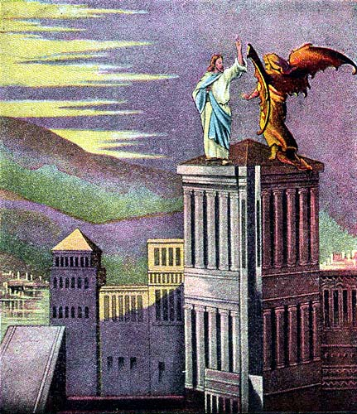
Temptation: Throw Yourself Down
Mt. 4:5-6 - “Then the devil took Him into the Holy city and had Him stand on the pinnacle of the temple and said to Him, if You are the Son of God, throw yourself down, for it is written, He will command His angels concerning You, and on their hands they will bear You up, so that you will not strike Your foot against a stone”
Mt.4:1-11
Lk.4:1-13
Mk.1:12-13
Mt.4:7 - “Jesus said to him, on the other hand, it is written, you shall not put the Lord your God to the test”

Slide 3
Temptation: Throw Yourself Down
The devil likes to appear “good”
Mt.4:1-11
Lk.4:1-13
Mk.1:12-13
Lk.12:20-21
2Cor.11:13-15
Rev.12:9

Slide 4
Temptation: Throw Yourself Down
There’s something more involved than His Sonship and pride
Mt.4:1-11
Lk.4:1-13
Mk.1:12-13
Js.2:19
Mk.5:1-20
Ps.91

Slide 5
Temptation: Throw Yourself Down
There’s something more involved than His Sonship and pride
Mt.4:1-11
Lk.4:1-13
Mk.1:12-13
Deut.6:16 (Ex.17:1-7)
Ex.14:10-12; 19, 30--31
Ex.15:22-27
Ex.16:1-4
Ex.17:7 (Ps.78:40-42)
“Is the Lord among us or not?”

Slide 6
Temptation: Throw Yourself Down
Don’t tempt / test the Lord Your God
Mt.4:1-11
Lk.4:1-13
Mk.1:12-13
Mt.12:38-42
Mt.16:1-4
1Cor.1:21-24
Attacks both through our weaknesses & our strengths
2Jn. 9
1Cor.13:4

Slide 7
Temptation: Throw Yourself Down
Use of scripture
Mt.4:1-11
Lk.4:1-13
Mk.1:12-13
(1) Don’t isolate from context
1Cor.6:19-20
Mt.7:1
(2) Look at “all” that the Bible says
(3) Scripture can be twisted
2Pet.3:16
2Tim.2:15

Slide 8
Temptation: Throw Yourself Down
It is written…
Mt.4:1-11
Lk.4:1-13
Mk.1:12-13
Gal.1:6-8
I am amazed that you are so quickly deserting Him who called you by the grace of Christ, for a different gospel; which is really not another; only there are some who are disturbing you and want to distort the gospel of Christ. But even if we, or an angel from heaven, should preach to you a gospel contrary to what we have preached to you, he is to be accursed!

