Slide 2
Mt.6:9-13
Our Father, which art in heaven, Hallowed be thy Name.
Thy Kingdom come. Thy will be done in earth, As it is in heaven.
Give us this day our daily bread.
And forgive us our trespasses, As we forgive them that trespass against us.
And lead us not into temptation, But deliver us from evil.
For thine is the kingdom, The power, and the glory, For ever and ever.
Amen.

Slide 3
Mt.6:9-13
Our Father, which art in heaven, Hallowed be thy Name. Thy Kingdom come. Thy will be done in earth, As it is in heaven. Give us this day our daily bread. And forgive us our trespasses, As we forgive them that trespass against us. And lead us not into temptation, But deliver us from evil. For thine is the kingdom, The power, and the glory, For ever and ever. Amen.
Jn.17
Lk.11:1-4
Jn.11:41-42
Acts 4:29-31
Col.1:9-12

Slide 4
Mt.6:9-13
Our Father, which art in heaven, Hallowed be thy Name. Thy Kingdom come. Thy will be done in earth, As it is in heaven. Give us this day our daily bread. And forgive us our trespasses, As we forgive them that trespass against us. And lead us not into temptation, But deliver us from evil. For thine is the kingdom, The power, and the glory, For ever and ever. Amen.
Context…
Mt.6:1 - beware of practicing righteousness before men
Mt.6:8 - So, do not be like them
Mt.6:9 - Pray then in this way…

Slide 5
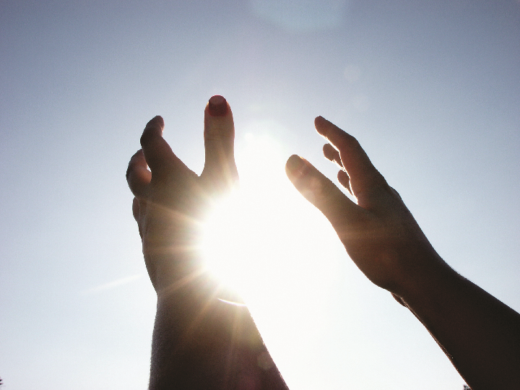
The Kind Of Prayer That Pleases God

Slide 6
Mt.6:9-13
Pray, then, in this way: Our Father who is in heaven, Hallowed be Your name. Your kingdom come. Your will be done, On earth as it is in heaven. 'Give us this day our daily bread. And forgive us our debts, as we also have forgiven our debtors. And do not lead us into temptation, but deliver us from evil. [For Yours is the kingdom and the power and the glory forever. Amen.'] For if you forgive others for their transgressions, your heavenly Father will also forgive you. But if you do not forgive others, then your Father will not forgive your transgressions.

Slide 7
The Kind Of Prayer That Pleases God
We can address God as “our Father”
O.T. - God as “Father”
Ps.89:26
Isa.9:6
Isa.63:16
Isa.64:8
Jn.1:12-13
Gal.3:26-27; 4:6-7
Rom.8:5-17; 1Pet.1:22-23
2Ths.2:15-17
“God our Father…”
Rom.1:7 Eph.1:2
1Cor.1:3 Php.1:2
2Cor.1:2 Col.1:2
Gal.1:3 Phlm.3

Slide 8
The Kind Of Prayer That Pleases God
We can address God as “our Father”
“Our God…”
1Ths.1:3
1Ths.2:2
1Ths.3:9
1Ths.3:11
1Ths.3:13
2Ths.1:11
2Ths.1:12
2Ths.2:15-16
“God our Father…”
Rom.1:7 Eph.1:2
1Cor.1:3 Php.1:2
2Cor.1:2 Col.1:2
Gal.1:3 Phlm.3

Slide 9
Mt.6:9-13
Pray, then, in this way: Our Father who is in heaven, Hallowed be Your name. Your kingdom come. Your will be done, On earth as it is in heaven. 'Give us this day our daily bread. And forgive us our debts, as we also have forgiven our debtors. And do not lead us into temptation, but deliver us from evil. [For Yours is the kingdom and the power and the glory forever. Amen.'] For if you forgive others for their transgressions, your heavenly Father will also forgive you. But if you do not forgive others, then your Father will not forgive your transgressions.

Slide 10
The Kind Of Prayer That Pleases God
Who Is In Heaven…
Ps.103:19
Paul
2Cor.4:16-18
Heb.11:13-16
1Cor.13:9-12
Mk.6:20 / Lk.10:20
1Ths.4:16-17
Realized his purpose (Php.1:21)
Knew earth wasn’t home (2Cor.5:1-9; Php.3:20-21)
Ready to go to Heaven (2Tim.4:6-8)

Slide 11
Mt.6:9-13
Pray, then, in this way: Our Father who is in heaven, Hallowed be Your name. Your kingdom come. Your will be done, On earth as it is in heaven. 'Give us this day our daily bread. And forgive us our debts, as we also have forgiven our debtors. And do not lead us into temptation, but deliver us from evil. [For Yours is the kingdom and the power and the glory forever. Amen.'] For if you forgive others for their transgressions, your heavenly Father will also forgive you. But if you do not forgive others, then your Father will not forgive your transgressions.

Slide 12
The Kind Of Prayer That Pleases God
Hallowed Be Your Name…
Ps.111:9
Deut.10:10-22
Ps.51:15-17
Acts 17:22-28
Isa.66:1-2
Ex.20:7
1Cor.10:31 / 6:19-20

Slide 13
The Kind Of Prayer That Pleases God
Ps.11:4-7…
The Lord is in His holy temple; the Lord's throne is in heaven; His eyes behold, His eyelids test the sons of men.
The Lord tests the righteous and the wicked, And the one who loves violence His soul hates. Upon the wicked He will rain snares; Fire and brimstone and burning wind will be the portion of their cup. For the Lord is righteous, He loves righteousness; The upright will behold His face.

