Slide 1
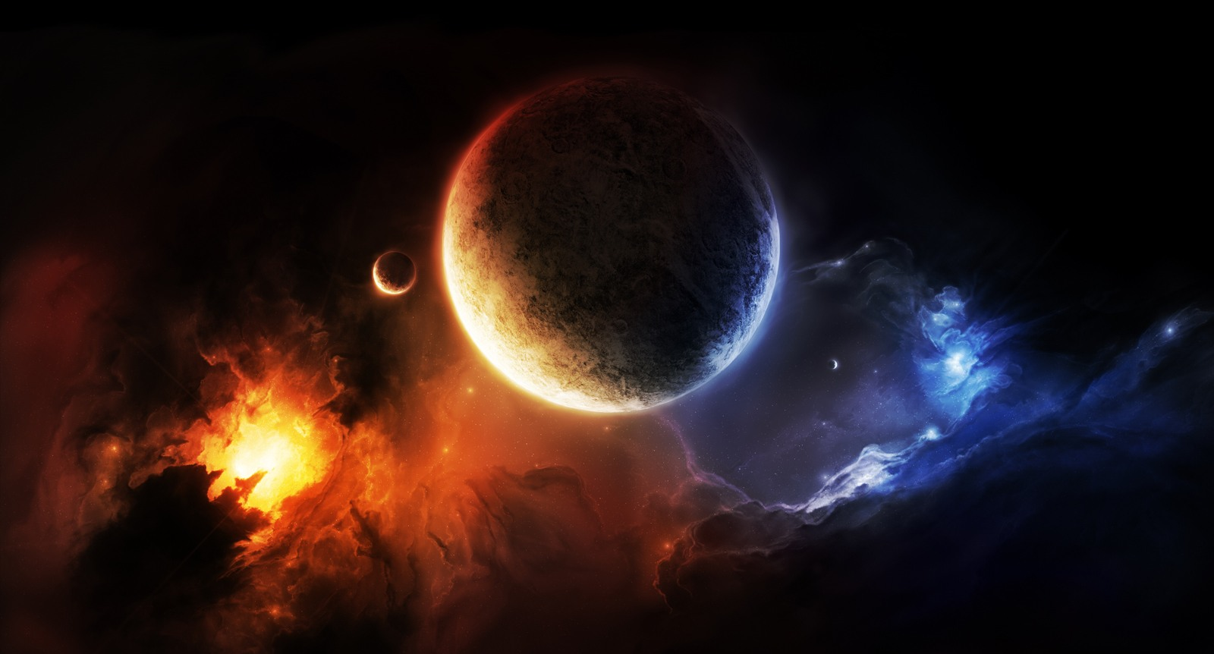
Naturalism: The belief that all things are products of a purely natural system and nothing exists outside the material universe.

Slide 2
Implications of Naturalism
There is no inner spirit; nothing survives death. There is no God. There is no objective moral standard. There is no judgment. Humans are nothing special, just animals of higher evolutionary development.

Slide 3
Naturalism: No Answer to the Five Most Consequential Issues of Life:
Origin
Identity
Purpose
Destiny
Morality

Slide 4
Theism: The belief that the physical world was created by an intelligent mind that stands above the creation.

Slide 5
Natural Process
No supreme being.
No divine communication.
No absolute standard.
No ultimate accountability.
No transcendent purpose.
Creation by God
Someone higher than us.
God has spoken to man.
Universal law governs all.
Responsible for actions.
Creation = purpose.

