Slide 2
A Life Without God
Futility of mind
Darkened understanding
Alienated from life
Ignorant
Hardened heart
Past feeling
Given to uncleanness

Slide 3
We Are Influenced By:
Genetics
Nurture
Broader environment

Slide 4
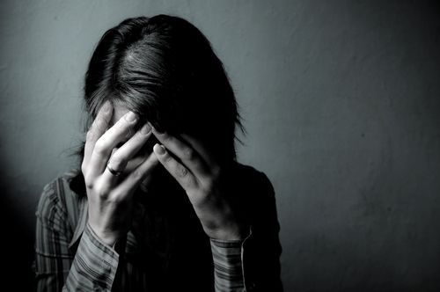
We are, in large measure, the end product of the choices we make.

Slide 5
Transformation
A new man in Christ
It is no longer I who live

Slide 6
Transformation
“I like myself as I am. I don’t want to change.”

Slide 7
Transformation
“Change is too hard. Besides, I’ve tried before and failed.”

