Slide 1
A Need Greater Than Self

Slide 2
The Joy of Serving
“Just as the Son of Man did not come to be served, but to serve, and to give His life a ransom for many.”

Slide 3
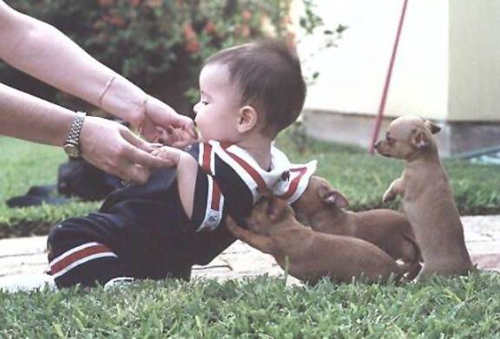
Serving becomes a joy when we realize how badly we are needed.

Slide 4
“I learned something from you!”

Slide 5
“Your example inspired me!”

Slide 6
“Your encouragement was just what I needed today!”

Slide 7
“I don’t know what I would have done if you hadn’t ________________!”

Slide 8
The Joy of Receiving

Slide 9
No one is as strong or wise alone as he needs to be.
We need others to help us mature.
We need to be accountable to others.
We need support when discouraged.

Slide 10
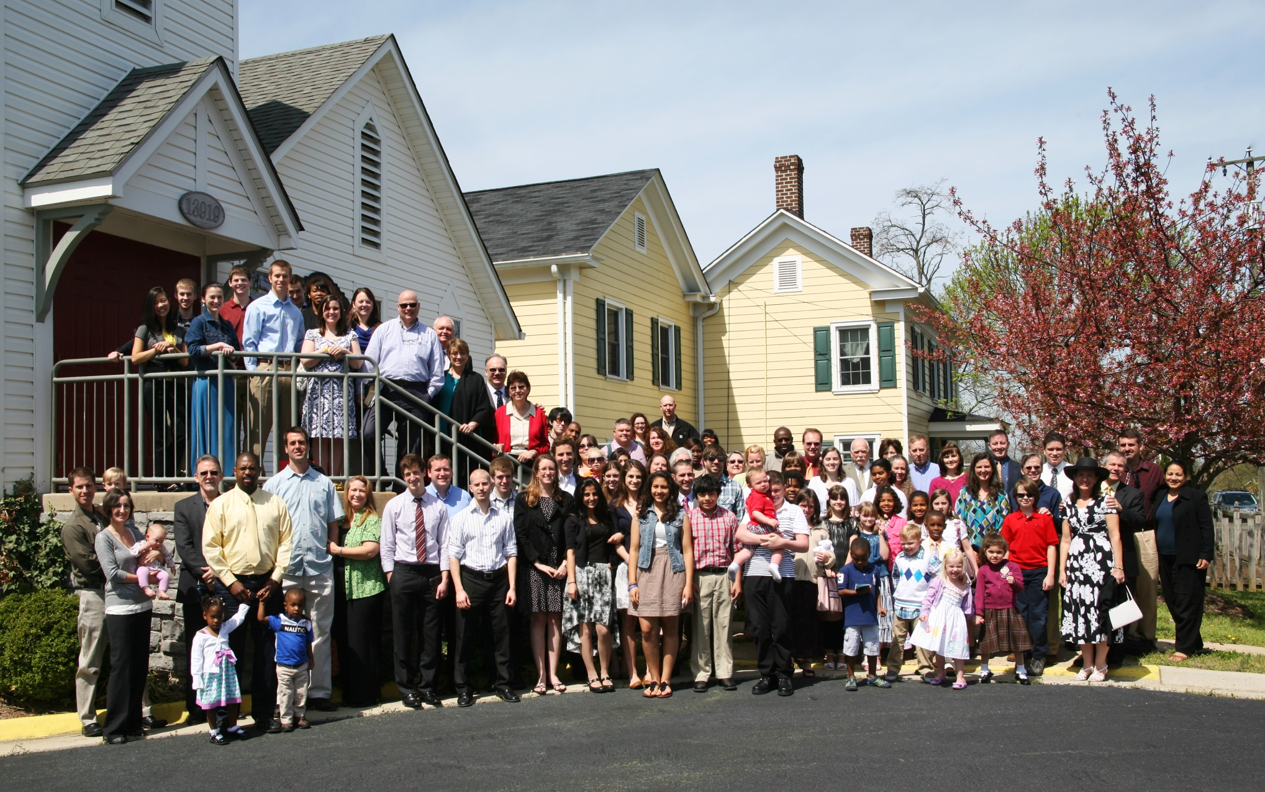
So many of God’s blessings come to us
via His people.

Slide 11
Summary on Joy:
True joy is the outgrowth of a stable, trusting and loving relationship with God.

Slide 12
Summary on Joy:
Our society is drained of joy by the godless philosophy of naturalism.

Slide 13
Summary on Joy:
Joy begins with forgive-ness and reconciliation with God. This frees our burdened conscience.

Slide 14
Summary on Joy:
This initial joy is followed by recreating our character into what God purposed us to be.

Slide 15
Summary on Joy:
Joy is perfected in association with others who likewise find their joy in God.

