Slide 2
They Remembered His Words
Acts 11:15-18
“And as I began to speak, the Holy Spirit fell upon them just as He did upon us at the beginning. And I remembered the word of the Lord, how he used to say, John baptized with water but you shall be baptized with the Holy Spirit….”

Slide 3
They Remembered His Words
Marriage
Mt.19:3-12

Slide 4
They Remembered His Words
Mt.19:3-12
God Joins…
God joins male with female…
God joins male with female AND… We must not put this relationship asunder

Slide 5
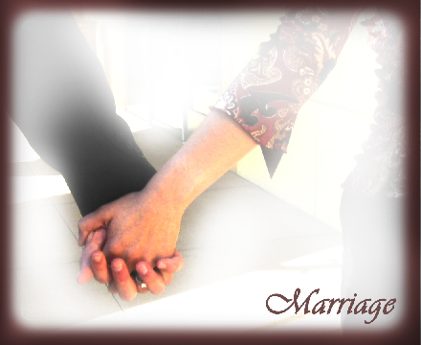
They Remembered His Words
God joins male with female AND… We MUST NOT put this relationship asunder
Mt.19:6
“What therefore God has joined together, let no man put asunder / separate”
Mt.19:3-12

Slide 6
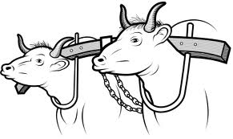
They Remembered His Words
Mt.19:6
“What therefore God has joined together, let no man put asunder / separate”
Grk. suzeugnumi - to yoke together, to fasten to one yoke, to unite
“What therefore God has joined together, let no man put asunder / separate”
Grk. chorizo - to go away, to depart, to separate oneself from, to leave a husband or wife (including divorce)
Exegetical Dictionary - “let not mankind break apart” what God has joined

Slide 7
They Remembered His Words
God joins male with female AND… We MUST NOT put this relationship asunder
Rom.7:1-4
(Col.2:14)
Bound by law to her husband…
Not released from the law of her husband unless he dies
Mt.19:3-12

Slide 8
They Remembered His Words
Rom.7:2 - bound to the law of her husband
Eph.5:22-33…
wife subject to husband in everything as the church is to Christ
wife respect your husband
husband be the head
husband love wife as self, give self to her just as Christ loved the church & gave Himself for her benefit
leave father and mother and be joined becoming one flesh

Slide 9
They Remembered His Words
Rom.7:2 - bound to the law of her husband
Col.3:18-19…
wife submit to your husband
husband love your wife
husband be the head
husband do not be bitter or harsh toward them

Slide 10
They Remembered His Words
Rom.7:2 - bound to the law of her husband
1Cor.7:3-4…
husband fulfill your duty to your wife
wife fulfill your duty to your husband
wife give yourself to your husband
husband give yourself to your wife

Slide 11
They Remembered His Words
Rom.7:2 - bound to the law of her husband
1Pet.3:1-7…
wife be submissive to own husband
wife show husband an example of one with inward beauty, of one who lives in a chaste (pure) & respectful way
husband dwell with wife in an understanding way
husband give your wife honor

Slide 12
They Remembered His Words
1Pet.3:1 - “Likewise you wives…”
Refers back to what?
1Pet.2:18-20 - servants submit to masters even if harshly treated
(1Pet.2:21-25 - the example of Christ)
Likewise you wives…
(Exception: Acts 5:29)

Slide 13
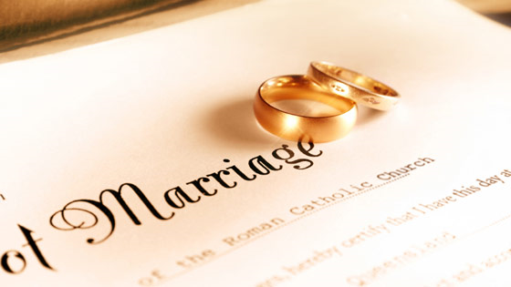
They Remembered His Words
What About 1Cor.7?
Mt.19:3-12
Authorize Separation (including divorce)?
Marital Responsibilities
vs.3-4
vs.10
vs.12
vs.39
Don’t leave, depart, divorce
Bound as long as live

Slide 14
They Remembered His Words
1Cor.7…
vs.1 - good to not marry, not have sexual relations (in view of persecutions - vs.26, 32-35)
vs.7 - wish that all men were as myself (unmarried)
vs.8 - it’s good to remain as I am
vs.28 - if choose to marry, have not sinned
vs.2 - one wife to one husband
vs.3-4 - fulfill duty to wife, fulfill duty to husband

Slide 15
They Remembered His Words
1Cor.7:5 …
“Stop depriving one another, except by agreement for a time, so that you may devote yourselves to prayer, and come together again so that Satan will not tempt you because of your lack of self-control.”
don’t deprive one another; don’t withhold your conjugal obligations; don’t refuse to come together sexually

Slide 16
They Remembered His Words
1Cor.7:5 …
“Stop depriving one another, except by agreement for a time, so that you may devote yourselves to prayer, and come together again so that Satan will not tempt you because of your lack of self-control.”
except by consent; don’t go without sexual relations unless both parties are in agreement

Slide 17
They Remembered His Words
1Cor.7:5 …
“Stop depriving one another, except by agreement for a time, so that you may devote yourselves to prayer, and come together again so that Satan will not tempt you because of your lack of self-control.”
sexual separation for a short period of time wherein God approves of withholding self from our mate

Slide 18
They Remembered His Words
1Cor.7:5 …
“Stop depriving one another, except by agreement for a time, so that you may devote yourselves to prayer, and come together again so that Satan will not tempt you because of your lack of self-control.”
the purpose of the sexual separation is that one might draw closer to God

Slide 19
They Remembered His Words
1Cor.7:6 -
“But this I say by way of concession / permission, not as a commandment”
Grk. suggnome
Louw & Nida - permission to do something (implying some type of concession), to be allowed to; 1Cor.7:6 “I say this as a matter of permission not as an order”
Not the same word that is used for one’s personal opinion or judgment as in 1Cor.7:25, 40
celibacy allowed but not commanded? (vs.1, 7-9, 25-28, 32-38)
abstaining from sexual relations allowed for a short period of time but not commanded? (vs.5)

Slide 20
They Remembered His Words
Focus On Each Other’s Needs
1Cor.7:4
(1Cor.7:5 / Mt.5:32)
1Cor.7:33 - “how he may please his wife”
1Cor.7:34 - “how she may please her husband”
Mt.19:3-12
Php.2:3-4
do nothing from selfishness
have humility of mind
regard one another as more important than self
do not merely look out for your own personal interests

Slide 21
They Remembered His Words
1Cor.7 - Where does the text say….
I can withhold myself from my mate in order to punish them or in order to get my way?
If my marriage reaches a point where I no longer like my mate, I can separate from them (wheth. temp. or perm.)?
If my husband or wife is not being the mate I think they ought to be or want them to be, I can separate from them?
If I feel like I don’t want to be married anymore and am not happy with my marriage, I can separate from my mate?
If I’m having problems with my marriage I can separate / divorce?
This would contradict… 1Cor.7:3-4 & vs.10 & vs.12-13 & vs.39

Slide 22
They Remembered His Words
1Cor.7:8-13 - Three groups mentioned
vs.8-9 - to the unmarried
vs.10-11 - to Christians married to Christians
vs.12-13 - to Christians married to an unbeliever
“But to the married I give instructions, not I, but the Lord, that the wife should not leave her husband (but if she does leave, she must remain unmarried, or else be reconciled to her husband), and that the husband should not divorce his wife.”
Mt.19:5-6, 9

Slide 23
They Remembered His Words
1Cor.7:10-11 - Christians married to Christians
“But to the married I give instructions, not I, but the Lord, that the wife should not leave her husband (but if she does leave, she must remain unmarried, or else be reconciled to her husband), and that the husband should not divorce his wife.”
Mt.19:5-6, 9 - “and said, 'For this reason a man shall leave his father and mother and be joined to his wife, and the two shall become one flesh'? So then, they are no longer two but one flesh. Therefore what God has joined together, let not man separate." … “And I say to you, whoever divorces his wife, except for sexual immorality, and marries another, commits adultery; and whoever marries her who is divorced commits adultery.” (NKJ)

Slide 24
They Remembered His Words
1Cor.7:8-13 - Three groups mentioned
vs.8-9 - to the unmarried
vs.10-11 - to Christians married to Christians
vs.12-13 - to Christians married to an unbeliever
“But to the married I give instructions, not I, but the Lord, that the wife should not leave her husband (but if she does leave, she must remain unmarried, or else be reconciled to her husband), and that the husband should not divorce his wife.”
Don’t leave…
Grk. chorizo - to separate oneself, to depart from, to go away, to leave
Phlm.15

Slide 25
They Remembered His Words
1Cor.7:11 - Parenthetical statement?
“But to the married I give instructions, not I, but the Lord, that the wife should not leave her husband (but if she does leave, she must remain unmarried, or else be reconciled to her husband), and that the husband should not divorce his wife.”
1Jn.2:1-2 - Don’t sin, but if you do….
1Cor.7:10-11 - Don’t leave / separate, but if you do…

Slide 26
They Remembered His Words
1Cor.7:11 - Parenthetical statement?
“But to the married I give instructions, not I, but the Lord, that the wife should not leave her husband (but if she does leave, she must remain unmarried, or else be reconciled to her husband), and that the husband should not divorce his wife.”
Repentance demands reconciliation!
Let no man put asunder what God has joined !!!!!!!
Rom.7:2 still applies!
1Cor.7:3-4 still applies!
Mt.19:6 still applies
1Pet.3:1-2 still applies!
1Cor.7:10 still applies!

Slide 27
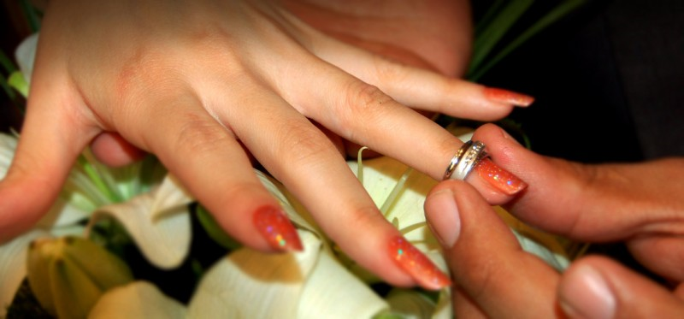
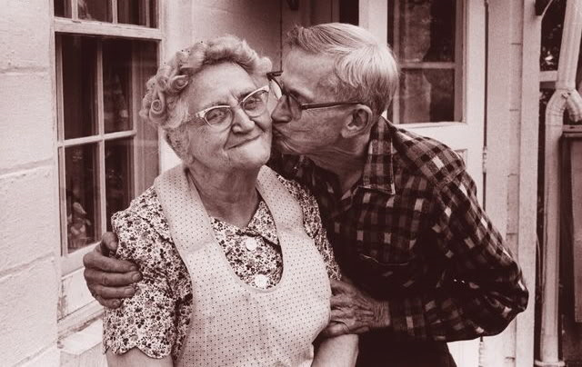
They Remembered His Words
Marriage is a lifelong commitment!
Mt.19:3-12
Stick-to-itiveness - resolute tenacity (Acts 11:23)
Mt.19:9-12 (disciples reaction)
Prov.1:24-33; 3:5-8

Slide 28
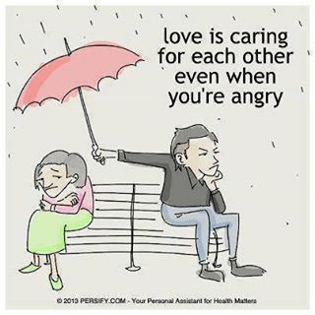
They Remembered His Words
Mt.19:3-12
God Joins…
God joins male with female…
God joins male with female AND… We must not put this relationship asunder

