Slide 1
You who put the LORD in remembrance, take no rest, and
give him no rest…
Isaiah 62:6-7

Slide 2
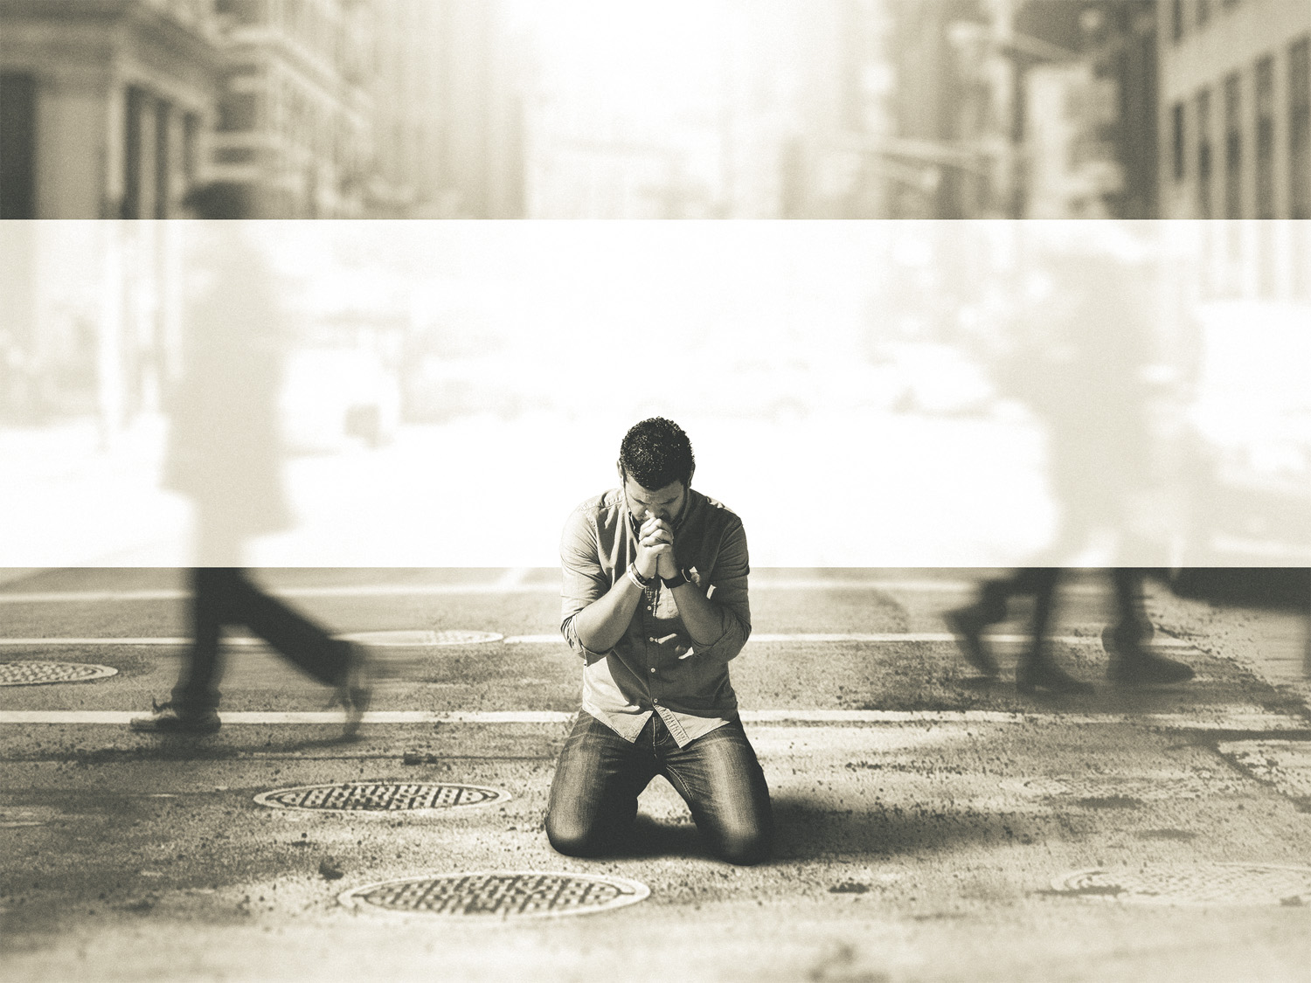
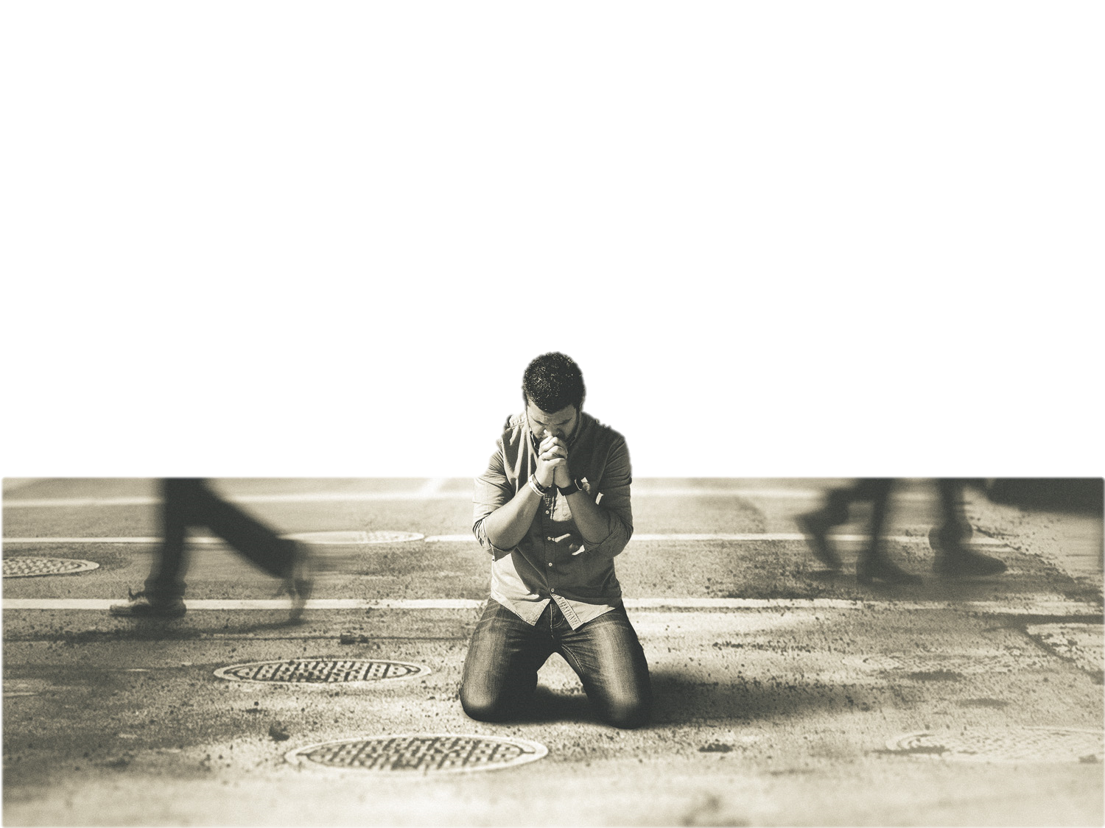
The Lord’s Invitation
Keep Me Awake!

Slide 3
Have you not known? Have you not heard? The LORD is the everlasting God, the Creator of the ends of the earth. He does not faint or grow weary; his understanding is unsearchable.
Isaiah 40:28

Slide 4
The Context of the Invitation
Keep Me Awake!

Slide 5
For Zion’s sake I will not keep silent, and for Jerusalem’s sake I will not be quiet, until her righteousness goes forth as brightness, and her salvation as a burning torch.
Isaiah 62:1

Slide 6
Uzziah—Mostly good, until the end
Jotham—Mostly good, left high places
Ahaz—Idolatrous, really bad
Hezekiah—Restored Judah & Temple

Slide 7
For Zion’s sake I will not keep silent, and for Jerusalem’s sake I will not be quiet, until her righteousness goes forth as brightness, and her salvation as a burning torch.
Isaiah 62:1

Slide 8
The nations shall see your righteousness, and all the kings your glory, and you shall be called by a new name that the mouth of the LORD will give. You shall be a crown of beauty in the hand of the LORD, and a royal diadem in the hand of your
God.
Isaiah 62:2-3

Slide 9
You shall no more be termed Forsaken, and your land shall no more be termed Desolate, but you shall be called My Delight is in Her, and your land Married; for the LORD delights in you, and your land shall be married…
Isaiah 62:4-5

Slide 10
…For as a young man marries a young woman, so shall your sons marry you, and as the bridegroom rejoices over the bride, so shall your God rejoice over you.
Isaiah 62:4-5

Slide 11
On your walls, O Jerusalem, I have set watchmen; all the day and all the night they shall never be silent. You who put the LORD in remembrance, take no rest, and give him no rest until he establishes Jerusalem and makes it a praise in the earth.
Isaiah 62:6-7

Slide 12
The LORD has sworn by his right hand and by his mighty arm: “I will not again give your grain to be food for your enemies, and foreigners shall not drink your wine for which you have labored; but those who garner it shall eat it and praise the LORD…
Isaiah 62:8-9

Slide 13
“…and those who gather it shall drink it in the courts of my sanctuary.”
Isaiah 62:8-9

Slide 14
What is Isaiah
Talking About?

Slide 15
Go through, go through the gates; prepare the way for the people; build up, build up the highway; clear it of stones; lift up a signal over the peoples. Behold, the LORD has proclaimed to the end of the earth: Say to the daughter of Zion…
Isaiah 62:10-12

Slide 16
…“Behold, your salvation comes; behold, his reward is with him, and his recompense before him.” And they shall be called The Holy People, The Redeemed of the LORD; and you shall be called Sought Out, A City Not Forsaken.
Isaiah 62:10-12

Slide 17
But you have come to Mount Zion and to the city of the living God, the heavenly Jerusalem, to innumerable angels in festal gathering, and to the assembly [church] of the firstborn who are enrolled in heaven, and to God, the judge of all, and to the
spirits of the righteous made…
Hebrews 12:22-24

Slide 18
…perfect, and to Jesus, the mediator of a new covenant, and to the sprinkled blood that speaks a better word than the blood of Abel.
Hebrews 12:22-24

Slide 19
Heeding the Invitation
Keep Me Awake!

Slide 20
You who put the LORD in remembrance, take no rest, and
give him no rest…
Isaiah 62:6-7

Slide 21
Our Father in heaven, hallowed be your name. Your kingdom come, your will be done, on earth as it is in heaven. Give us this day our daily bread, and forgive us our debts as we forgive our debtors. And lead us not into temptation, but deliver us
from evil.
Matthew 6:9-13

Slide 22
You who put the LORD in remembrance, take no rest, and
give him no rest…
Isaiah 62:6-7

Slide 23
It Takes
More than One!
Keep Me Awake!

Slide 24
You who put the LORD in remembrance, take no rest, and
give him no rest…
Isaiah 62:6-7

Slide 25
Keeping God Awake!

